Slide 1
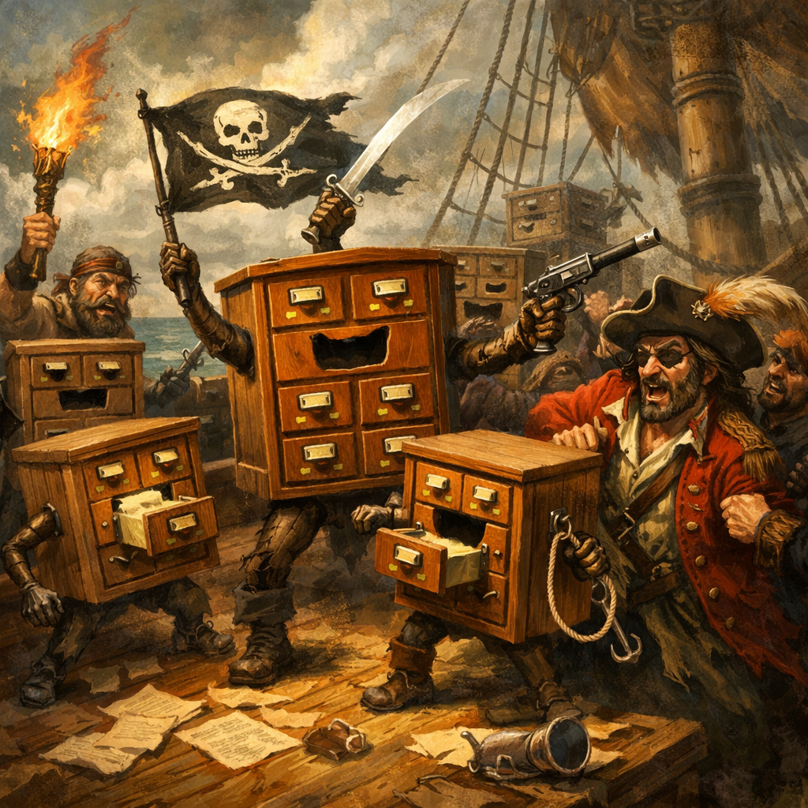
Mutiny or Modernization:
When Disruptive Technology
Takes the Helm
Teresa Augustine
Valparaiso University, Valparaiso, IN
teresa.augustine@valpo.edu

Slide 2
Disruptive Technology
Oxford Reference (2026): A specific technology that can fundamentally change not only established technologies but also the rules and business models of a given market, and often business and society overall.

Slide 3
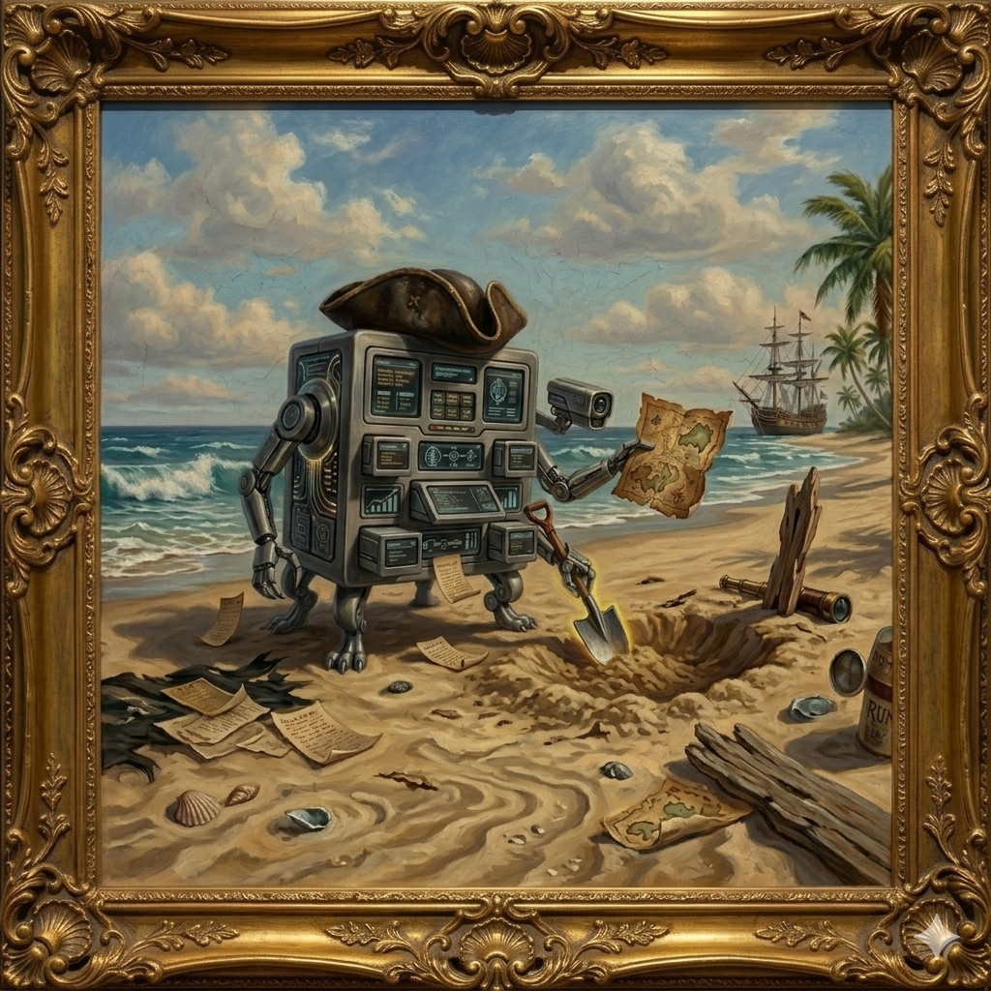
The Electronic Card Catalog
The Interloper of Index
c. 1980s

Slide 4
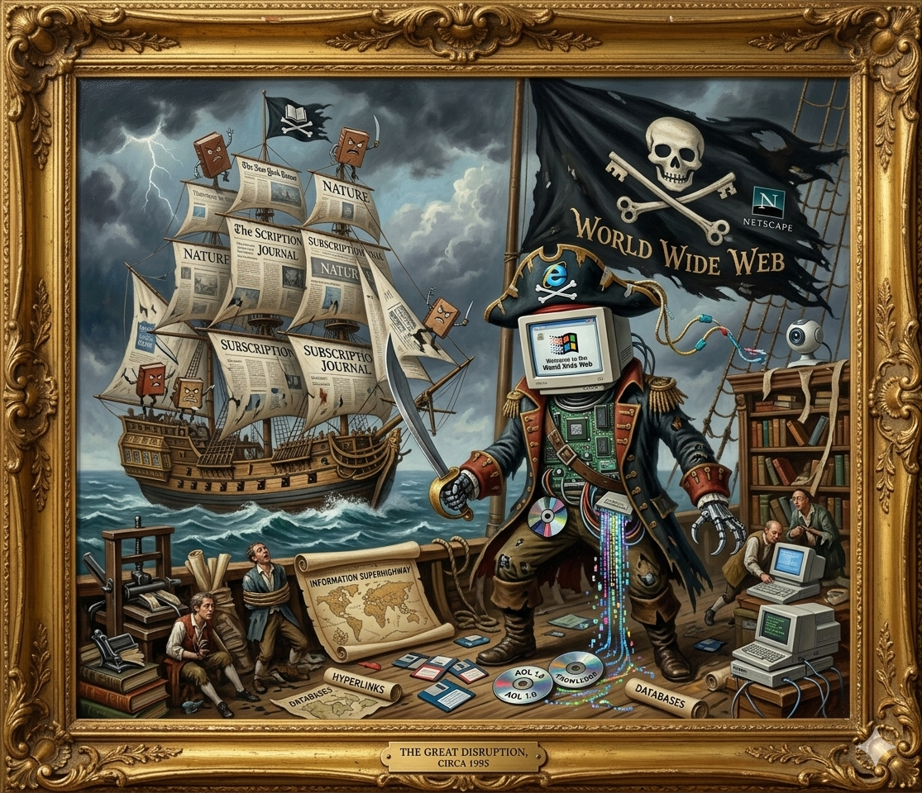
The Internet
The Scourge of
the Seven Seas
c. 1990s

Slide 5
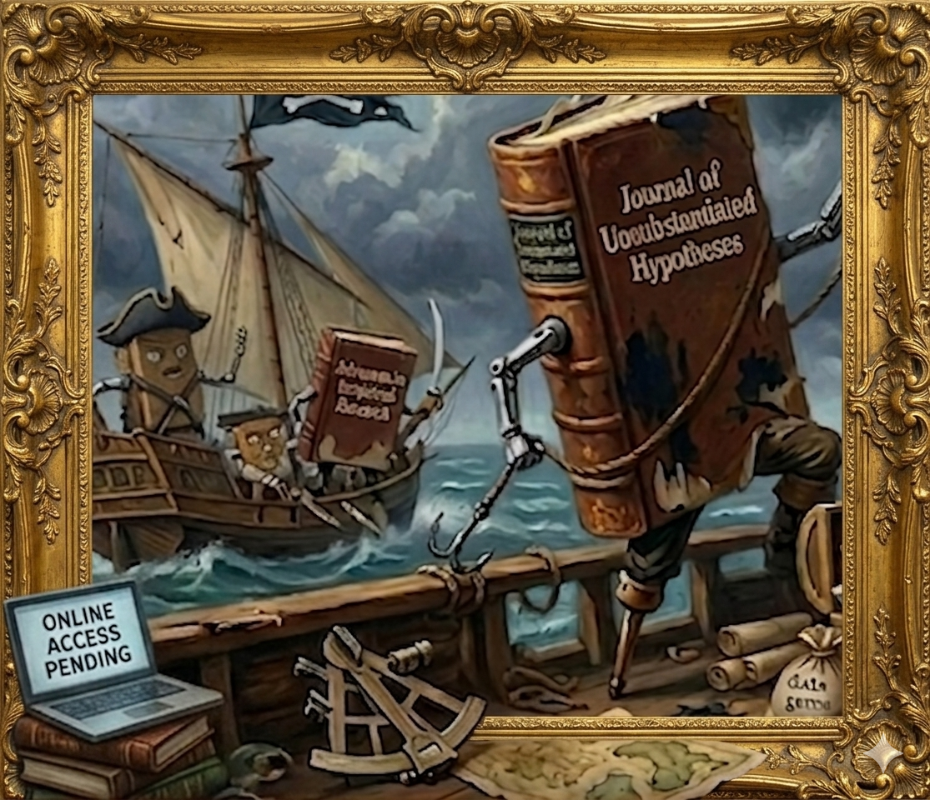
The Online
Journal
The Scallywag of Scholarship
c. Late 1990s

Slide 6
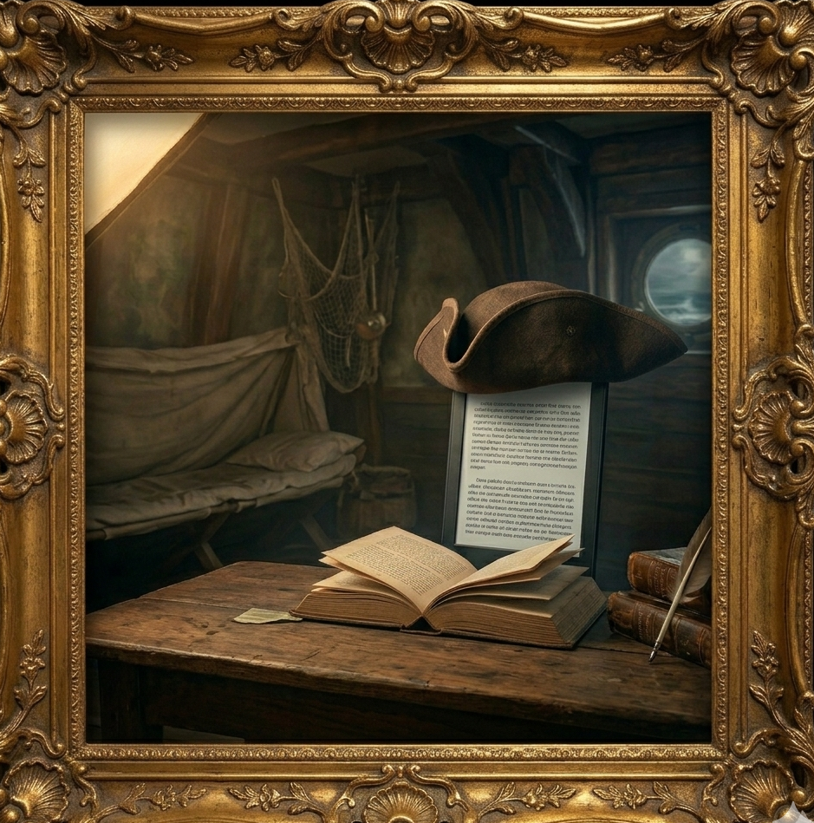
The E-Book
The Terror of Tomes
c. Early 2000s

Slide 7
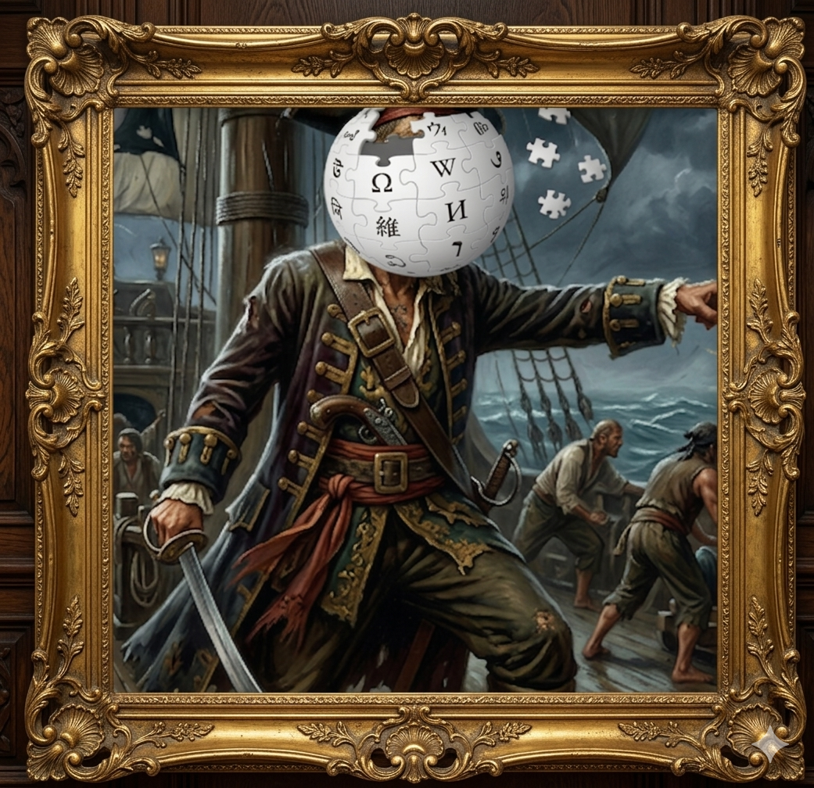
The Wikipedia
The Rapscallion of
Reference
c. Early 2010s

Slide 8
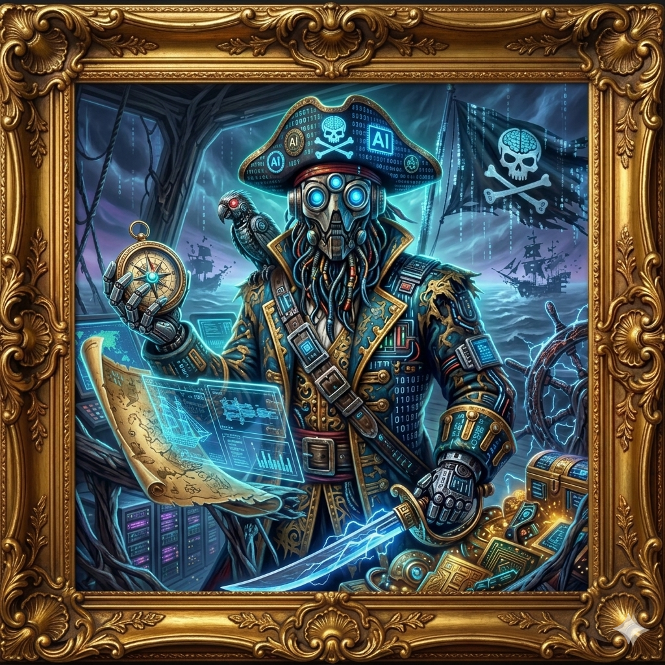
The
Generative
Artificial Intelligence
The Neural Marauder
c. Today

Slide 9
BUT AI FEELS different…

Slide 10
DISRUPTIVE
TECHNOLOGY
Finding 1:
Major
Change
ReD
FLAGS

Slide 11
Finding 2: Libraries are susceptible to external factors.
Finding 3: Libraries are resilient.
Finding 4: Libraries are moved forward by innovators.

Slide 12
Finding 5: Librarians have supported and educated their communities for decades, now is the chance to lead.

Slide 13
“Libraries cannot cling to the past, steadfastly refusing to change, nor can they simply go along for the ride passively accepting what comes along. Libraries and the individual librarians working in them must not only welcome the future, but also believe they have a stake in shaping it."
(Stueart, 1984, p. 1726)

Slide 14
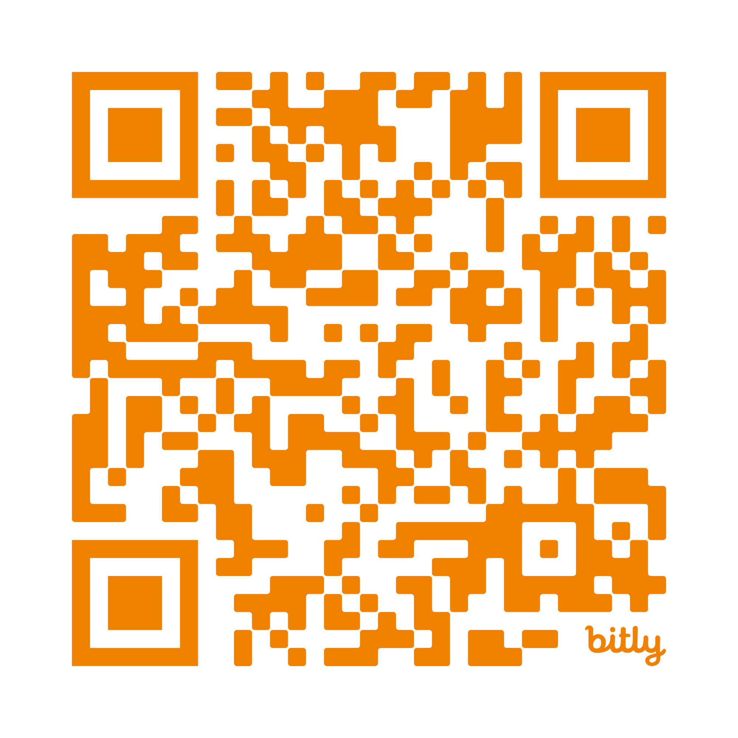
ReFerences:
http://bit.ly/4nbjNvL
Note: Title page image generated by Open AI’s ChatGPT (2026) all other images generated with Google Gemini (2026).

