Slide 1
Fact-Checking the Bots:
A Research Assignment for the AI Era
Joshua Wallace
Graduate Services Librarian
Tarleton State University

Slide 2
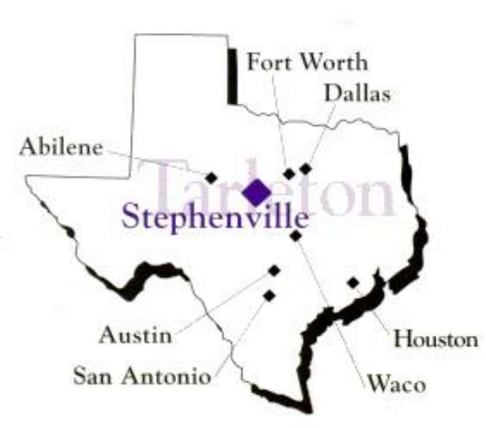
Tarleton State University
Founded in 1899
Joined Texas A&M System in 1917
21,000 students

Slide 3
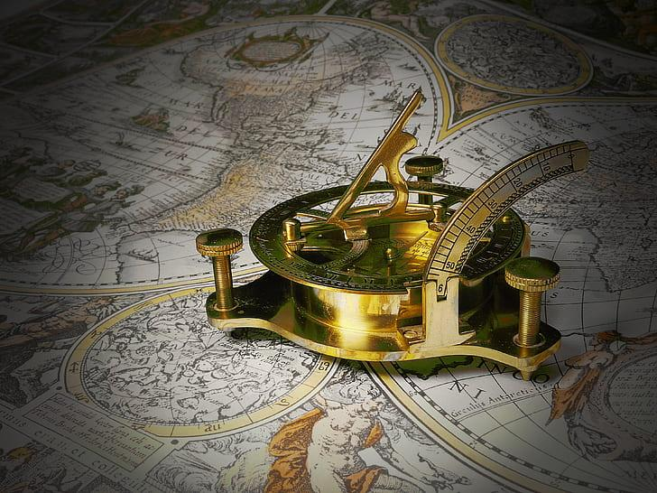
Agenda
•Background
•The assignment
•Student reflections
•Connecting to ACRL Framework
•Wrap-up

Slide 4
Background
•History instructor since 2004
•Academic librarian since 2007
•Used to have a traditional research paper
•I first encountered student using AI in 2023
•Moved to in-class essays
•In late 2024 I brainstormed an idea for incorporating AI
•Implemented it 3 times so far: Spring 25, Fall 25, and Spring 26

Slide 5
What Students Were Asked to Do
Ask ChatGPT to write a 5-paragraph essay on a historical topic
Identify 8–10 factual claims
Verify each claim using credible library sources
Complete a verification chart labeling claims as:
  True
  False
  Other (partially true, unverifiable, etc.).
Write a 1-page reflection
Submit a works cited/bibliography

Slide 6
Example Verification Chart
Claim from AI Essay | Source Consulted | Verification (True / False / Partially True) | Notes
George Washington was born in 1732 in Virginia. | Encyclopedia Britannica | True | Born Feb. 22, 1732 (O.S. Feb. 11) in Westmoreland County, VA.
As a young man, he worked as a surveyor. | Mount Vernon Digital Encyclopedia | True | Washington became the official surveyor for Culpeper County in 1749.
Washington’s victory at Yorktown in 1781 ended the Revolutionary War. | American Battlefield Trust | Partially True | Yorktown was decisive, but the Treaty of Paris (1783) formally ended the war.

Slide 7
Student Reactions
Reaction Type | Number | Percentage
Mostly/broadly accurate | 37 | 86%
Oversimplified/lacked nuance/vague | 28 | 65%
Missing details/context/incomplete | 20 | 46.5%
Explicit need to fact-check/verify | 14 | 32.5%
Found factual errors/fabrications | 11 | 25.6%
Deepened understanding of topic | 11 | 25.6%
Useful as starting point/brainstorming tool | 8 | 18.6%
Growth in critical thinking | 6 | 14%
Writing quality issues (fluff/awkward/embellished) | 5 | 11.6%
Unsupported/no citations/weak evidence | 2 | 4.7%
N = 43
104 students have done this assignment.
33 did it in Spring 25 before I required a reflection component.
71 students have completed a reflection, but 28 didn’t provide a relevant assessment of the AI’s performance.

Slide 8
Student Verdict: “Mostly Accurate, But…”
Many students found ChatGPT broadly accurate at a general level
But they also described the essays as:
  Vague
  Brief
  Surface-level
  Incomplete
  Lacking context

Slide 9
The Most Common Problem: Oversimplification
Students repeatedly said AI writing was too simplified
Common issues included:
  missing nuance
  limited context
  compressed explanations
  broad summaries without complexity

Slide 10
When “Accurate” Still Misleads
Several students noticed that AI left out important people, events, or context
Omissions made some essays misleading even without false statements
Examples:
Montgomery Bus Boycott: over credited the Montgomery Improvement Association while omitting other organizers such as the Women’s Political Council
Andrew Carnegie: emphasized success while omitting darker aspects of his business practices
Stamp Act: made history sound “too neat” and removed the “messy human side”

Slide 11
Students Also Found Direct Errors
Some student identified clearly false details
Examples:
fabricated Harriet Tubman quote in an Underground Railroad essay
claim that Yamamoto led the attack on Pearl Harbor rather than Nagumo
wrong date for dissolution of Standard Oil: 1908 instead of 1911
overstated numbers in the Salem Witch Trials
confusion between the Occupation of Veracruz of 1914 and the Mexican-American War of 1846-48

Slide 12
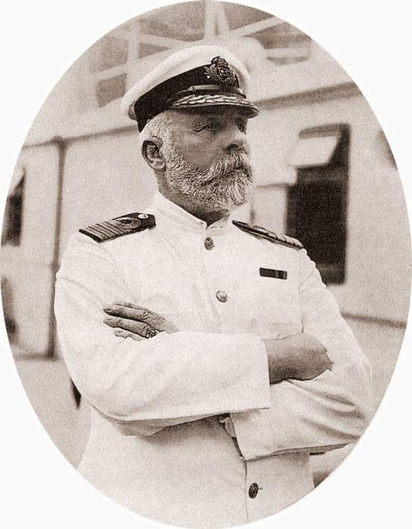
AI as Starting Point, Not Authority
Many students still saw value in AI
They described it as useful for:
  brainstorming
  quick summaries
  getting started
But they also concluded:
  AI must be fact-checked
  credible sources are essential
  AI should not be used as a primary research source

Slide 13
Verification Improved Historical Understanding
Students said fact-checking helped them:
  dig deeper into topics
  notice details they had missed
  understand complexity and nuance
  engage more critically with historical information
Examples:
  9/11: student said the process helped them dig deeper into the tragedy
  French and Indian War: student appreciated smaller details AI skipped
  Articles of Confederation: checking every claim deepened understanding

Slide 14
Where This Fits in the ACRL Framework
Authority Is Constructed and Contextual
•Students learned that polished AI prose can sound authoritative while still being incomplete or wrong
Information Creation as a Process
•AI-generated essays lacked visible sourcing, transparency, and disciplinary context
Research as Inquiry
•Students moved from accepting claims to testing and questioning them through research

Slide 15
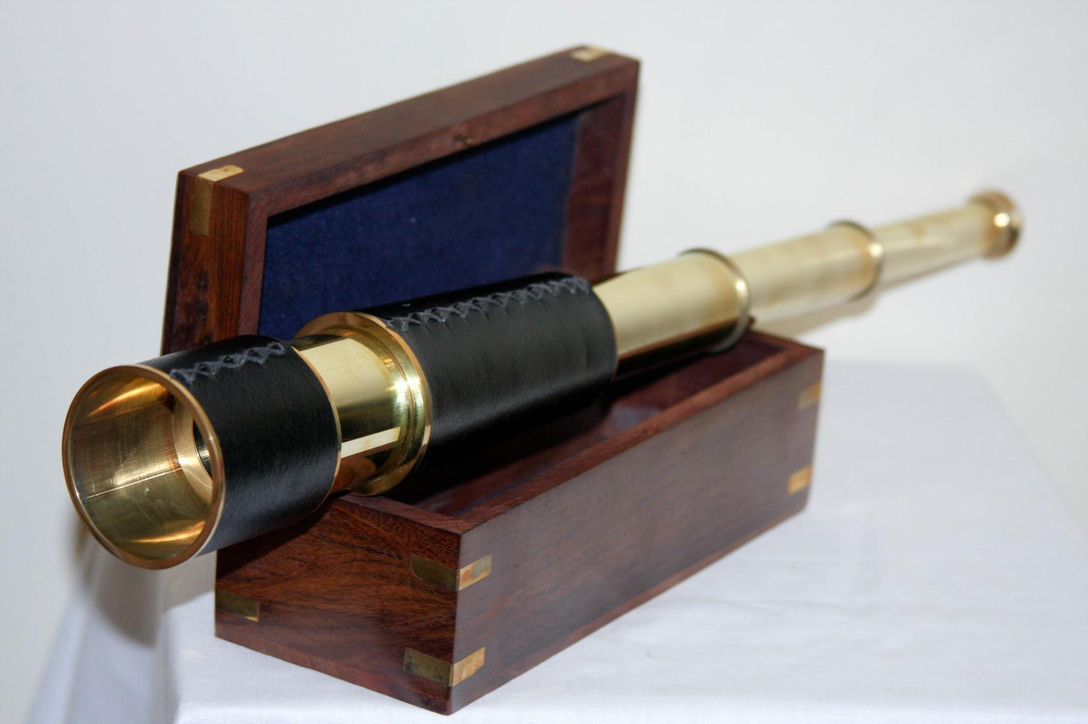
What Students Learned to Look For
Students encountered:
outright falsehoods
fabricated details or quotes
incorrect names or dates
oversimplification
omissions of key context
exaggerated or embellished language
lack of sourcing or transparency

Slide 16
Benefits of this Assignment
Moves the classroom conversation beyond plagiarism
Gives students practice identifying claims and verifying evidence
Helps students see that confidence and fluency ≠ authority
Encourages use of library resources in a meaningful context
Can be adapted to other topics and disciplines

Slide 17
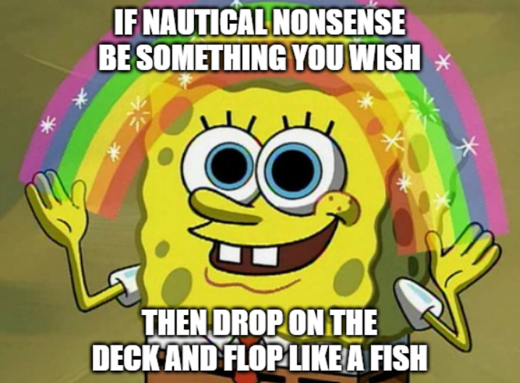
Questions?
jwallace@tarleton.edu
254-968-9455

