Slide 1
Diving into the Waters of Student Learning Assessment
Individualized Programs that Bring Depth to Our Instruction Practices
Notes:
Ashley

Slide 2
Agenda
01
04
02
05
03
06
Intros & Outcomes
What do we do with the data?
Creation & Revision
Recommendations
Implementation
Goals for assessment
Notes:
Ashley

Slide 3
Intros & Outcomes
01
Notes:
Ashley

Slide 4
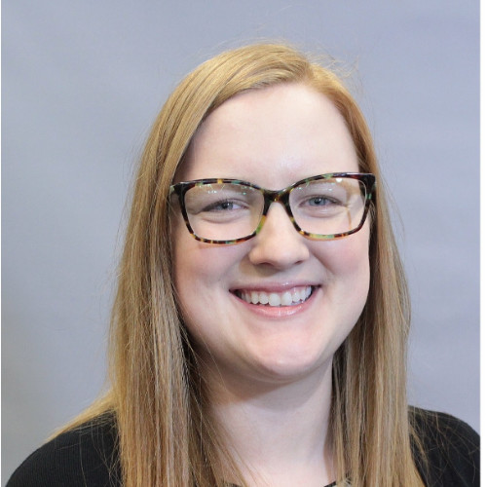
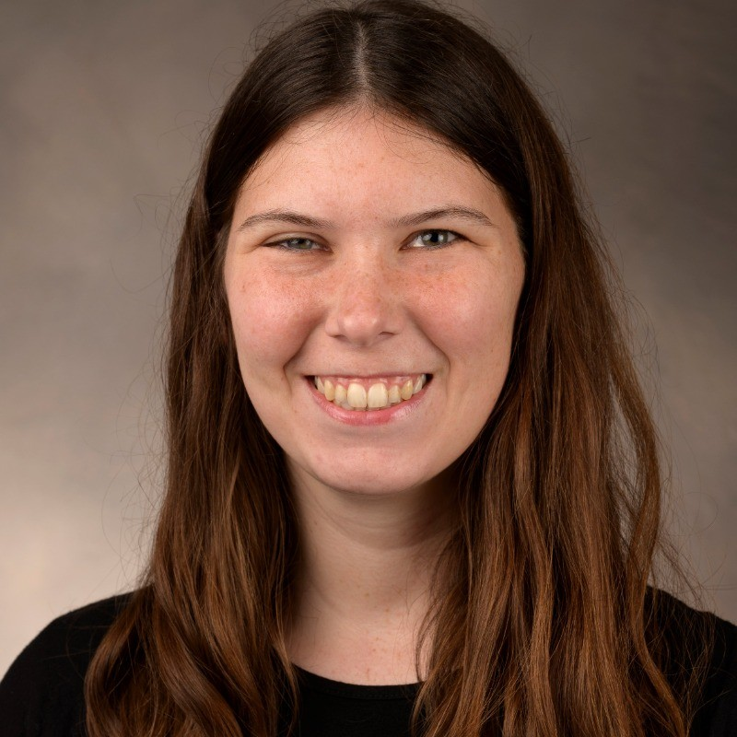
Ashley Blinstrub | she, her
Accessibility Lead & Student Success Librarian at George Mason University
ablinstr@gmu.edu
Jasmine Spitler
Assessment & User Experience Librarian at Elon University
jspitler2@elon.edu
Notes:
Ashley & Jasmine
Who are we? Where do we come from? What are we learning today?

Slide 5
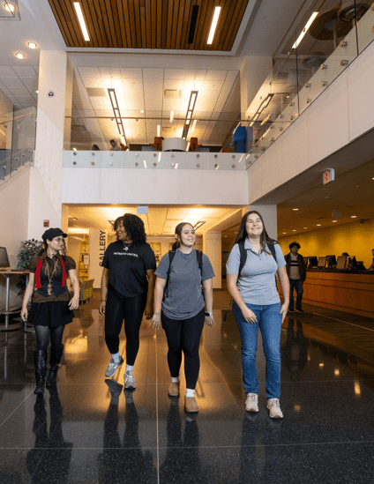
Institutional Context: George Mason University
Large R1 public university in Northern Virginia
40,378 Total Enrollment (Including Mason Korea)
Between 25 and 35 library instructors
10 Members of Teaching and Learning Team
Notes:
Ashley

Slide 6

Institutional Context: Elon University
Mid-size Doctoral/Professional private university in North Carolina
7,000 FTE Students
13 library instructors (currently)
3 members on the Instruction & Outreach Team
Notes:
Jasmine

Slide 7

Learning Outcomes
After the session, attendees will be able to describe the collaborative process of creating and revising student learning assessment plans.
After the session, attendees will be able to identify ways to navigate through the barriers of assessment efforts.
After the session, attendees will be able to create a framework for a student learning assessment plan for their own institutional context.
Notes:
Jasmine

Slide 8
Student Learning Assessment Overview
Student Learning Assessment
Instructors measure the effectiveness of their teaching by linking student performance to specific learning objectives.
Gives instructors data to understand how students are learning and what can be improved or changed.
Programmatic Assessment Plans
Evaluates student learning by continuously collecting data which shows not only how student learning is affected by library instruction but also shows the impact of an entire program versus a single instructional session.
Assessment as Learning to Teach
As students & instructors move through the assessment cycle, there will be both an increase in student learning & improved instructional practices
Notes:
Ashley

Slide 9
Creation & revision
02
Notes:
Jasmine How do we collaborate with colleagues to create and revise our student learning assessment plans?

Slide 10
Mason: Creating & Revising the Student Learning Assessment Plan
Second Iteration of Student Learning Assessment Plan
3-Year Plan
One Minute Paper Assessment Project
2016
2024
2015
2020
First Iteration of Student Learning Assessment Plan
3-Year Plan
Third Iteration of Student Learning Assessment Plan
6-Year Plan
Notes:
Ashley Library instructors collect one minute papers at the end of instruction classes. Instruction and Assessment Coordinator, Maoria Kirker, tabulated all of this data
Instruction Coordinator attended ACRL Immersion in 2015 and developed the first plan using what she learned from that conference and research. Developed first programmatic learning outcomes.
I started in 2019 and began reviewing prior reports, talking with the previous coordinator, and surveyed users of the plan. Revised programmatic learning outcomes
Revisions based on prior reports, trend changes in information literacy, and discussions with plan users. Six-Year Plan Revised programmatic learning outcomes.

Slide 11
Mason Current Plan Highlights
Connecting to Strategic Planning Documents: Accreditation, strategic plans, etc.
Timeline of Assessment & Pairing Outcomes
From Sub Outcomes to Skills Tables
Students will be able to articulate their information Need
Developing a research question
Determine the scope of the research investigation
Pre-research
How information is organized
Topic development
Matching needs to source types
Identify stakeholders who might produce information about their topic
Identify researcher gaps in knowledge
Notes:
Ashley: Timeline, Skills Tables

Slide 12
Student Learning Outcomes
Developed by several members of the Teaching and Learning Team and we received feedback from everyone in LRE. Based on the curriculum of George Mason University and ACRL Framework.
Elon adopted the same outcomes when creating their Student Learning Assessment Plan.
Learning Outcomes
Students will be able to articulate their information need.
Students will be able to implement a focused search strategy.
Students will be able to evaluate information, where it comes from, and how it’s used.
Students will be able to investigate how information sources work together around a topic.
Students will be able to critically engage with their own identities, biases, and ideas in order to contribute to the scholarly conversation.
Students will be able to critique the ways authority is constructed.
Notes:
Ashley

Slide 13
Elon: Creating the Student Learning Assessment Plan
Retired the Activity Tracking Form, launched the Service Desk and Research Consultations & Instruction Forms
Activity Tracking Form Established
2022
August 2024
2020
June 2024
Launch of the Student Learning Assessment Plan
3-Year Plan
Advocated for an Assessment Librarian
Notes:
Jasmine All interactions of all kinds are collected in one form on Qualtrics form. Student learning assessment data is not used.
Previous School of Communications liaison librarian with assessment responsibilities left to take a fully remote position.
Created & launched student learning assessment plan along with Patrick Rudd, Coordinator of Instruction & Outreach based on ACRL Framework and Mason’s Plan.
Switched to LibInsight for easier data collection

Slide 14
Elon Current Plan Iteration
Major Sections
Grounding Theory: “Assessment as Learning to Teach”
Connections to External & Internal Structures: SACSCOC, University Strategic Plan, Center for Advancement of Teaching & Learning, & the Office of Institutional Research
Data Best Practices: How to protect student data
Learning Outcomes (same as Mason’s)
Timeline: 2 outcomes paired each year
Outcomes & Skills
Form Documentation
Notes:
Jasmine– Data Best Practices, Timeline & Form Documentation

Slide 15
Implementation
03
Notes:
Jasmine How do we navigate barriers? How do we create buy-in?

Slide 16
Mason Implementation
Mandatory Participation
It is mandatory to assess two outcomes per year and turn in a report or two reports. The form to turn in reports is emailed to all instructors once in the fall semester and twice in spring semester.
Trainings
Offer trainings and office hours throughout the year on Student Learning Assessment.
Teach a session about Student Learning Assessment at Library Teaching Institute at Mason
Piloting a Canvas course on Student Learning Assessment
Student Learning Assessment Toolkit
Notes:
Ashley

Slide 17
Elon Implementation
Mandatory Participation
It is mandatory to asses 2 outcomes per year, with 2 submissions per fall and spring semesters
Support network
I hold one on one consultations, open assessment working sessions, and develop trainings in the summer
Notes:
Jasmine

Slide 18
What do we do with the data?
04
Notes:
Ashley How do we make changes? Who do we report the data to?

Slide 19
What does Mason do with the data?
Improvements
Reporting
Individual instructors make continuous changes to their instruction based on assessment data
Score the reports annually with a rubric I developed. I don’t share this with instructors.
Report to the university Office of Institutional Effectiveness and Planning
Sharing with faculty members and departments.
Notes:
Ashley

Slide 20
What does Elon do with the data?
Improvements
Reporting
I score the reports annually.
Individual instructors are expected to make continuous changes to their instruction based on assessment data
I report to the library instructors annually. In the final year of our three year plan (2027), we’ll revise accordingly, as we’re in the middle of strategic planning.
Notes:
Jasmine

Slide 21
Recommendations
05
Notes:
Ashley What advice do we have? How do you create an individualized framework?

Slide 22
What have we learned?
Don’t Reinvent the Wheel
Begin where you are
Trainings & Support
Consider Feedback
1
2
3
4
There are a lot of materials out there about assessment plans and assessing student learning
Meet everyone where they are in terms of skill level and how comfortable they are.
Give professional development opportunities for folks to develop these skills either in-house or at conferences
As you continue with assessment, listen to library instructors and administrators
Notes:
Jasmine 1&2; Ashley: 3&4

Slide 23
Future Plans
06
Notes:
Ashley Where do we want these plans to go in the future? What research do we want to continue to work on?

Slide 24
What’s next?
Common Rubrics
Creation of common rubrics to “Grade” student work across library instruction
Curriculum Mapping
Mapping outcomes to courses
Involve Teaching Faculty
Improving communications with teaching faculty
ACRL Framework
Aligning outcomes to the new framework or revising outcomes.
Accreditation Standards
As accreditation changes loom considering how we are aligning the plan with
Notes:
Ashley: Common Rubrics, Curriculum Mapping; Jasmine: ACRL Framework, Involving Teaching Faculty, Accreditation Standards

Slide 25
References
Blinstrub, A. (2020). Student Learning Assessment Plan Academic Years 2021-2023. George Mason University Libraries. https://library.gmu.edu/sites/default/files/users/mkirker/student_learning_assessment_plan-fy_21-231.pdf
Blinstrub, A. (2023). Student Learning Assessment Plan Academic Years 2024-2029. George Mason University Libraries. https://library.gmu.edu/sites/default/files/common/TeachingAndLearning/student_learning_assessment_plan_2024-2029.pdf
Kirker, M. J. (2016). Student Learning Assessment Plan Academic Years 2017-2019. George Mason University Libraries. https://library.gmu.edu/sites/default/files/users/mkirker/student_learning_assessment_plan.pdf
Oakleaf, M. (2009a). The information literacy instruction assessment cycle: A guide for increasing student learning and improving librarian instructional skills. Journal of Documentation, 65(4), 539–560. https://doi.org/10.1108/00220410910970249
Spitler, J., & Rudd, P. (2024). LibGuides: Elon Student Learning Assessment Guide: Home. https://elon.libguides.com/c.php?g=1469203&p=10932578
Student Learning Assessment Toolkit. (2023). https://infoguides.gmu.edu/slassessmenttoolkit
Notes:
Jasmine

Slide 26
Thanks!
Do you have any questions?
ablinstr@gmu.edu
jspitler2@elon.edu

