Slide 1
Building Faculty Capacity for Information Literacy: Partnering with the Office of Faculty Development for Sustainable Integration and Scholarly Growth
Jessica Cerri, head of public services
Fayetteville state university
Fayetteville, NC
Loex 2026

Slide 2
Agenda
Timeline of collaboration
How the collaboration was expanded over several semesters
  Faculty research and publication support
  Information Literacy support for faculty
How you can take these strategies and apply them to your own programs

Slide 3
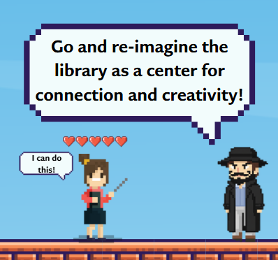
Shaping the collaboration
Little to no faculty engagement or interest in Library support in 2023-24.
  Revamped Canvas Introduction to Information Literacy. Added our first Read and Publish deal with IGI.
  Library participated in the Core Curriculum Review and subcommittee task force to reassess Core Learning Outcomes for General Education requirements.
  Added a Faculty Author Event Series.
Spring of 2024.
  The Library reached out to the Office of Faculty Development to create a partnership to engage with faculty and showcase the recent changes to the library and library services.
Fall of 2024.
  OFD workshops began with 4 sessions (3 faculty research and publication support, 1 information literacy support)
  Revised Canvas Information Literacy course to include micro credentialing to make the course more flexible and consumable in bite size chunks.
Spring of 2025.
  1 additional session was added to support the new Information Literacy Core Learning Outcome.
Fall of 2025.
  1 additional session was added.
Going from zero to sixty in two years

Slide 4
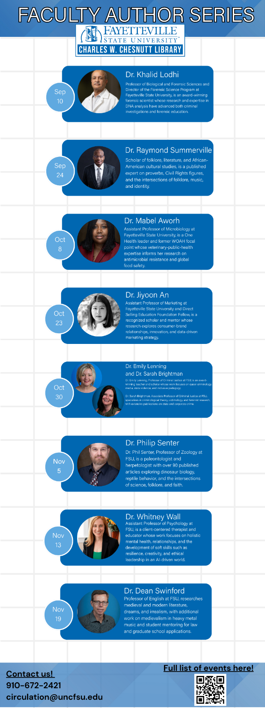
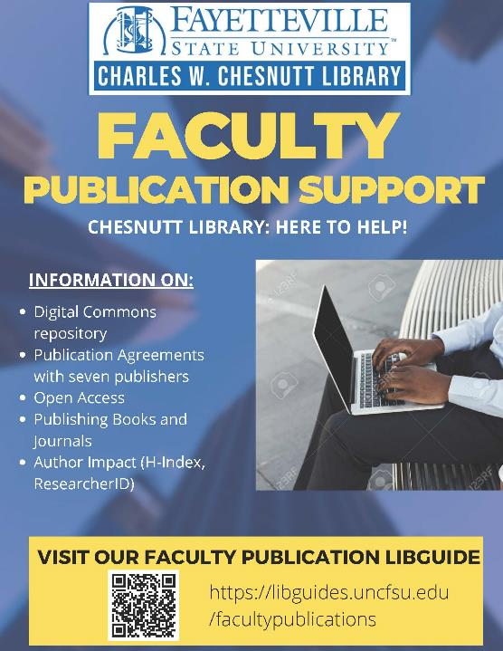
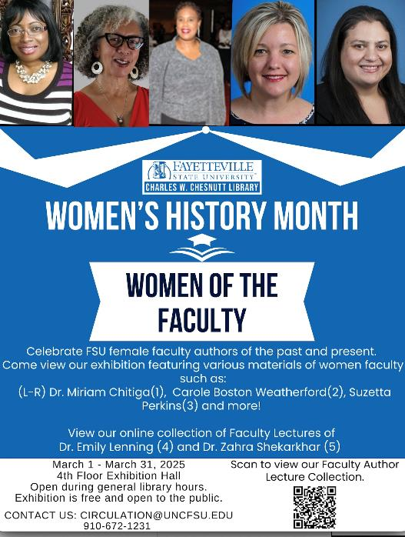
Finding the Faculty Hook to Create Buy-In
The Library first decided to reach out to faculty with support for their own research and publishing.

Slide 5
Supporting Faculty Research and Publication with Library Resources and Services
Develop Read and Publish Deals with Publishers to Alleviate the Burden of Cost
Work with publishers and consortia to establish Read and Publish Agreements
Build the program with more publishers
Promote the Opportunities
Work with the Office of Faculty Development to create workshops helping Faculty understand and use agreements
Celebrate Faculty Successes
Create a Faculty Author Event Series to allow Faculty to present their newly published research to the campus at large
Build a LibGuide specifically for Faculty publication efforts – including finding H-indexes and other metrics
Create individual Faculty pages in Digital Commons listing publications and links to their works. Make efforts to add works to the collection.
Spam Faculty Senate!

Slide 6
Read and Publish Deals Increase Faculty Buy-In and Publication Output
Our first deal was only one publisher - IGI
As faculty learned of the opportunities, the Library has made efforts to add to the number and type of publishers included in this support.
Year | Agreements | Faculty publications through R&P
2022-23 | 2 | 1
2023-24 | 4 | 3
2024-25 | 8 | 12
2025-26 | 8 (with expanded APCs) | 12 to date

Slide 7
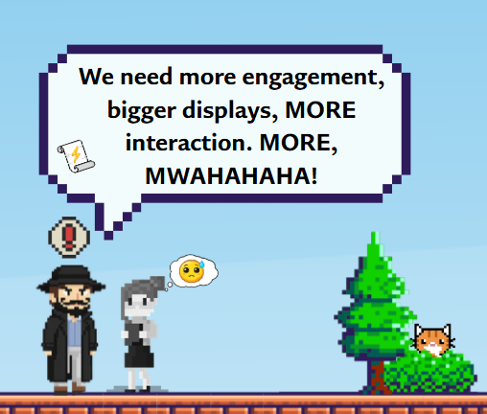
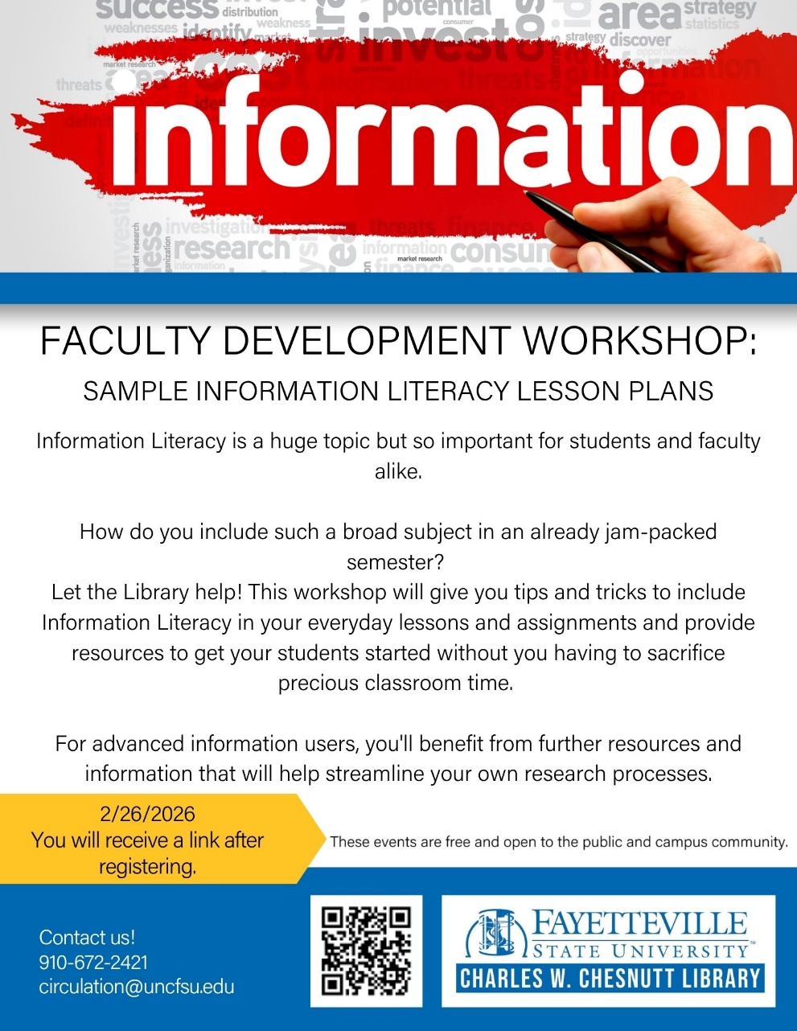
Making Information Literacy Easy for Faculty
With the impending Core Learning Outcome changes, the Library focused on ways we could support faculty understanding and teaching of the ACRL framework.

Slide 8
Creating a 2-pronged approach
Asynchronous Canvas Course
Incorporating Information Literacy in Bite-size Lessons
Created a Canvas course with modules built around the ACRL framework
Faculty can assign without worrying about assessing on their time – Librarians grade all assignments
Course certificate is provided as proof of completion
Collaborated with Office of Faculty Development to create workshops exploring:
  Sample lesson plans that were 5-minutes or less and easily customizable
  Created a LibGuide with all the ACRL concepts covered including screenshots of our system and short tutorials that can be revisited at any time
  Technology such as Keenious that can help students with guided research

Slide 9
Canvas Course
During the first year, we had several faculty take advantage of the course.
  106 students obtained the Information Literacy certificate.
The second year, there was a dip in participation due to the length of the overall course.
  83 students obtained the Information Literacy certificate.
After listening to the feedback of Faculty and students, the Library changed the course to a micro credentialing experience. Instead of one certificate for the overall course, each module or concept would now have a certificate. This allowed for more flexibility and customization. We also added a module for AI & Ethical Use.
  With this new system 379 certificated were awarded.

Slide 10
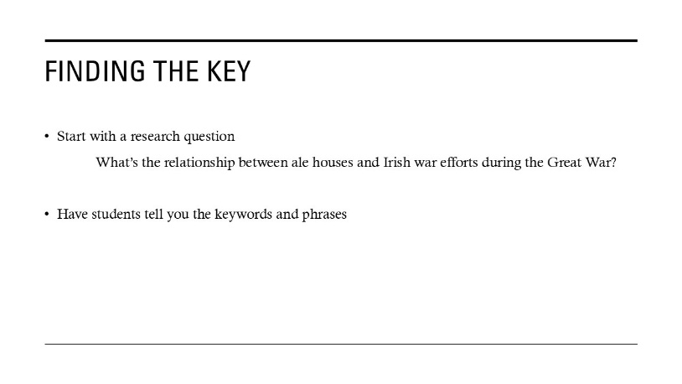
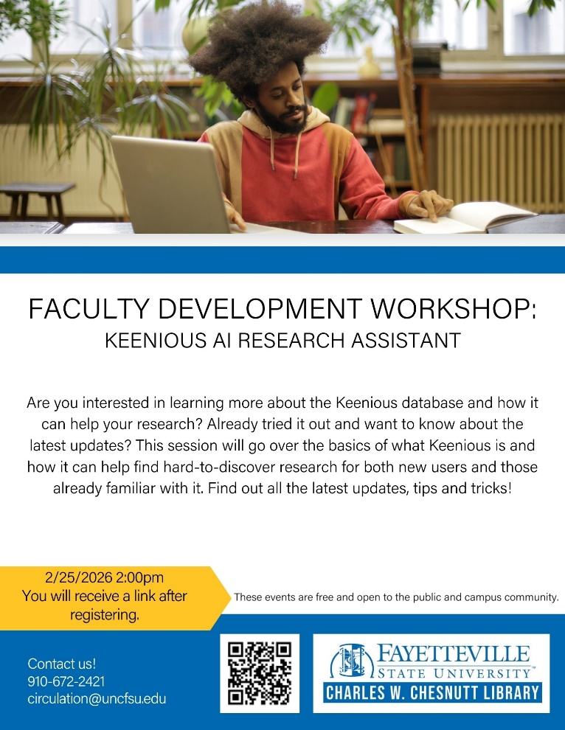
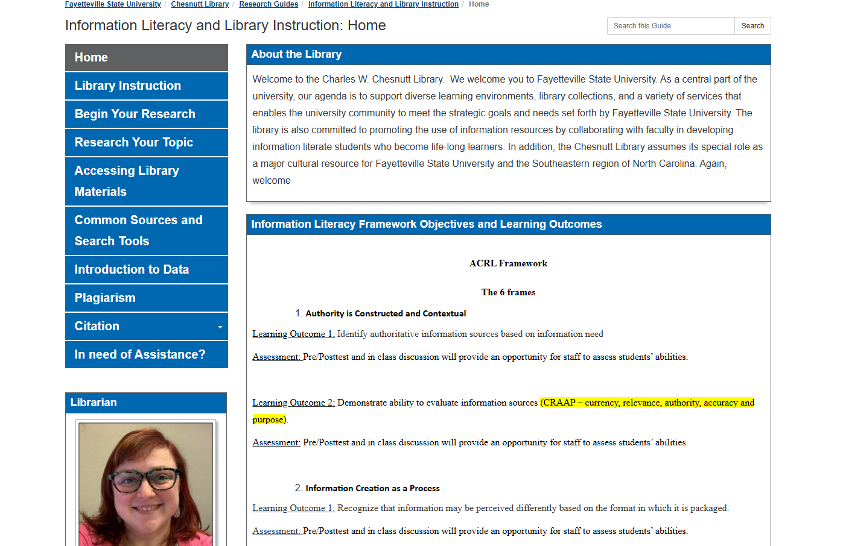
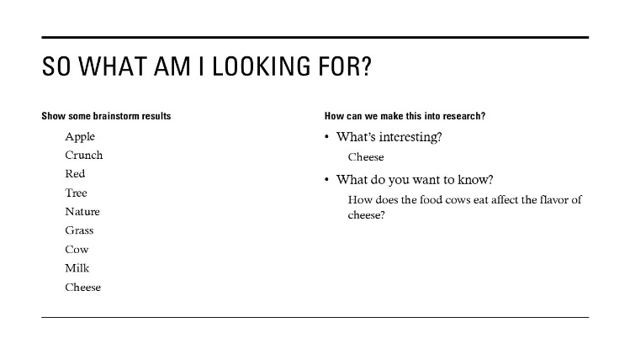
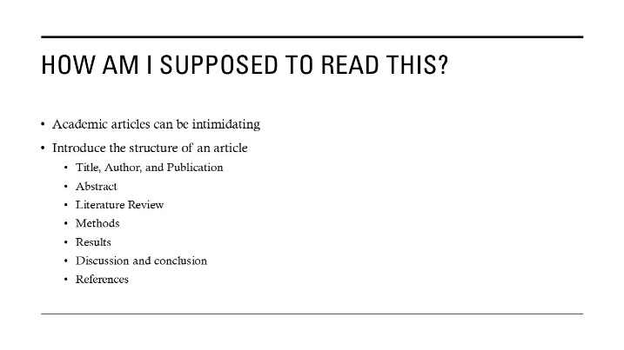
Office of Faculty Development Workshops for Information Literacy

Slide 11
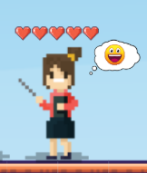
Lessons Learned
Collaborating with the Office of Faculty Development
  They have more reach and influence with faculty.
  Be clear with expectations for both parties.
  Check in often – even after the schedule is set to be sure everyone involved has all the information necessary for successful promotion and implementation of events
Overall
  Faculty are busy and they have long memories. Past impressions and experiences may be hard to overcome.
  Show interest in Faculty first.
  Be patient.
  Keep doing good things. Faculty will be impressed. Remind them to tell their colleagues when they are happy.

Slide 12

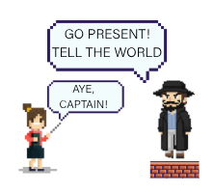
Thank you!
jcerri@uncfsu.edu

