Slide 1
Escaping the Bermuda Triangle:
Understanding Mathematics Faculty Perspectives on Library Services to Encourage Collaboration and Communication
Jennifer LC Burke, Butler University
Elizabeth Novosel, University of CO Boulder
Notes:
Jenni Start

Slide 2
Session Outline
The Beginnings
Insights
1
4
The Project
Resulting Projects
2
5
Key Findings
Discussion
3
6
How and why we ever got in the boat
Finding our way through the storm
How we approached the waves
Cleaning up the aftermath
Well, there’s good news and there’s bad news…
Questions for YOU

Slide 3
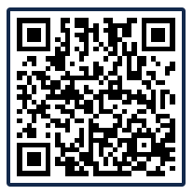
Poll Question
Join by QR code:
Join by Web: PollEv.com/jennib288
Join by Text:
Send jennib288 to 37607

Slide 4
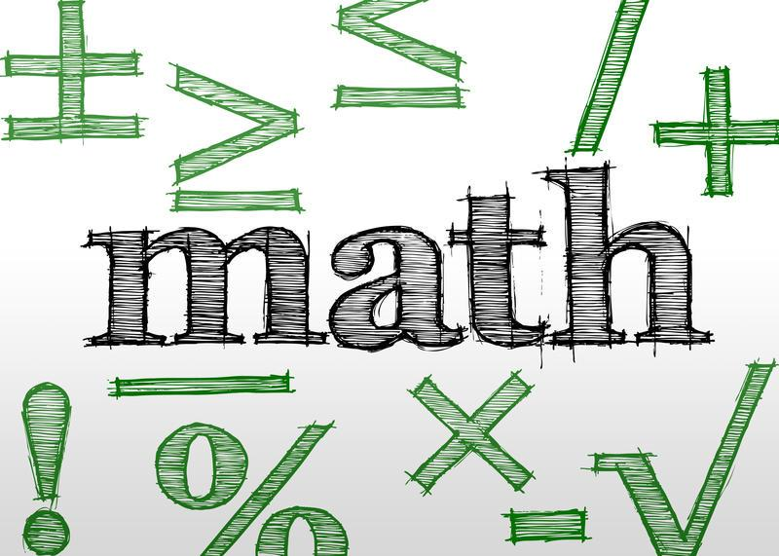
How It All Started
New position: needed support
All three librarians worked with math departments & noticed lack of engagement
Goals:
Understand math faculty
Provide better support

Slide 5
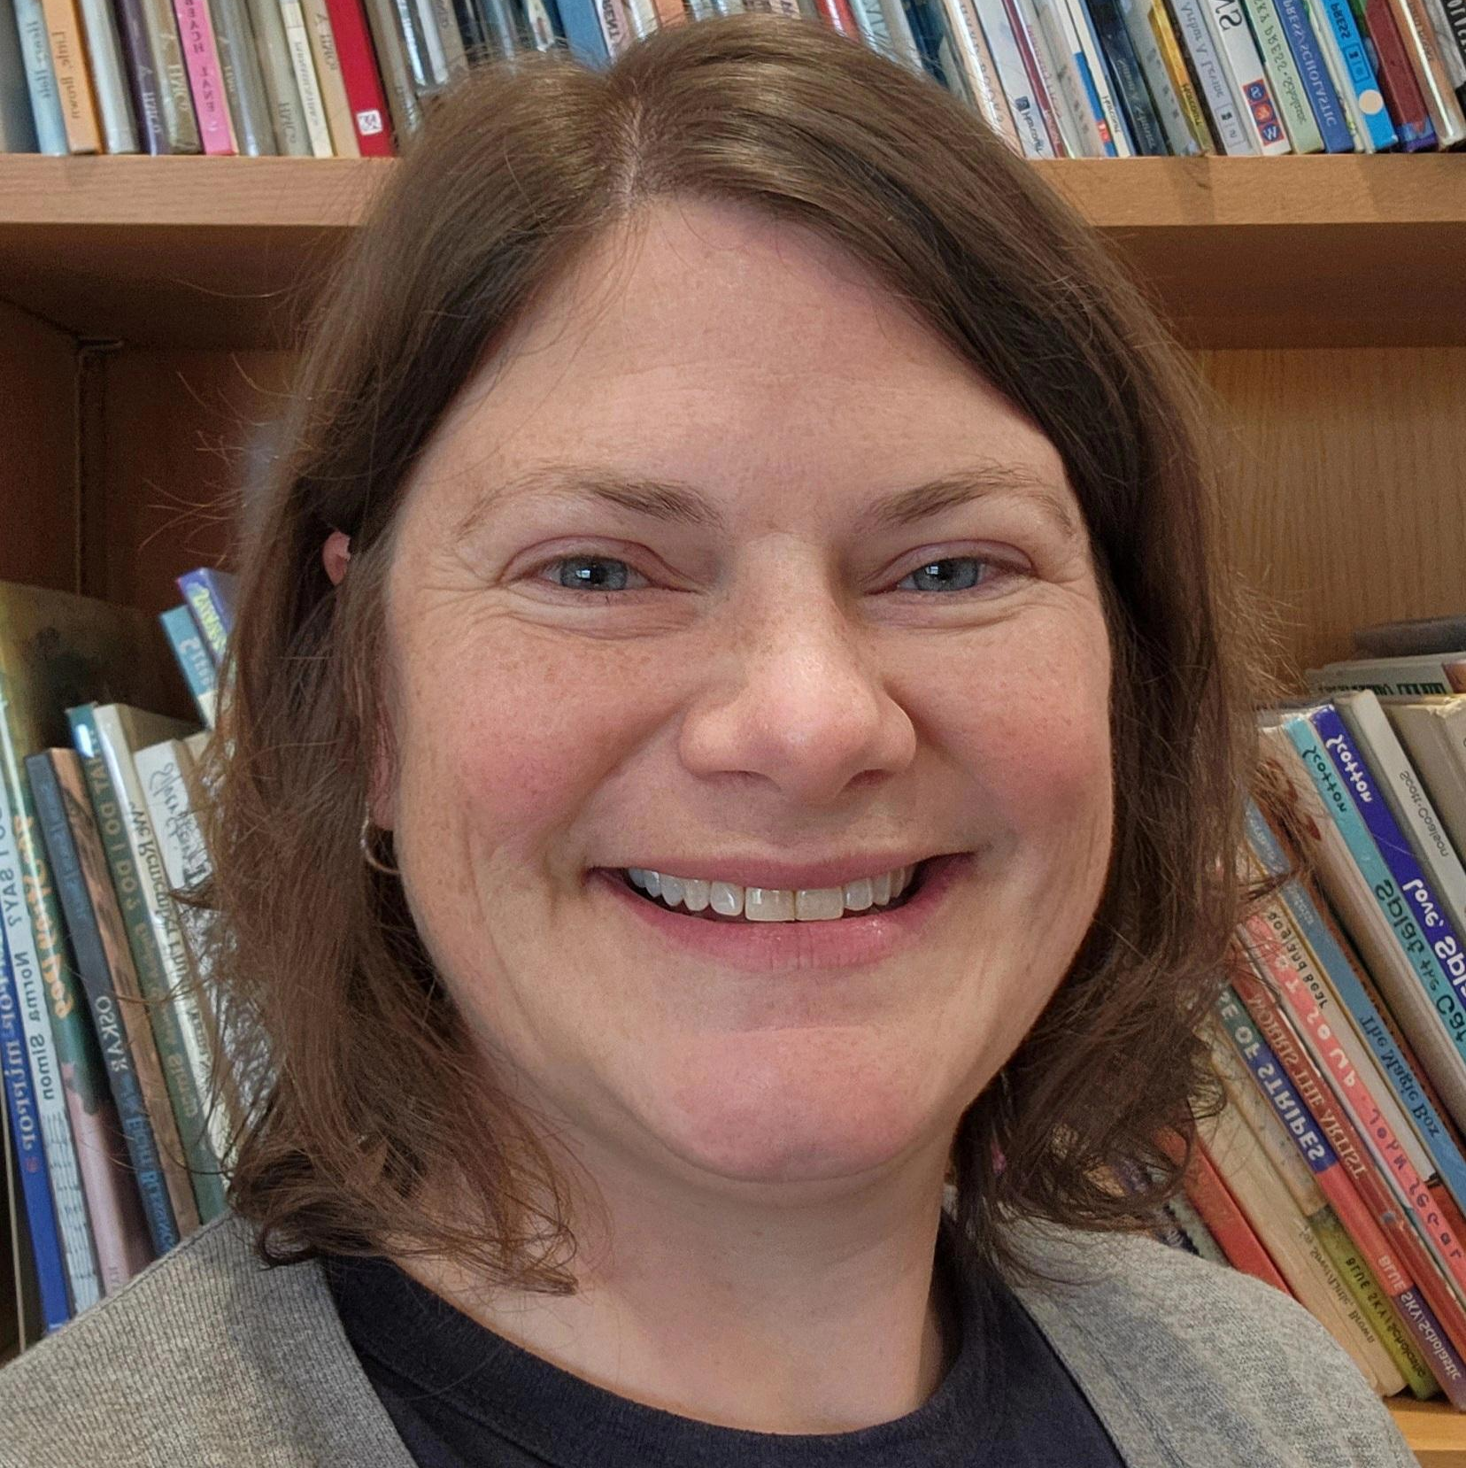
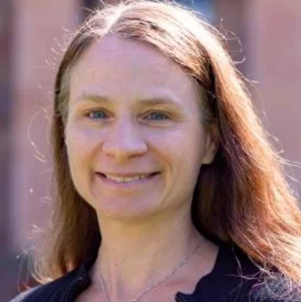
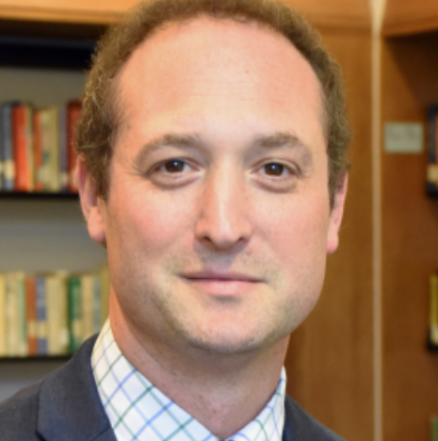
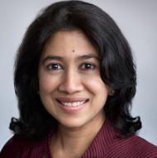
Our team
Jenni
Burke
Elizabeth Novosel
Daniel
Kipnis
Rasitha Jayesekere
Assistant Professor
Science Librarian
Assistant Professor
CompSci & Math Librarian
Associate Professor
STEM Librarian
Professor
Statistics & Actuarial Science

Slide 6
Research Questions
How often do mathematics faculty interact with academic librarians?
For what purposes do mathematics faculty, instructors and instructional staff interact with academic librarians?
What resources and services do mathematics faculty use for their research and instruction?

Slide 7
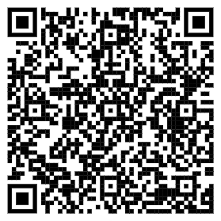
The Survey
The Details | Dissemination | Limitations | Responses
Qualtrics software 20 questions Qualitative and Quantitative mix Sept-Nov 2023 | Listservs: ALA Science & Tech PAMnet Amer. Math Assn Websites: STEM Librarians Discord Emails: Librarians, Faculty, Faculty Chairs | No response rate can be calculated Sample size too small for some statistical models | 188 valid, complete responses from USA and Canada (80% USA) 58.5% tenure-track faculty

Slide 8
Our Findings
Notes:
Liz Start

Slide 9
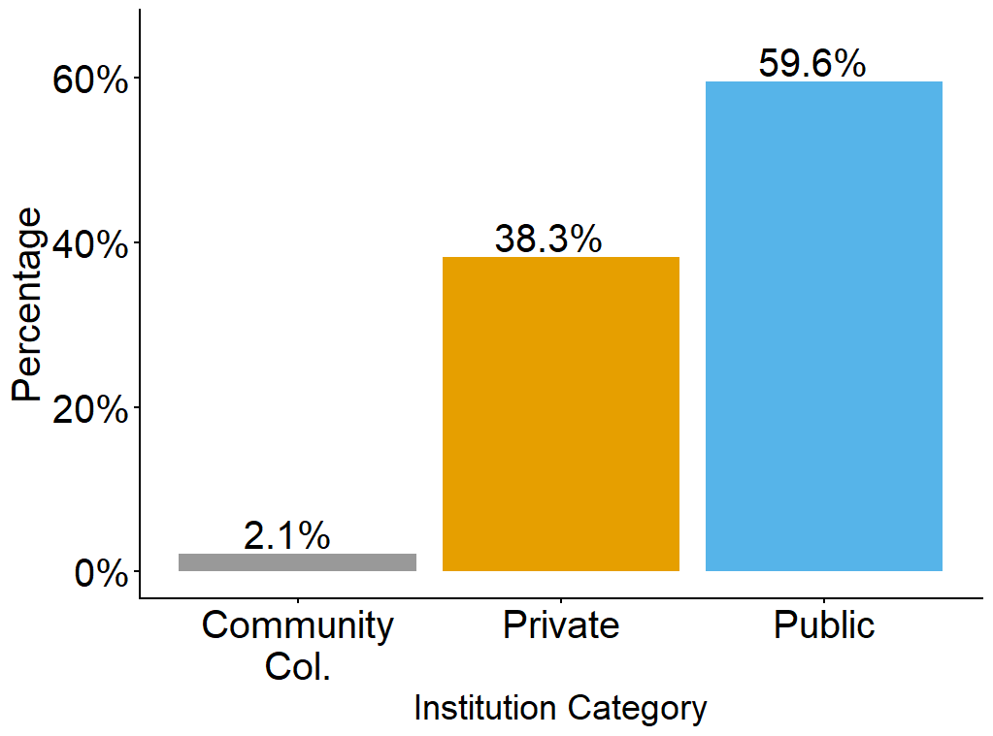
Institution Category
Notes:
Liz Start

Slide 10
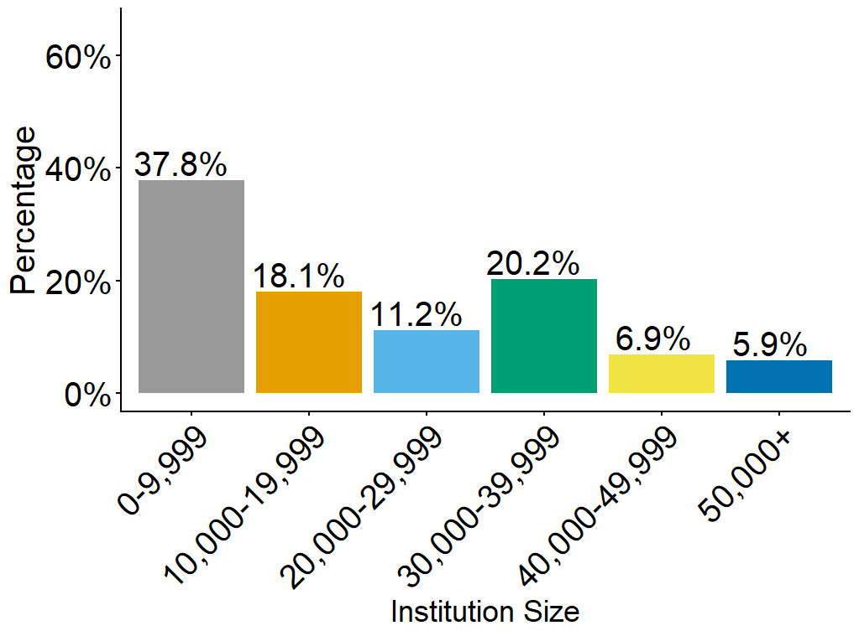
Institution Size
Notes:
Limitation: the predominant states that answered were Indiana and Colorado, which can explain the large number of small institutions

Slide 11
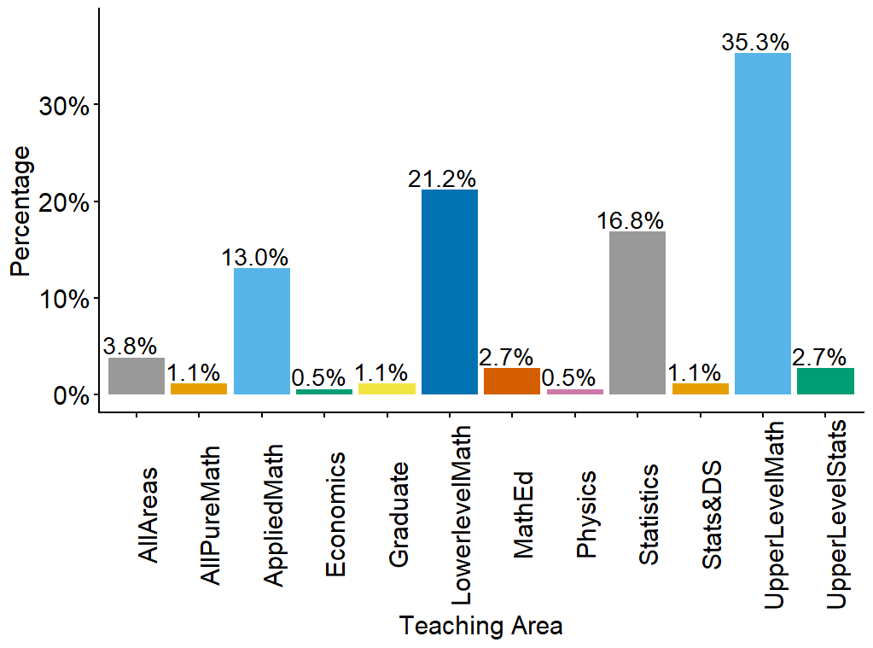
Primary Teaching Area

Slide 12
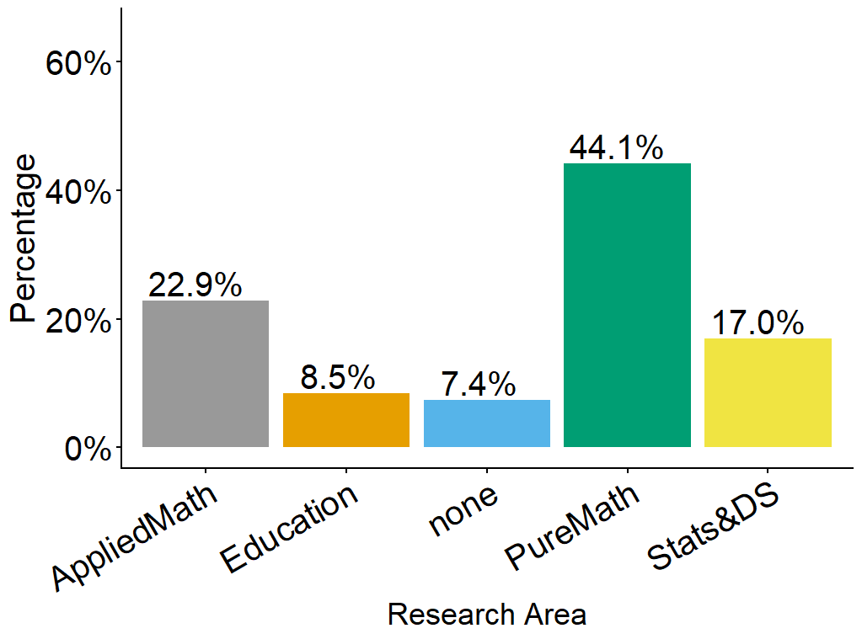
Primary Research Area

Slide 13
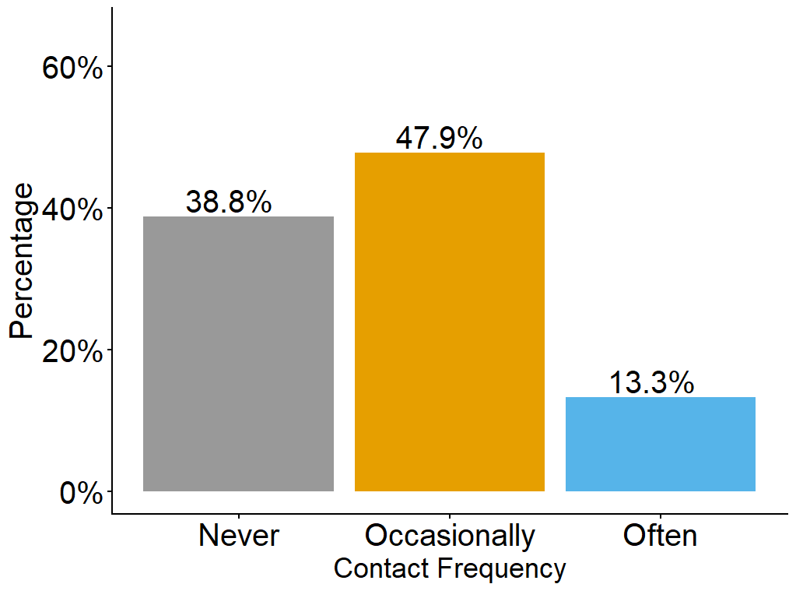
Contact Frequency
Frequency of Contact with Librarian

Slide 14
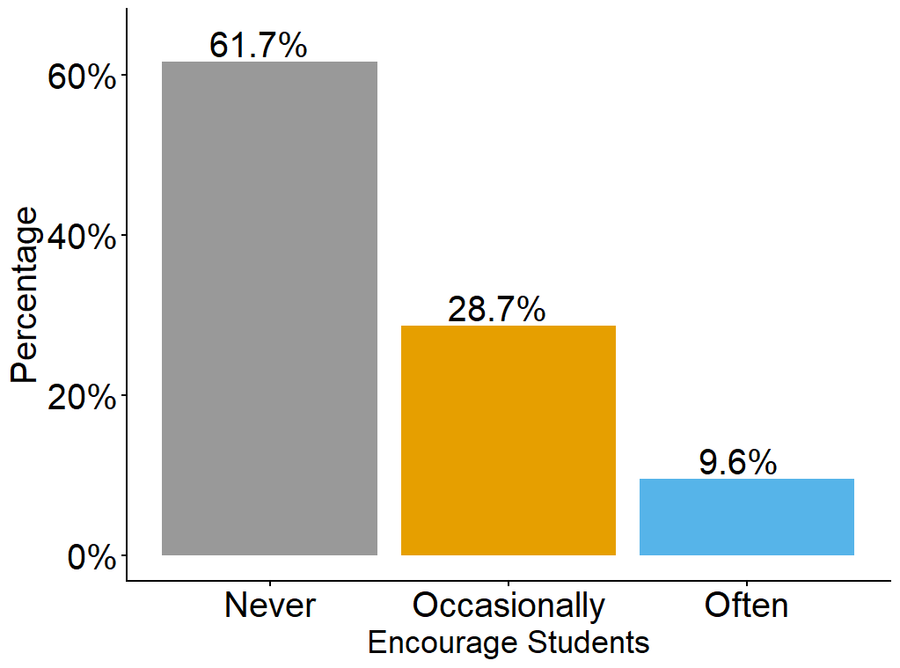
Frequency of Encouraging Students to Meet with Librarians

Slide 15
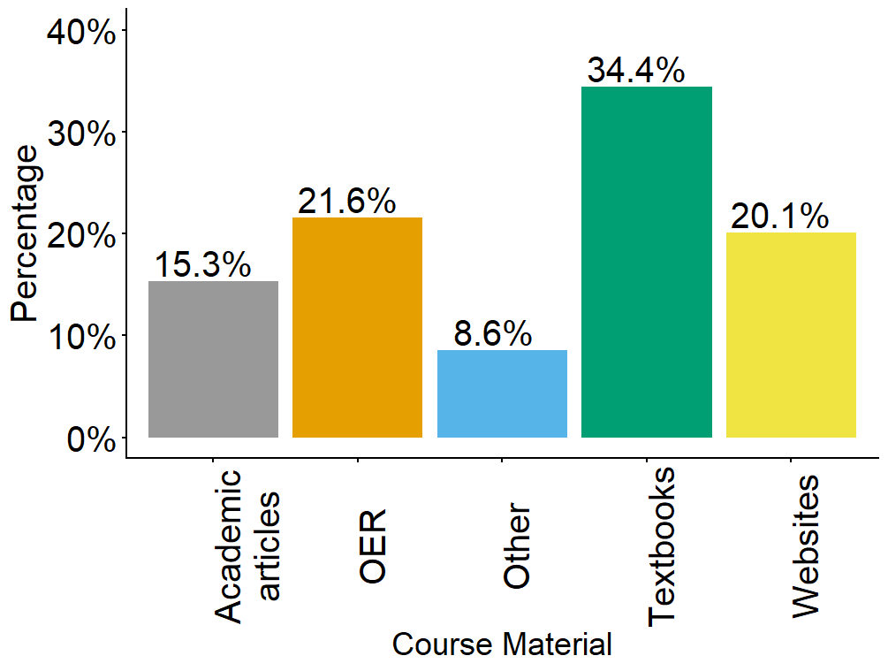
Course Materials Used

Slide 16
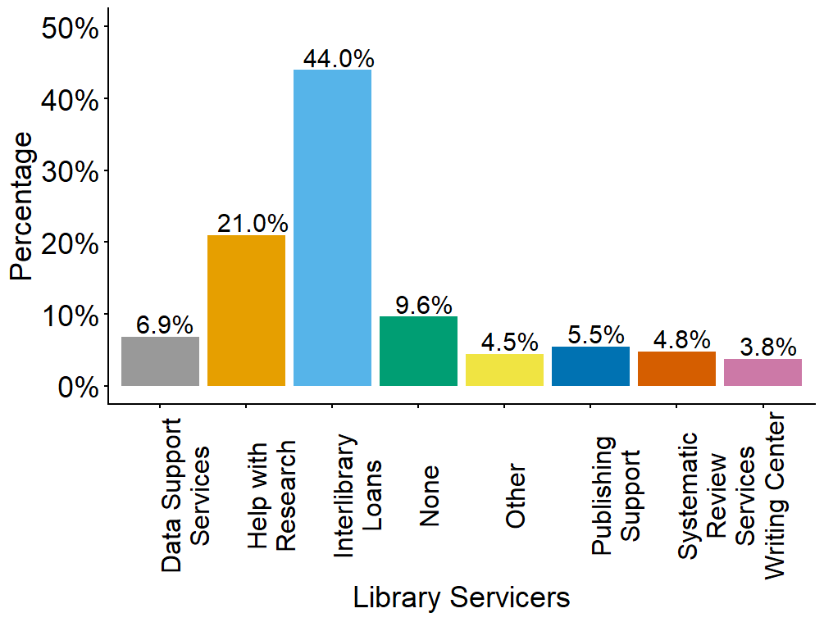
Library Services Used

Slide 17
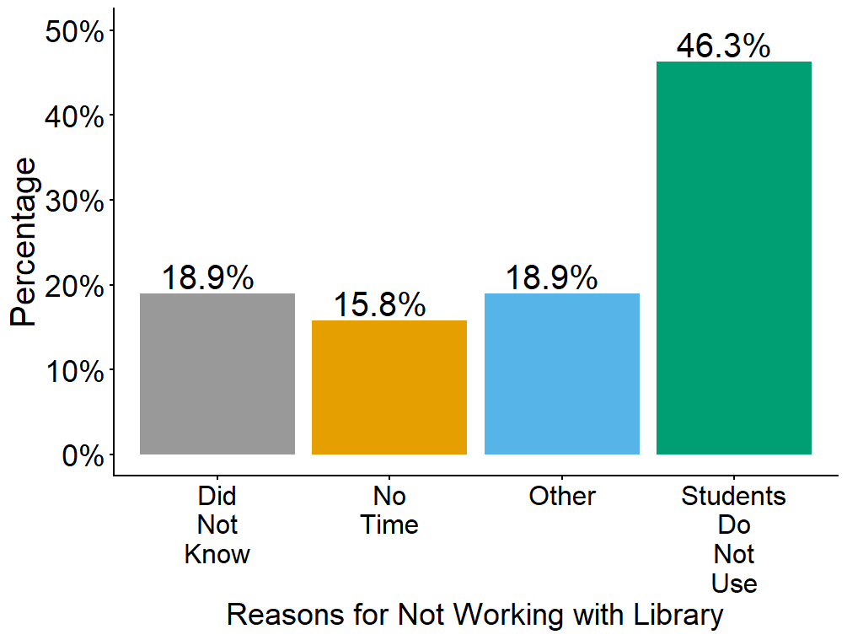
Reasons NOT Working with Librarian for IL Instruction

Slide 18
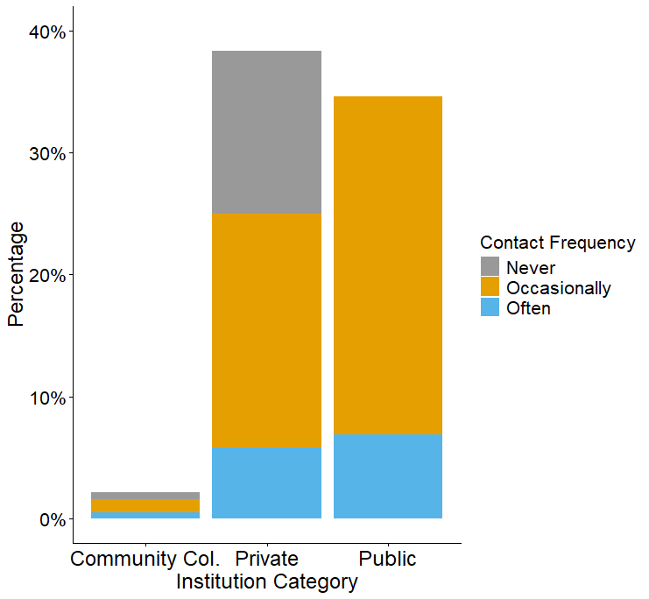
Institution Type & Contact Frequency
Notes:
Why do public fac work with librarians?

Slide 19
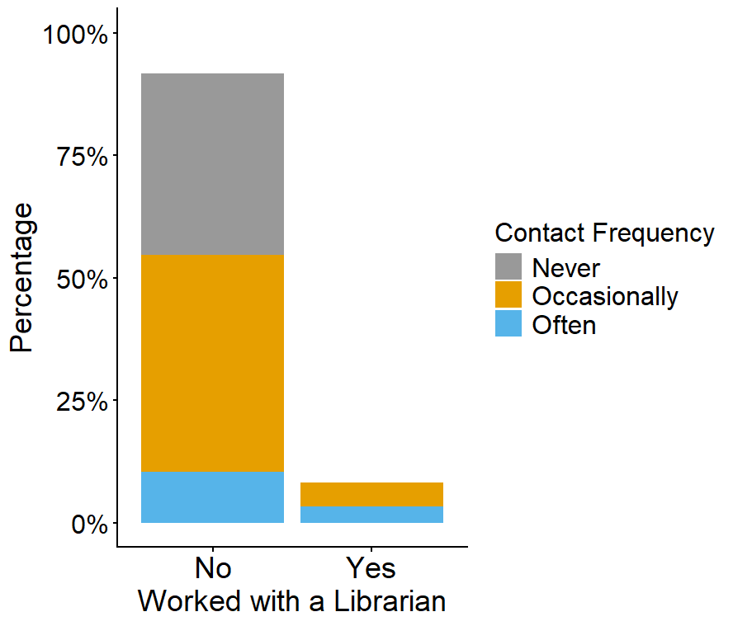
Worked w/ Librarian For Instruction
&
Contact Frequency

Slide 20
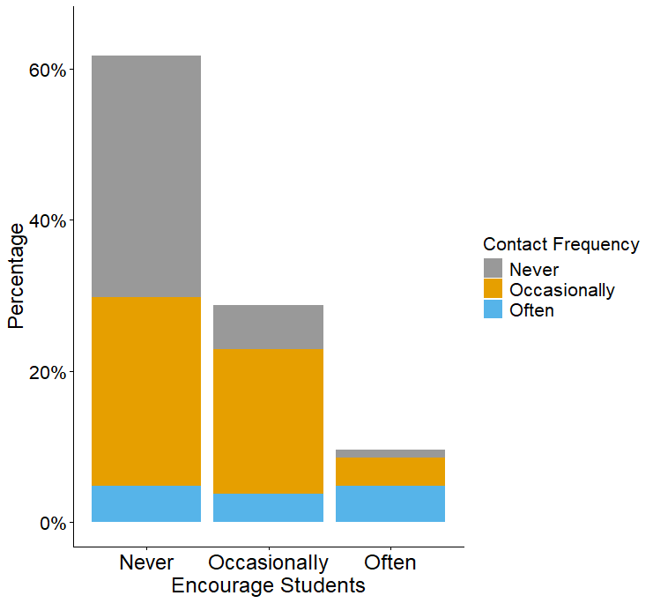
Encourage
Students to Contact Librarian
&
Contact Frequency

Slide 21
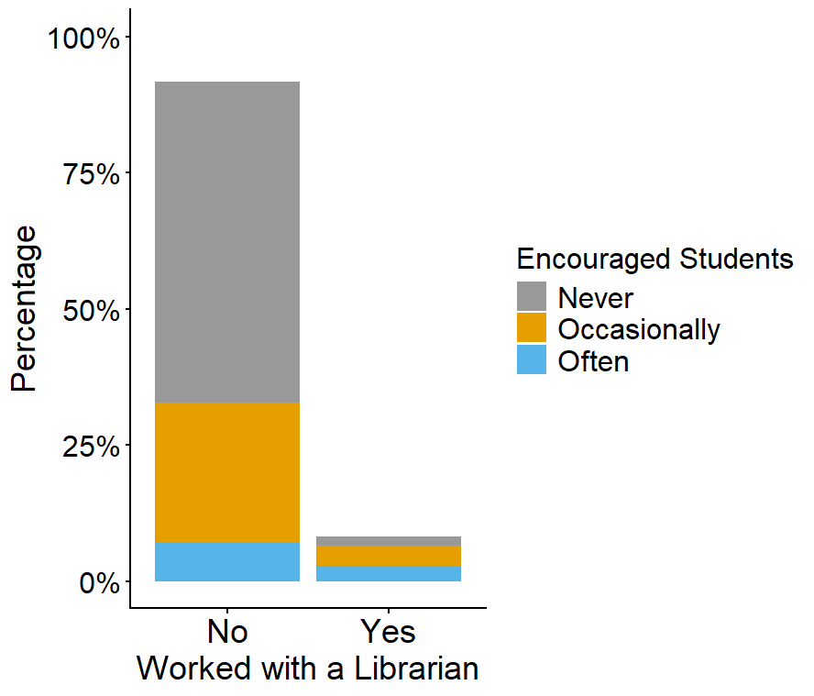
Work with Librarian for Instruction
&
Encourage Students to Contact Librarian

Slide 22
How are Math Faculty Using the Library?
Communication
Services
13% contact their librarian often
Nearly 22% use OERs
48% contacting librarian occasionally
15% use academic articles to teach
10% often encourage students to use library
44% use ILL for their research
29% occasionally encourage students to use library
21% use library assistance to find research articles for research
Notes:
*We do not know if the library was involved in the OERs being used
*While we know that faculty can be pulling academic articles through Google Scholar, we can safely assume at least some of this comes from the library
The respondents used other campus services, such as the writing center and data services, but the two most prominent campus research services used were ILL and asking the library for assistance in finding articles.

Slide 23
Math Faculty Perceptions of Libraries
27 (of 75) liked their librarian or academic library
Responses were generally positive about: Collaboration, positive interaction Library services & equipment
Disappointment & frustrations: Lack of communication Trouble accessible materials Concern for institutional undervaluing of libraries and librarians
“I’m happy with my library liaison. I just don’t use them much.”

Slide 24
Themes in Responses
“I’m not sure what resources the librarians could offer that would be helpful in my class.”
“Students do use library resources, but I am able to provide them with a direct link to the materials I want them to use.”
“Math is too advanced and technical for a librarian typically to deliver insight on mathematical topics.”
“I do not know how exactly that can help my students.”
Notes:
Shows that math faculty don’t understand what we do

Slide 25
What Faculty Want
Access to journals, books, ebooks, textbooks
Software (Overleaf & NVivo)
Spaces: lecture rooms, study rooms, extended hours
Funds for APCs
Support for: OERs, systematic reviews, writing for graduate students
IL instruction and increased collaboration

Slide 26
Insights & Conclusions
Emerging themes:
  Communication - how and how often
  Lack of knowledge of each other’s work
Librarians should consider professional development:
  Upskilling data practice
  AI & software pertaining to math
  Math lectures, conferences, webinars
Lean into the importance of general research skills
  Evidence of math students entering graduate school without strong basic research skills
Notes:
*We need to find common language and we need to be precise and consistent in communication of our services - what we offer and what is it

Slide 27
Resulting Outcomes & Projects
Stronger outreach to Mathematics for collection development
Guided conversations with the upcoming Engineering Department at Butler University (Fall 2026)
Display project with the Butler University College of Education
(Which resulted in )
Honors thesis on using library materials and literature with elementary mathematics students
Jenni’s PhD research concentration

Slide 28
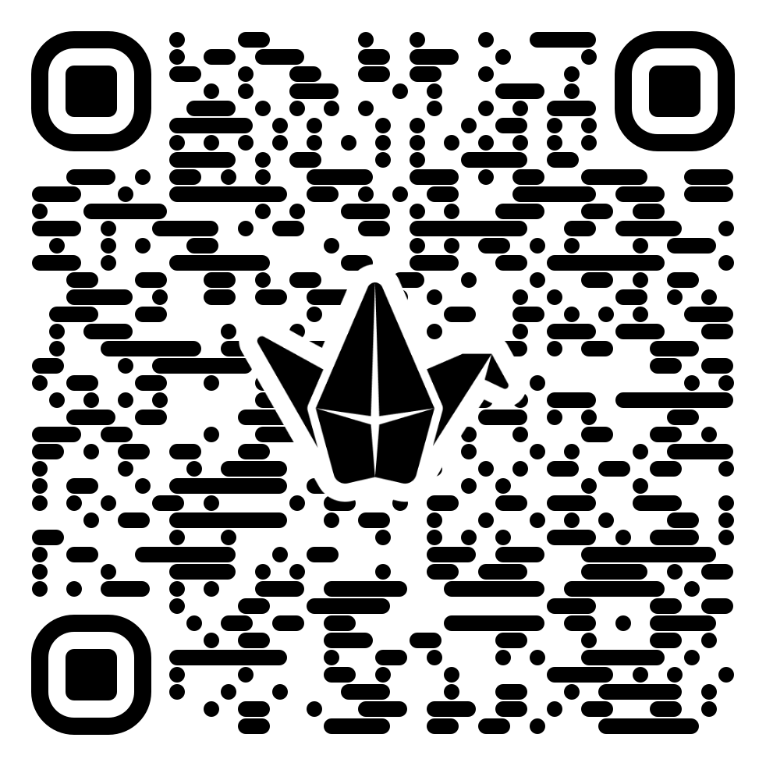
Questions for you!
From the information presented, were there any ideas that connect to your work?
Do you have any additional thoughts about our study?
Share your success stories!

Slide 29
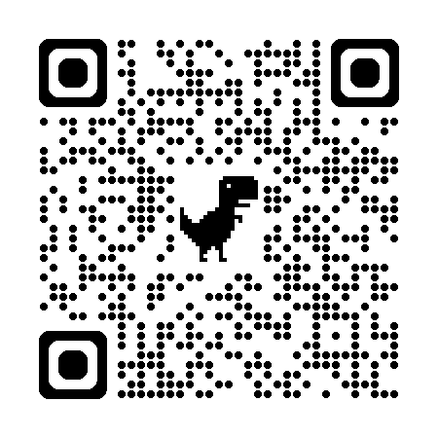
Thanks / Q&A
-Jenni Burke, Butler University, jburke1@butler.edu
-Liz Novosel, University of Colorado Boulder,
elizabeth.novosel@colorado.edu
-Dan Kipnis, Rowan University, kipnisd@rowan.edu
-Rasitha Jayesekere, Butler University, rjayasek@butler.edu
Burke, J. L., Novosel, E. C., Kipnis, D. G., & Jayesekere, R. R. (2025). Adding Libraries to the Equation: Mathematical Sciences’ Underutilization of Academic Librarians. Issues in Science and Technology Librarianship, (110). https://doi.org/10.29173/istl2857
Credits: This presentation template was created by Slidego, and includes icons by Flaticon and infographics & images by Freepik

