Slide 1
Ripple Effects: Wide-Ranging Impacts of a Project for Assessing Chat Reference for Information Literacy Instruction
Cameron Caswell & Brandy Whitlock
Anne Arundel Community College
LOEX, May 9, 2026

Slide 2
Truxal Library
Academic library supporting a large suburban community college
Support wide range of disciplines
16 full time library employees, including 5 faculty librarians.
We offer in person and online reference support, tailored instruction sessions, and an embedded librarian program to support online classes
Reference – in person and robust chat service.
Chat is staffed by paraprofessional reference staff and librarians

Slide 3
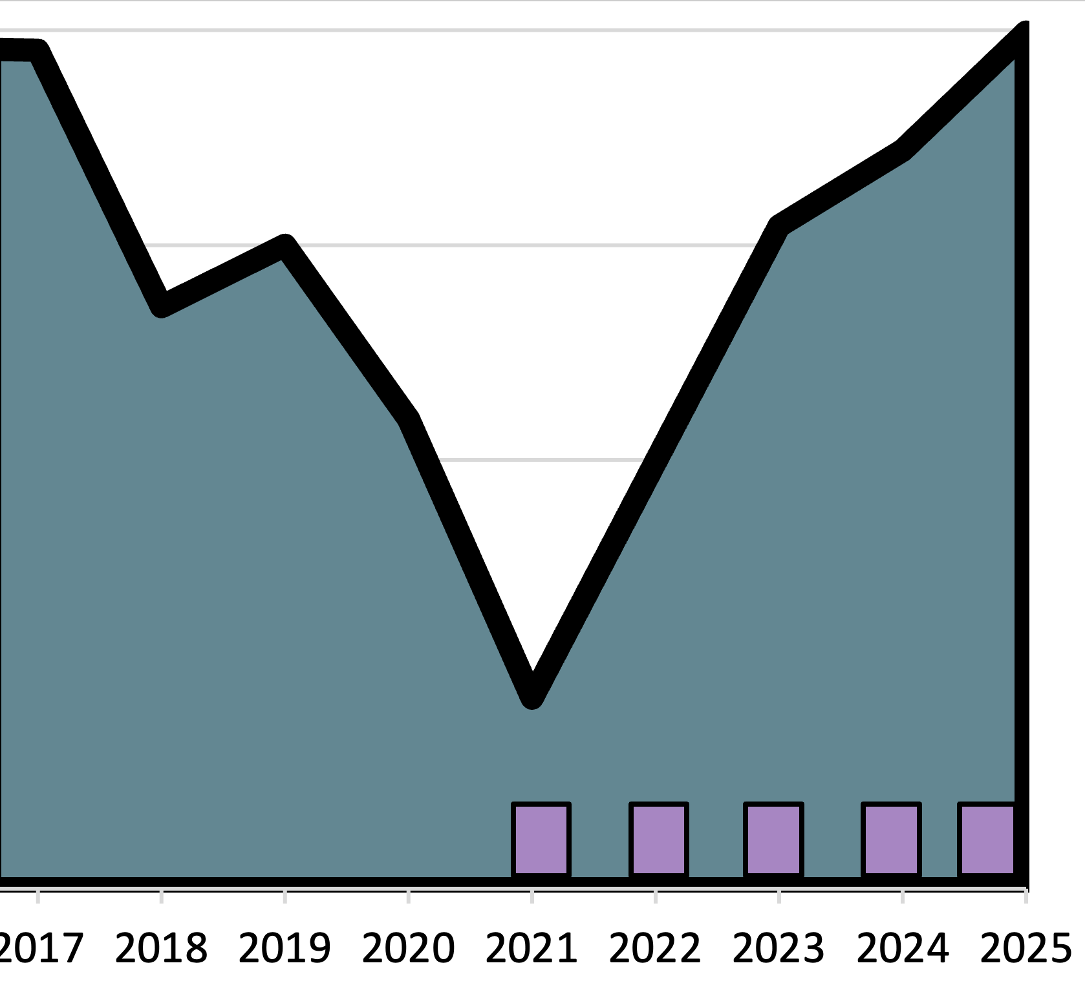
Chat took root during the pandemic
Falls (8/15-12/31) | % chat
2018 | 0.1
2019 | 0.1
2020 | 23.9
2021 | 9.7
2022 | 8
2023 | 7.5
2024 | 7.6
2025 | 8.1
Chat

Slide 4
Chat – where substantive reference happens
Chat
Desk
Notes:
Fall 2025
Percentage of
In-depth reference transactions that occur via chat:
38%
Other modes:
Wb form - .32%
Virtual writing center - 3.97%
Text message - .48%
Telephone - 3.02%
Other - .32%
Chat - 38%
In person - 47.22%
Email - 3.34%
Courseware message - .79%

Slide 5
A new habit of annual chat assessments
FY2021
  Chat assessment with rubric based on model reference behaviors
FY2022
  Chat assessment with rubric based on model reference behaviors + presence of teaching criteria
FY2023, FY2024, & FY2025
  Chat assessment with rubric based on ACRL information literacy framework, “Hunter rubric”

Slide 6
Chat assessment “presence of teaching”
Criterion based on RUSA (2008) guidelines
Ratings:
Teaching is not attempted at all when it clearly would be appropriate at points
Teaching is attempted, but not successfully carried out
Teaching patron one or two new concepts/techniques as part of the transaction
Provides information literacy instruction throughout the transaction; three or more concepts/techniques are taught
Notes:
FY2022
Reference and User Services Association. (2008). Guidelines for behavioral performance of reference and information service providers. American Library Association.
4.1.7 Explains how to use sources when appropriate.
4.1.8 Offers pointers, detailed search paths, and names of resources used to find the answer, so that patron can learn to answer similar questions on his/her own, when appropriate.

Slide 7
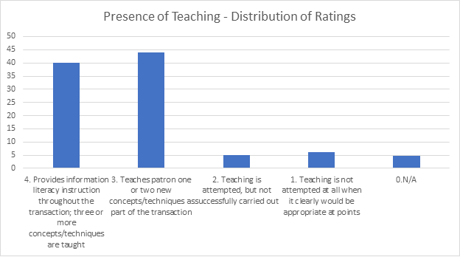
Confirmation of “presence of teaching,” now what?
But what are we teaching?
Could we teach more?
Notes:
2022 assessment findings…
Of the transcripts rated in our 2022 project, we found that about:
*40% of transcripts rated a 4 indicating that information literacy was provided throughout the transaction; three or more concepts are taught.
*44% of transcripts rated as 3 indicating that the patron was taught one or two new concepts
*5% of transcripts rated as 2 indicating that teaching is attempted, but not successfully carriend out
*6% of transcripts rated as 1 indicating that no teaching was attempted when it clearly would be appropriate at points.
*5% of transcripts rated as 0 indicating that none of the other criterion applied.

Slide 8
A new rubric & approach sought
Hunter, J., Kannegiser, S., Kiebler, J., & Meky, D. (2019). Chat reference: Evaluating customer service and IL instruction. Reference Services Review, 47(2), 134-150.
“Purpose: Reflecting on the new ACRL Framework, a deficiency was observed in literature on the assessment of information literacy instruction in chat reference…The purpose of this study is to discover if and how librarians were teaching information literacy skills in chat reference transactions and identify best practices to develop training and resources.”

Slide 9
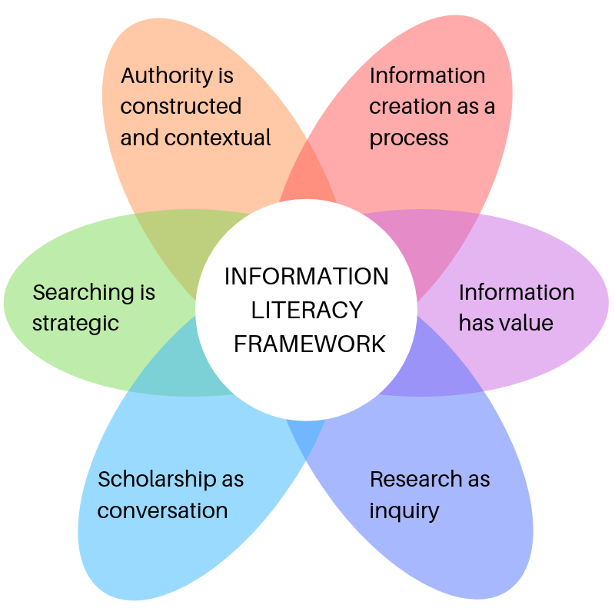
Rubric from Hunter, J., et al. (2019)
Image from: Metcalf, E. 2021. A Beginner’s Guide to Information Literacy.

Slide 10
Authority is constructed and contextual
Explain how to research an author’s credentials
Teach student to evaluate a source to determine if it is authoritative for their research purpose
Discuss why authoritative sources differ depending on context
Notes:
Most uncertainty for this frame

Slide 11
Information creation as process
Explain differences in source types and discuss when each may be appropriate
Discuss evolution of information
Discuss or explain the peer-review process

Slide 12
Information has value
Define the purpose of limitations on information
Show student how and why to properly cite sources
Discuss why they have access to specific college resources

Slide 13
Research as inquiry
Help student develop a research question or choose a topic
Evaluate search results and reassess search strategy
Share search tips and explain how they work

Slide 14
Searching as strategic exploration
Help student narrow their research topic to appropriate scope
Help identify high-quality sources by discussing why a source is appropriate or not
Help formulate new search strategies

Slide 15
Scholarship as conversation
Discuss or explain how citing others’ work helps build field of scholarship
Discuss or explain how the peer-review process contributes to higher quality research

Slide 16
Adapted for our team
Hunter project
Rated all (369) qualifying transcripts within a semester
Project task force normalized with common set of transcripts at outset, but further coding was undertaken individually
Coding was at frame level
Truxal Library project
Rated a sample of 30 transcripts, pulled from a pool of qualifying transcripts within a semester
Project members attended normalizing sessions at outset, then all 30 transcripts were rated by all participants
Coding was at frame – example level, resulting in more granular and concrete data about teaching activities that are occurring in chat

Slide 17
Project features
Sample of 30 transcripts from fall
Rubric based on professional guidelines & literature
8-10 library staff reviewing and coding
2-hour norming /training session

Slide 18
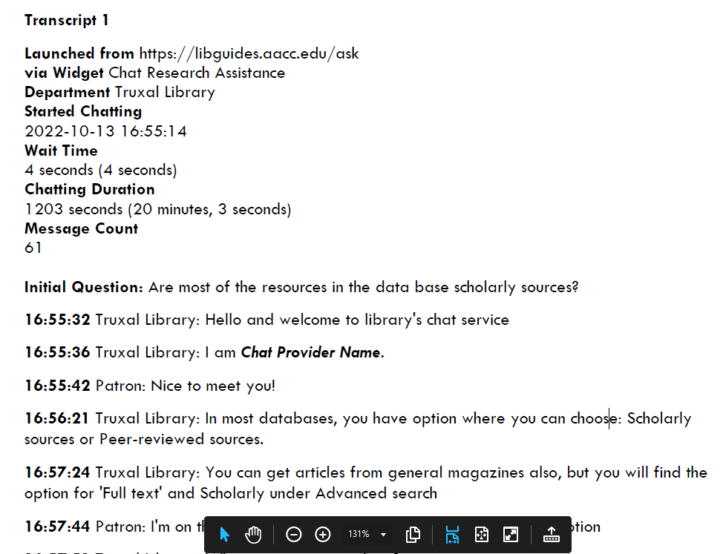
Transcript Preparation

Slide 19
Findings by Frame, 2023-2025
Notes:
Each year we have found that most teaching within chat is occurring around Searching as Strategic Exploration & Research as Inquiry, In second place are Information has value and Information creation as process.

Slide 20
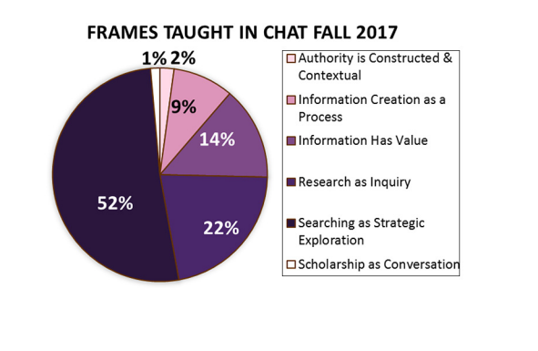
Hunter results

Slide 21
Frame 2: Information creation as process – 50%
Point out differences in source types - 57.9%
  "you can search via the library catalog and find books, ebooks, and videos"
  "if you are looking for articles, you can search via the library databases"
  "This database will include major newspapers like the New York Times, Washington Post, etc."
Discuss when each may be appropriate – 31.6%
  "Do you only need newspaper articles? Or some other magazine and journal articles are still ok to use?"
Discuss or explain the peer-review process – 5.3%
Discuss evolution of information – 3%
Notes:
From 2025 results

Slide 22
Frame 3: Information has value – 46%
Show student how and why to properly cite sources – 77.4%
  "Also, note that when you are looking at the full record for the article there are tools to help you generate a citation"
  "When you click on that, it opens a box near the top of the page that allows you to select the citation style you need....scroll down bit to see APA...."
  "Once you open an article that is useful, you will find citation, MLA under Tools and Cite"
Define the purpose of limitations on information – 15.1%
Discuss why they have access to specific college resources – 2.2%
Notes:
From 2025 results

Slide 23
Frame 4: Research as inquiry – 80%
Share search tips and explain how they work – 51.7%
  "Oh, I left out quote marks - try entering them around the phrase - "technology adoption""
  "Click on that link and type in: "bill russell" in 1st window and basketball player in the 2nd."
  "You can use APA psyarticles, Jstor, databases as well and use the same strategy: beauty AND standards AND (self-esteem OR comparison)"
Evaluate search results and reassess search strategy – 32.2 %
  "it is good to try variations on the search"
Help student develop a research question or choose a topic – 15.7 %
  "I can help you find sources about this - are you wanting something that focuses on the business/industry aspect of this? Is this for a business class or more general, like for a COM class?"
Notes:
From 2025 results

Slide 24
Searching as strategic exploration – 81%
Help formulate new search strategies – 61.3%
  "Oh, I havent tried the Academic search premier let me try now"
  "you can refine the search result"
  "I add one more search term "Body image""
  "maybe some other search terms, possibly "response" instead of "resilience" might yield more results."
Help student narrow their research topic to appropriate scope - 29.1%
  "A slight different way: in the 2nd window, I narrowed it down to USA."
Help identify high-quality sources by discussing why a source is appropriate or not – 8.5%

Slide 25
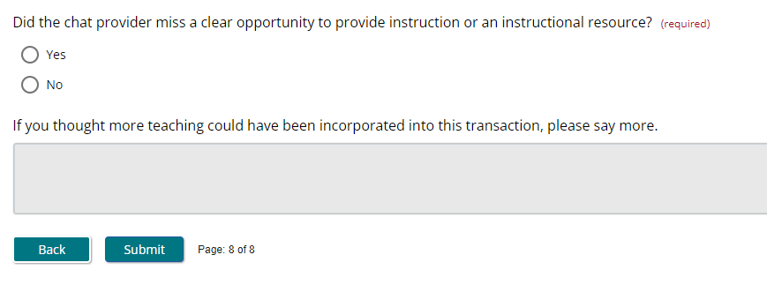
Structured reflection

Slide 26
Was a teaching opportunity missed?

Slide 27
Looping back & learning from our reflection

Slide 28
Ongoing learning & development
Share out & discuss participate feedback
Notes:
Session is offered to share out results library-wide. For example, here is feedback we gleaned from the 2023 project. In total there were 94 suggestions, which break down into these broad types

Slide 29
Feedback – Break down teaching into steps
“More step-by-step directions might have been helpful”
Provide step by step directions for constructing search in a database, inc. using limiters (11)
Share how to find research guides for patron’s subject (8)
Provide step by step directions for finding a database or a specific resource such as citation guide (7)

Slide 30
Feedback – Sharing & Explaining more
“Provider could have included a little bit about the search terms that led to those article results”
Explain why a certain database is being recommended (12)
Explain why certain keywords are recommended, why others might be left out, and how to find more (12)
Provide explanation of search strategies used in an example search (5)
Explain advanced search techniques such as quote marks (3)
Explain how a subject heading was found (3)

Slide 31
Feedback – Clarify
“Provider might have asked about assignment parameters - may have given an opportunity to talk about information as process - format types”
Point out differences in source types & clarify types of sources needed (7)
Ask student about past search efforts (6)
Ask questions about student's interest to aid them in broadening or narrowing topic (4)
Follow up with clarifying questions (3)

Slide 32
Feedback – more good insights!
“Provider could have asked the student to complete a search while they were chatting, in order to check for comprehension”
Point out importance of citing sources (7)
Test links, make sure recipient can open them (3)
Encourage patron to try searching while on the chat (1)
Encourage student to select article from results (1)

Slide 33
Post assessment follow-up survey
Ongoing learning & development
How confident do you feel when staffing the chat service?
What types of questions do you feel confident answering?
What types of questions do you feel hesitant answering?
Is there specific training/preparation that you feel would be helpful to you as a chat provider?
Have you found participating in the chat assessment project to be beneficial? Why or why not?
Notes:
Sent to all chat providers

Slide 34
Follow-up survey: Why have you found participation in the chat assessment project to be beneficial?
Ongoing learning & development
When I read my chat transcripts, I find out about my skills and knowledge, see what went wrong, and understand and learn from my mistakes. Also, when I read others' transcripts, I have an opportunity to learn from their work. I think chat assessment project is very useful.
Notes:
Sent to all chat providers

Slide 35
Ongoing learning & development
Follow-up survey, continued
Exposure to the score criteria and attending the group score-norming sessions opened my eyes to some areas of my practice that I could improve upon and have directly impacted the way that I deliver chat reference.
I've learned from other chat providers about what they do and how they handle different situations. I've improved my service because of the interactions we've had around assessing the service.
Notes:
Sent to all chat providers

Slide 36
Approaches critical for developing our community of practice
Ongoing learning & development
Focus on observation, not fault-finding
Encourage empathy and generosity
Provide several opportunities for reflection and feedback
Celebrate strengths
Respond substantively to concerns and suggestions
Make the data meaningful

Slide 37
Impacts - Ongoing learning & development
Ongoing learning & development
Trainings developed based on feedback from the assessment and the feedback survey:
  Understanding ACRL’s Framework for Information Literacy for Higher Education
  Teaching during Reference Toolkit
  Virtual Reference Tools Refresher
  Health Research Refresher
  Legal Research Refresher
  Accessible and functional links

Slide 38
Impacts – Creation and revision of instructional materials
Ongoing learning & development
Revising and adding individual scripts
Revising and adding FAQs
Revising library research guides

Slide 39
Impacts – Bringing reference & instruction closer
Bridges gap between reference services and more formalized instructional work
Acknowledges the teaching that occurs within reference

Slide 40
In closing
Chat assessment = rich and repeatable experience for our team

Slide 41
Thank you!
Brandy Whitlock, bmwhitlock@aacc.edu
Cameron Caswell, tccaswell@aacc.edu

