Slide 1
Welcome!
While you’re waiting…
One sticky note = one fear
Dot stickers = +1 for another sticky note
What makes you feel nervous/anxious/afraid about this scenario?
You are attending a national library conference. You’ve already been at the conference for a full day, and you are now attending a session where you are learning about a new affective teaching method.

Slide 2
Braving the Storm:
Using Fearstorming to Navigate Student
Needs and Measure Affective Impact
LOEX
Payton D. Cooke
Engagement and Instruction Librarian
Connecticut State Community College
Notes:
Title

Slide 3

First: a brief introduction
Payton D. Cooke (she/her)
MA – Literary Studies
MS – Library and Information Science
Engagement and Instruction Librarian
@ CT State – Manchester
Fun fact: I have been attending LOEX longer than I have had a library job..
Notes:
Who Am I?

Slide 4
TABLE OF CONTENTS
01
02
Groundwork
Mini-Fearstorm
03
04
How to Fearstorm
Fearstorming in Action:
A Case Study
Notes:
Table of Contents

Slide 5

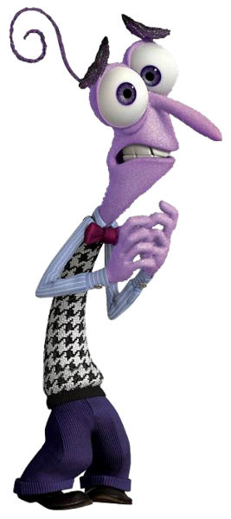
Fear is a universal human experience. When it is ignored, pushed down, or viewed as failure, it only grows in power.
01
What is fear?
Notes:
Fearstorming begins with the simple recognition that everyone experiences fear.
But what is fear?
Fear is a nuanced concept that can be described in levels of intensity or experiences such as anxiety, nervousness, phobias, worry and more; however, at its core, fear is a basic human emotion.
Sometimes we think about fear as an intense, immediate experience – like a lighting strike.
But really – [this guy]: a basic human emotion, a universal experience.

Slide 6
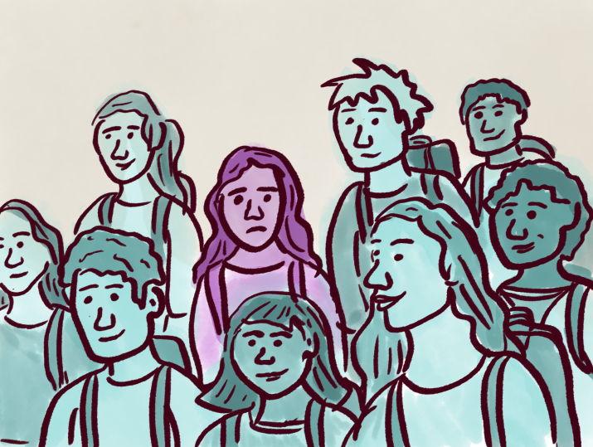
Fear in Academia
Imposter Syndrome
Admitting fear = admitting you’re not “good enough”
Notes:
Lots of research on the triggers and outcomes of fear in academia. Less attention is paid to addressing the fact of its existence.
Everyone has fears but no one talks about them. In fact, in the academic space, where one is seemingly surrounded by successful, intelligent, and confident peers, admitting uncertainty or fear feels like failure in and of itself.
In some ways it feels like by acknowledging the fear we’re somehow saying “I’m not good enough”. So we stay quiet.
This normalized silence exacerbates fear and creates a lack of confidence, anxiety, and imposter syndrome that feeds back into fear and perpetuates the cycle. So we stay quiet and fears grow.

Slide 7
WHAT IS
FEARSTORMING?
Fearstorming is an activity where participants are encouraged to anonymously voice unspoken concerns about a topic.
an ideation activity
a collaborative reflection process
an instructional method
a classroom assessment technique
Notes:
It is lots of things and depending on how you use it different aspects will have more focus.
Takes fear as the starting point for confidence, not the opposition.
Like brainstorming, fearstorming invites open, nonevaluative expression – but instead of generating ideas or topics, participants are encouraged to give space to their fears before diving into new tasks. As a practical definition: Fearstorming is an activity where participants are encouraged to anonymously voice unspoken concerns about a topic.

Slide 8

Where did it come from?
Fearstorming: Prepare for Feedback & Launch with Confidence
D4D 2019 | Claire DeMarco & Abby Conway
Notes:
My adaptation of fearstorming goes a step further – introducing the concepts of peer validation and facilitated reflection. The result is an affective method for creating an environment of trust, connection, and learning while also forming a basis for assessing learner confidence throughout a lesson.

Slide 9
Our Fearstorm
LOEX
Prompt:
You are attending a national library conference. You’ve already been at the conference for a full day, and you are now attending a session where you are learning about a new affective teaching method.
Notes:
Live demonstration.
Attendees were encouraged to write on sticky notes responding to what made them nervous about this scenario as they walked into this session. Dot stickers are provided so that they can “+1” any other responses that they agree with/vibe with/ have felt before.
Facilitated reflection.

Slide 10
02 | How to Fearstorm
One
Two
Three
PREPARE
FACILITATE
REFLECT
Set the scene
Release the storm
Analyze the aftermath
Notes:
Fearstorming can be adapted to many disciplines, topics, and classes.
There are three main phases that guide an effective fearstorming session – preparation, facilitation, and reflection.

Slide 11

Preparation: Why are you here?
You are asked:
Fearstorm topic:
Fearstorm topic:
Teach students how to navigate library databases
Library research
You are asked:
Teach librarians a new teaching method
Learning a new teaching method
Notes:
Your topic will vary based on academic and participants’ context.
Good place to start is why you were asked to visit the class, or give your presentation.
First example: library one shot
Second example: the fearstorm we did today.

Slide 12
Preparation:
Crafting a Prompt
Your professor gives you the following assignment:
Write a 5-7 page persuasive essay that takes a stand on an issue that focuses on an important topic of your choice. You must use at least five sources of information including at least two peer-reviewed academic articles, one book or book chapter, and one contemporary news article.
What makes you nervous about research?
Notes:
Distilling your topic into a prompt or scenario helps scaffold your fearstorm.
Both of these prompts allow students to respond to the same fundamental topic: library research.
Prompt A: opens up the question to any kind of research (scientific research, academic research, personal research). Could be a good thing.
Prompt B: Seems more specific but what is actually happening -> structure to guide students without imposing restrictions. Students can respond with many different fears (examples). These are all also valid responses to Prompt A, but the structure of prompt B gives students the language to identify pain points that might not have been thought of on the spot.

Slide 13
Facilitation: Running the Fearstorm
Explanation
Materials
Participation
Explain fearstorming to participants. Frame fear as the start, not a failure.
Sticky notes
Engage as an equal player.
Write your own fear. +1 participant fears.
Be real
¼ inch stickers
Notes:
Explanation:
Pull back the curtain and explain the rationale.
I avoid giving examples, as I do not want to bias the responses. All fears are valid, regardless of how big
or small, definite or vague.
Materials:
One fear per sticky note. Dot stickers to +1
The dot stickers are used when students see another note they resonate with. Whether they feel the same way, or have felt that way, or simply “vibe” with that experience, they can put a dot sticker on that note. I often explain this in terms of giving a “plus one” to that person’s response.
Participation:
As students are working through the fearstorm, engage as a participant: write down your own fear, add “plus ones” to student responses and engage as an equal player in the space. When done authentically and unobtrusively, this is a powerful statement that you – as the reputed “expert” in the room – also experience fear and, moreover, that you too accept and value students’ experiences.

Slide 14
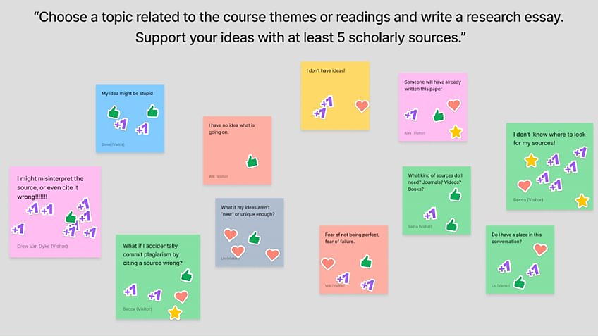
Digital Fearstorms
Notes:
Online fearstorms. Example from Figjam
Depending on your context: viable alternative to simulate the dot sticker validation as the facilitator. To do this: place more emphasis on the reflection, digging deeply into the themes across notes, working through the most prevalent themes while also drawing in supposed outliers.
I have also used this exact image to ground an asynchronous module – because I can’t read what students have written I use this as an example to launch this reflection piece.

Slide 15
Reflection
Acceptance / Positive Regard
Realness
Empathetic Understanding
Rogers, C. R. (1969). Freedom to Learn. Charles E. Merrill Publishing Company.
Notes:
Once the fear is on the sticky note, we have taken it out of our head and put it aside which, by itself, can be a very intentional act.
No one had trouble coming up with a fear. Regardless of the people in the room – their roles, their skills, or their confidence – no one struggled to think of something that made them nervous, uncertain, or anxious. This simple fact readies the group for connection and open-minded learning.
Empathetic Understanding: “a sensitive awareness of the way the process of education and learning seems to the student” (Rogers, 1969, p. 111).
Realness – storytelling. Not limited to first-hand experiences.
Weave in opportunities for students to work with and through fears. Don’t want to “solve” their fears, as it invalidates the fear as having power.
And I’m not the expert!
But, structuring different ways we can work through them, we reduce the power.

Slide 16
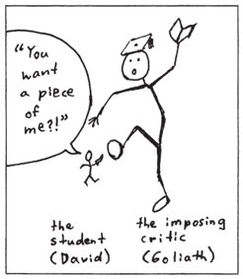
Fearstorming in Action
How to Pick a Fight (with a Scholar)
Notes:
I originally adapted fearstorming to serve as the opening activity to a workshop called “How to Pick a Fight (with a Scholar).” The focus of the workshop is rhetorical strategies in academic writing. In my own experience, I have found that while research assignments routinely require students to use academic sources, students are often unsure how to use them and do not engage with sources on a critical level. In some cases, this limits students’ opportunities to demonstrate their own thoughts and arguments, causes anxiety, and narrows student research. Based around Gapia’s (2004) eight strategies for engaging with scholarly conversation, the workshop aims to introduce academic writing as inherently based on familiar rules of conversation and to provide students with discrete strategies to use when engaging with sources in a research paper.
As part of the learning outcomes for this workshop, I wanted to increase students’ confidence in their own scholarly abilities – to see themselves not just as bystanders to scholarship, but as participants. However, confidence is tricky to quantify. I could ask students to complete a survey or Likert scale before and after the workshop, but these did not have the formative impact that I wanted. I didn’t just want students to say they were nervous about research, I wanted them to understand that this feeling was valid and an entirely normal part of the process. As an additional factor, my understanding of the student needs (i.e. fears) defining the workshop was largely anecdotal and based on personal experience. The conversations which led me to discover these needs were had in one-on-one settings, where rapport had already been established. In a group setting, these conversations are harder to have as they ask students to be vulnerable with me, their peers, and perhaps even their professor. Once again, admittance of fear in a highly-charged setting like college, can feel like a failure – in some ways I was battling against the fear of admitting you’re scared. Finally, I needed this opening to be ultimately relevant to the student experience. If the activity translated as a performative icebreaker, I would not only miss the opportunity to connect with students, but risk losing them completely.
Fearstorming as the solution.

Slide 17
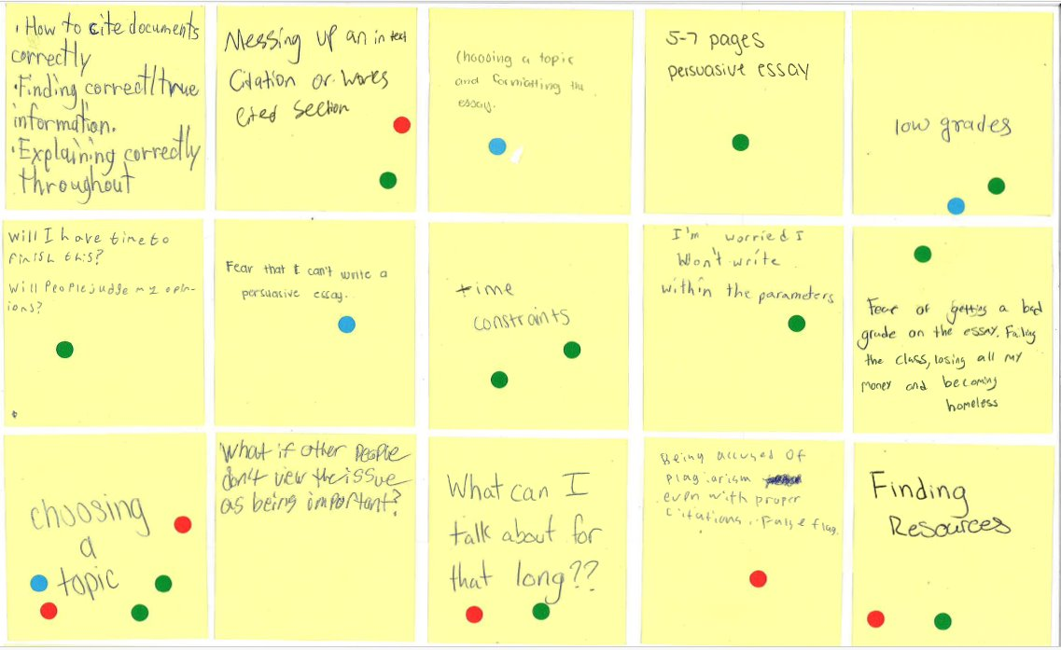
Notes:
First fearstorm.
Although the topic of the workshop is far narrower than the results of the fearstorm, I make time for as many student worries as possible and frame the rest of the workshop as one tool to add to their kit.
So what do we have here?

Slide 18
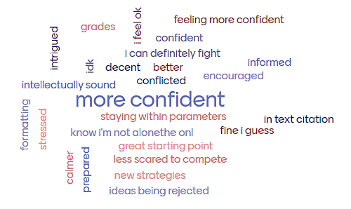
Notes:
Midway through the lesson, I ask students to think back to the fearstorm and reflect on how they feel after learning the strategies. While most fearstorm responses may not directly relate to engaging with scholarly sources, I frequently get responses that indicate an increased sense of confidence and a reduced sense of fear.
To be fair: this was my first word cloud and I believe that some of the responses are under the impression that this is another fearstorm and that they are responding to things that still worry them – which is why we’re getting responses like “in-text citation” and “grades” and “idea being rejected”.
And some of them are still responding with “stressed” – but at least they feel SAFE saying that!
My favorite note: “I can definitely fight.” That’s the attitude I want. Resilience and confidence.

Slide 19
Student Responses to Fearstorming
Notes:
At the end of the workshop, I always ask students to write a two-minute response to the following prompt: “What was the most important idea or skill you learned in today’s lesson? Why is it important?” Most of the responses are understandably related to the eight strategies that serve as the core. However, nearly a third of students also express the importance they find in the fearstorming activity – either stemming from our collaborative reflection, or the simple act of voicing their fears.

Slide 20
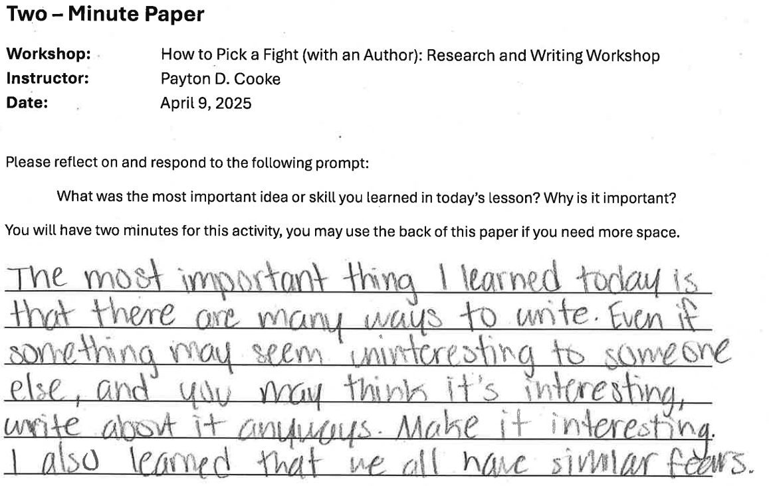

Slide 21
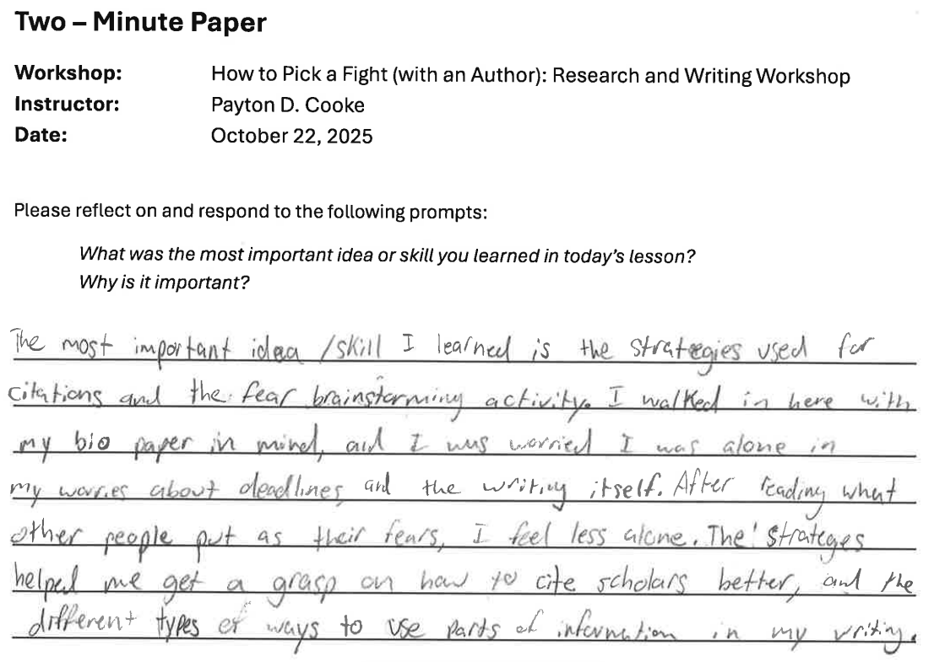

Slide 22
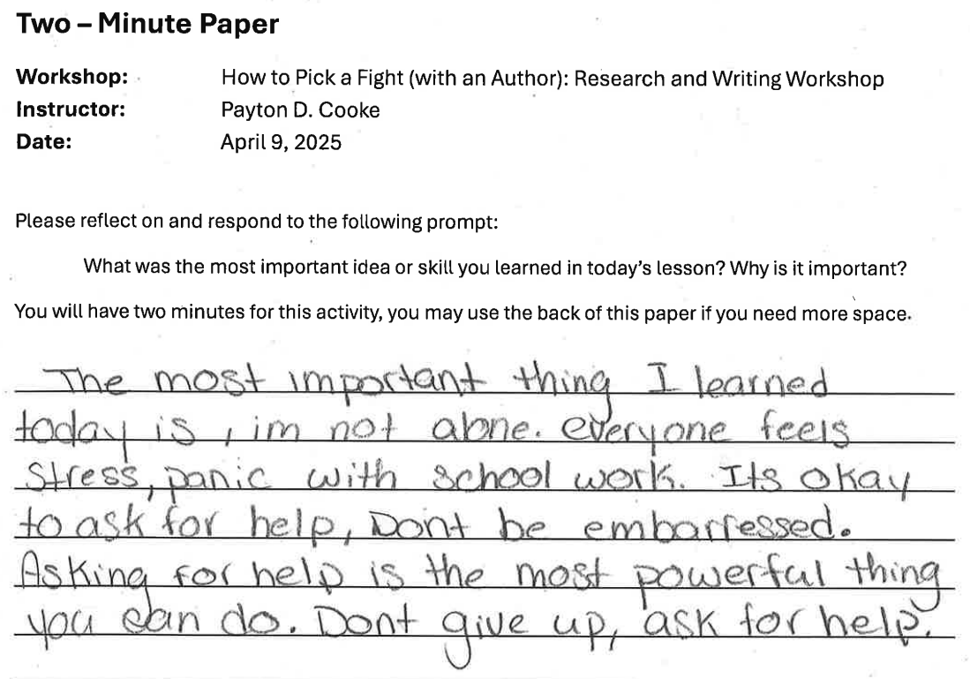

Slide 23
How is Fearstorming Useful?
For Students:
For Facilitators:
Increase confidence and lessen the impact of academic fear
Increase rapport with students
Gain an understanding of student fears and ideas for new resources, lessons, and services.

Slide 24
Fear is a universal human experience. However, when it is ignored, pushed down, or viewed as failure, it only grows in power.
Fearstorming offers a way to acknowledge the fear and learn to set it aside in a way that makes room for meaningful learning.

Slide 25
Stay in Touch!
LOEX
Payton D. Cooke
payton.cooke@ctstate.edu

