Slide 1


Coming Together: Interactive Collaboration Leads to Life-Long Connection
LYNETTE SEELMEYER
Teaching & Learning Librarian
University of Northern Colorado
Lynette.Seelmeyer@unco.edu

Slide 2

What did we do?
New two-part instruction for GOAL 402 – our graduating students
Reorganized and re-scaffolded library instruction
for GOAL 101 – GOAL 301

Slide 3

How did we do it?
Partnering with the GOAL program
Reaching out to and collaborating with community partners
Collaborating with UNCO Libraries' Facilities team

Slide 4
at UNCO's michener library
Staying safe online
Checking password strength
Looking up students' home public libraries
Preparing for our field trip

Slide 5
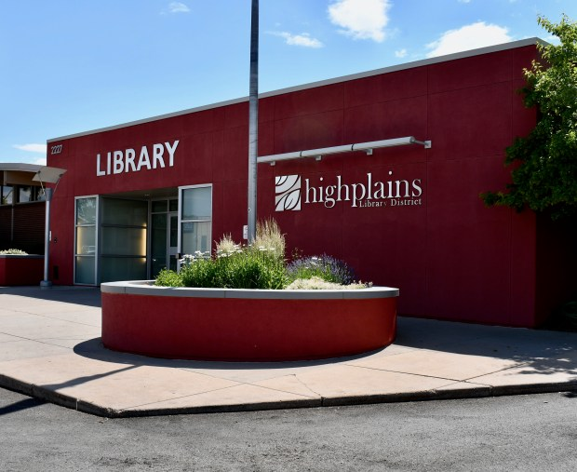

FIELD TRIP!
CENTENNIAL PARK LIBRARY
HIGH PLAINS LIBRARY DISTRICT GREELEY, COLORADO

Slide 6
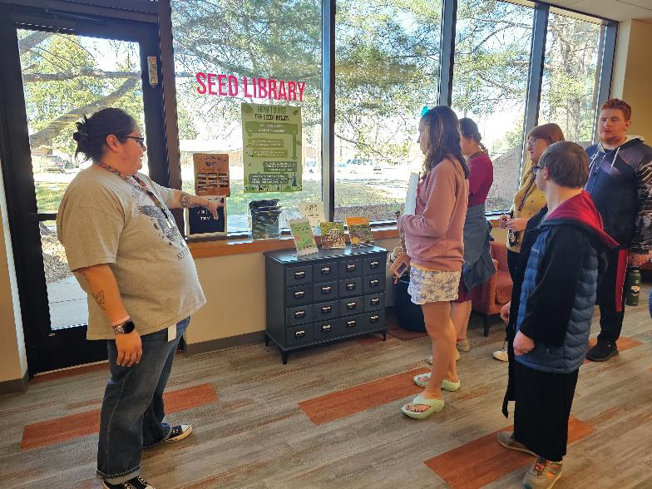
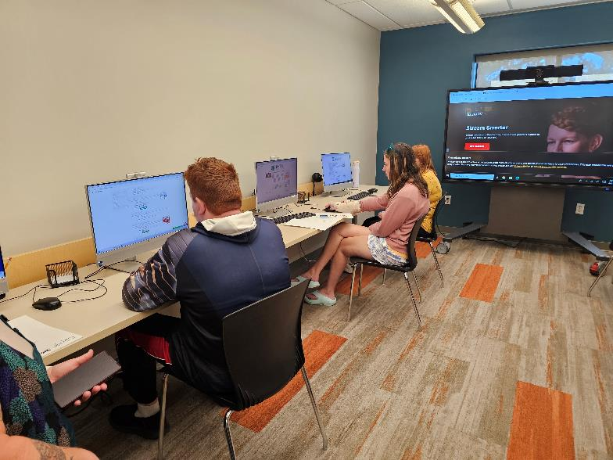
    LIBRARY RESOURCES – LIBRARY SERVICES
    TOUR – THE SEED LIBRARY – THE MAKERSPACE

Slide 7
what's next?
Fully re-scaffolded lesson plans and online content for
GOAL 101 – 301 ready to go for Fall 2026
Collaboration with GOAL on library instruction for GOAL 401
Review of the Centennial Park field trip content and format for our next visit in Spring 2027!

Slide 8
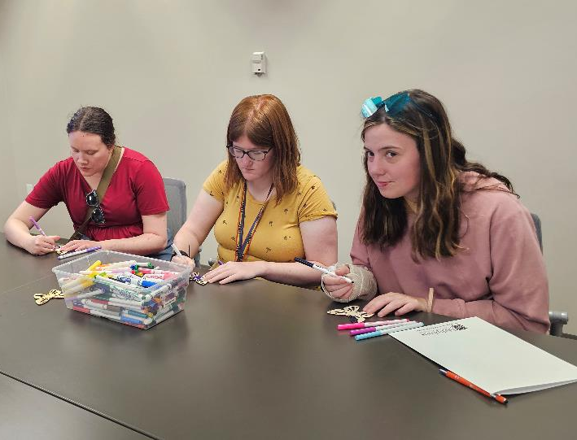
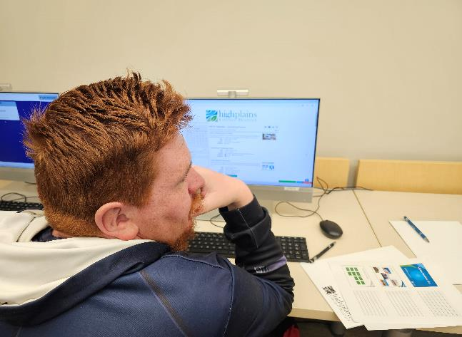
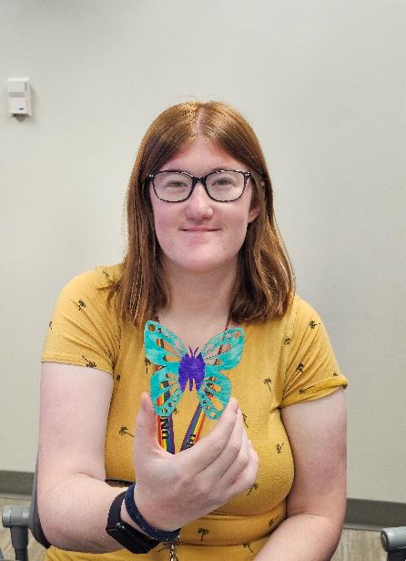
Conclusion and thanks!

