Slide 1

Anchoring our Library Instruction Practices to the Critical Teaching Behaviors Framework
Marlee Dorn Givens
Georgia Tech Library
LOEX 2026
Notes:
My name is Marlee Givens, and I am the Instruction Manager for Academic Engagement at the Georgia Tech Library.
Today we’re going to talk about how we anchored our library instruction practices to the Critical Teaching Behaviors framework, or CTB.

Slide 2

Learning outcomes
By the end of this presentation, participants will be equipped to
Identify examples of Critical Teaching Behaviors (CTB) that align with best practices in course-integrated instruction
Discuss strategies for applying the CTB framework in their own instructional leadership
Reflect on how the CTB framework can foster a culture of teaching excellence in their institutions
Notes:
As participants, by the end of this presentation you will be equipped to…

Slide 3
Our context
New department
Instruction retreats
New liaison structure
Teams for Colleges
Varied experience
Establishing practices
Workflows
Accessibility
How to teach
Teaching teams
Sharing practices
Future
Self-reflection
Peer observation
Notes:
To understand why we turned to CTB, it helps to understand what was happening organizationally.
In the past few years, the Georgia Tech Library went through two major reorganizations. First, we formed a new department—Academic Engagement, or AE—made up of librarians whose primary responsibilities were instruction and outreach. Around the same time, demand for instruction in areas like data literacy and multimedia exploded, and a few individuals were carrying a disproportionate teaching load. To address that, we moved to a team‑teaching model.
We also created my position, which is focused on leading an Instruction Team, establishing best practices for instruction, and organizing an annual instruction retreat. One of the first things I did was start facilitating informal discussions about teaching at our AE department meetings.
Team teaching worked well—and led to the second reorganization: replacing individual subject liaisons with seven Teams for Colleges, each responsible for instruction, research consultations, and outreach. Now we have more librarians teaching, with a wide range of teaching experience. We needed to get many folks up to speed, but first we needed to define what we mean by “good teaching.”
We had already established workflows and were working on accessibility in preparation for Title II. What we didn’t yet have were shared expectations, a common vocabulary, or documented examples of what effective library teaching looked like.
Clarifying, defining, and documenting our practices would also facilitate the adoption of teaching reflection and peer observation.

Slide 4

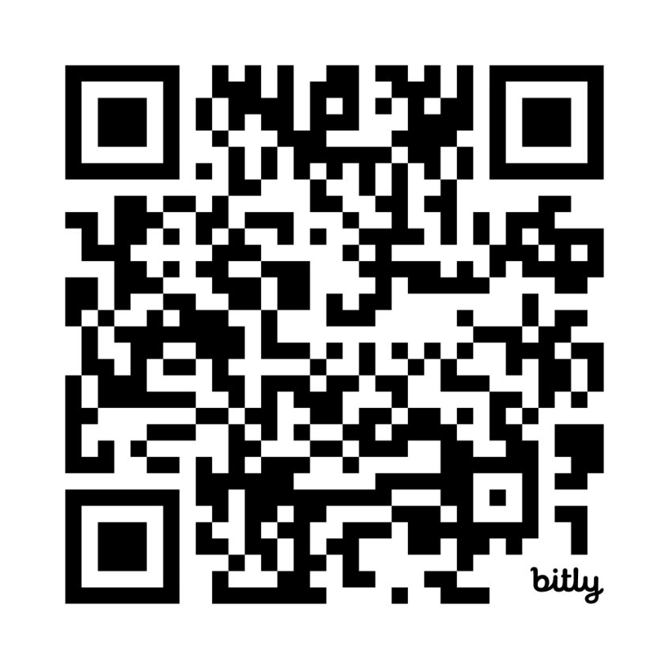
Critical Teaching Behaviors: Defining, Documenting, and Discussing Good Teaching
Lauren Barbeau, Ph.D.
Claudia Cornejo Heppel, Ph.D.
criticalteachingbehaviors.org
Notes:
That’s where Critical Teaching Behaviors came in.
CTB is a research‑based framework developed by Lauren Barbeau and Carla Cornejo Happel. Dr. Barbeau is on the faculty of Georgia Tech’s Center for Teaching and Learning.
CTB’s purpose is to define good teaching by identifying observable behaviors, not personality traits or teaching style. It defines a framework based on six categories: Align, Include, Engage, Assess, Integrate Technology, and Reflect.
The book, published in 2023 by Routledge, has a companion website (criticalteachingbehaviors.org) – this QR code will take you to the About page of the website, where you can see the framework.

Slide 5
Our intro to Critical Teaching Behaviors
Peer observation workshop
Teaching reflection workshop
Notes:
Animations] My department first learned about critical teaching behaviors during an instruction retreat, [click1] at a workshop conducted by Dr. Barbeau. We invited her to teach us about peer observation, and in her workshop she outlined the CTB framework and gave us the basics of peer observation. She provided a note-taking instrument and led us through a practice teaching observation.
[click2] At the end of the workshop, we knew that jumping into peer observation was not for us. It was a stressful experience. We realized that peer observation is not something we can learn in one workshop – naming and describing teaching practices while observing them in real time are specialized skills that require repeated practice. And to be honest, we knew that we didn’t have the required level of trust in our newly formed department.
About one year later, I participated in a Center for Teaching and Learning leadership cohort, [click3] and Dr. Barbeau led a workshop for us on teaching self-reflection. We used the CTB framework to reflect on teaching strategies and evaluate our approach. [click4] This experience was much more positive. It was, of course, a lot less stressful to self-reflect than to observe and take notes on someone else. And I saw the potential for the CTB framework to shape our department’s conversations about teaching, to define what we mean by “good teaching,” and prepare for future practices.
I proposed to my supervisor and the Instruction Team that we start adapting CTB for our library’s instruction program. They agreed, and the Instruction Team got to work.

Slide 6

Our goals
Clarify and document practices
Demystify instruction
Train and support new instructors
Cultivate effective practices
Evaluate and reflect on teaching
Notes:
Here’s what we wanted to do, and how we thought CTB would help us:
First, we wanted to clarify and document our practices
We thought CTB would help us name and describe what we do as instructors, for each other and for our new peers in Teams for Colleges
We wanted to demystify instruction for our colleagues, in order to better train and support them
We wanted to cultivate a common set of best practices, and to discourage outdated practices people might have picked up along the way
And we wanted to set a foundation for future work like onboarding, reflection, and eventually peer observation

Slide 7
Our process
Instruction Team
Department
Teams for Colleges
Spreadsheet
Universal Design for Learning
Sample behaviors
Presentation
Affirmation
Instruction manager
Workshops
Survey
Retreat
Informal discussions
ACRL Framework
Workshops
Future applications
Notes:
Our process essentially started with me.
The CTB model I learned in the workshops was originally designed with semester‑long, credit‑bearing courses in mind. Most of our instruction is one‑shot, course‑integrated teaching. So we asked: How does this translate to library instruction? And what behaviors do librarians already use that aren’t explicitly named in CTB?
I surveyed the Instruction Team about which CTB behaviors and documentation made the most sense in our context. We then created a spreadsheet adapted from the CTB framework and populated it with the most relevant examples. We added UDL and the ACRL framework as additional lenses for a future conversation with the department.
The department had already begun to have informal discussions about teaching practices. At one of our instruction retreats, the Instruction Team led a facilitated discussion of each of the CTB categories, which culminated in a list of sample behaviors that—together—could start to define “how we teach” at the Georgia Tech Library.
AE then presented these behaviors to Teams for Colleges, affirming our definitions of good teaching, and then planning for workshops and future applications in self-reflection and peer observation.

Slide 8
Critical Teaching Behaviors
Align
Include
Engage
Assess
Integrate Technology
Reflect
Notes:
[Animation] The framework has six categories:
Align
Include
Engage
Assess
Integrate Technology
Reflect
Each category includes
Definition
examples of representative behaviors
Potential sources of documentation—things like lesson plans, activities, slides, or student feedback.
You can follow the QR code to see the whole chart, or if you’re not a QR code person, you can open the colorful CTB brochure I’ve shared.
[click1] I will walk you through our process for the Engage category.

Slide 9
Example CTB: Engage
Original CTB
Representative behaviors
Provide regular and open communication
Design activities to promote engagement
Encourage participation using varied instructional strategies
Foster self-regulated learning
Use relevant examples and applications
Stimulate discipline-specific critical thinking
Sources of documentation
Activity instructions/prompts
Communications to students
Lesson plans, online modules
Peer feedback/observation
Presentation slides
Student feedback
Syllabus
Video recording
Notes:
Representative behaviors include things like:
Communication
Activity design
Participation strategies
Relevant examples
Critical thinking
Sources of documentation that might show evidence that the instructor is engaging might include:
Activity instructions or prompts
Lesson plans
Slides
Feedback from students or peers
I put all of these into a survey for the Instruction Team. I asked them, in the context of course-integrated instruction, which of these behaviors and sources of documentation most resonate with you? I asked them to pick their top three choices.

Slide 10
Example CTB: Engage
Instruction Team survey
Notes:
Here are the results of the survey. These are the top behaviors and sources of documentation in the Engage category, when thinking about typical one-shot library instruction.
Everyone agreed on regular and open communication and relating content to relevant examples and applications
The third and fourth behaviors were using a variety of instructional strategies and designing activities to promote engagement
Everyone also agreed that activities and slides were good sources of documentation for Engage.
The other sources of documentation we chose were communications, lesson plans, and student feedback
We created a spreadsheet based on the colorful CTB framework chart and included only the behaviors and documentation we confirmed from the Instruction Team’s discussion of these survey results.

Slide 11
Example CTB: Engage
Instruction Team additions
UDL
  Break down complex projects/tasks into smaller achievable components
  Create opportunities for students to engage in small groups
  Provide a forum for students to discuss their questions or knowledge
ACRL Framework
  Research as Inquiry
Notes:
To the spreadsheet we added columns for UDL and ACRL Framework.
Because our AE colleagues were also familiar with Universal Design for Learning (UDL) and the ACRL Framework for Information Literacy, we wanted to provide these additional points of reference, to foster richer conversations about the spreadsheet.
We thought these additional perspectives would provide multiple entry points into discussions about teaching and connect this work to existing professional values.

Slide 12
Example CTB: Engage
Department discussion questions
Which of the “representative behaviors” do you currently use as teaching strategies?
Are there similar strategies you use that are not included in the chart?
Which “sources of documentation” do you recognize from your own teaching?
Which “Engage” practices are important for new members of Teams for Colleges to master?
Notes:
The Instruction Team presented our spreadsheet to the rest of AE during an instruction retreat. We led a guided discussion of Align, Include, and Engage, and we took notes on whiteboards during the retreat.
This was deep intellectual work, and we didn’t want to overwhelm our colleagues, so we discussed the other three categories—assess, integrate technology, and reflect—at department meetings.
In each case, we used this structure and basic questions:
Which of the “representative behaviors” do you currently use as teaching strategies?
Are there similar strategies you use that are not included in the chart?
Which “sources of documentation” do you recognize from your own teaching?
Which “Engage” practices are important for new members of Teams for Colleges to master?

Slide 13
Example CTB: Engage
Department discussion results
GT Library examples
  Offer student-student and student-content activities
  Relate content to students' relevant experience
  Provide practical examples
  Chunk and scaffold content
  Solicit feedback from students before, during, and after class
(Additional examples for Align, Include, Assess, Integrate Technology, and Reflect are in the handout)
Notes:
We then condensed our whiteboard notes into a list that we added to the spreadsheet in a column called Georgia Tech Library examples. For engage, these are
Offer activities that promote student-student and student-content engagement
Relate content to students' relevant experience
Provide practical examples
Chunk and scaffold content
Solicit feedback from students before, during, and after class
I have provided all of our examples on a table in your handout.
Final thoughts:
These examples are not necessarily things that we each do all the time.
But we expect that each library instructor will do something from this list in every class.
New instructors have a variety of examples to think about learning and practicing, with the assurance that these will be effective with Georgia Tech students.
We can use these examples to plan training and onboarding for library instructors.
Are you ready to go through this same process yourself? If you need to, turn your handout back over and look at the audience reflection activity.

Slide 14
Audience reflection
criticalteachingbehaviors.org/about-ctb
Align
Include
Choose a frame from the Critical Teaching Behaviors framework.
Review the representative behaviors and sources of documentation.
Which examples resonate with your instructional practices?
What other examples would you include?
Engage
Assess
Integrate Technology
Reflect
Notes:
For this activity, you will need the CTB framework, which is available at the QR code on the screen – this takes you to the link criticalteachingbehaviors.org/about-ctb – and if you aren’t able or interested in following that link, you can open the colorful CTB brochure.
The reflection prompts are in the paper handout. I’ll give you 3 minutes to review one CTB category and reflect on the questions. Then I’ll ask for a few volunteers to share their thoughts.
Next, I’ll share some benefits we have experienced in adopting the CTB framework.

Slide 15
Benefits to our department
Adopting the CTB framework means that we now
  Share a common vocabulary of practices
  Set expectations: “this is how we teach here”
  Lead peer training and onboarding
  Have ready examples of behaviors and documentation
  Discuss teaching practices regularly
  Help each other troubleshoot
Notes:
One immediate outcome was alignment.
Librarians in Academic Engagement have begun using a shared vocabulary to talk about teaching.
AE can now articulate what “good teaching” looks like at the Library and set expectations around teaching practices.
We have the confidence to use that language to train and support our peers in Teams for Colleges and to onboard new hires.
We now have ready examples to share in discussions and workshops
We are now more apt to discuss teaching practices and help each other troubleshoot.

Slide 16
Benefits for self-reflection
“Chunking” the self-reflection process
Reflecting on behaviors rather than feelings
Identifying documentation to show effectiveness
Defining strategies to learn more about
Being intentional about motivation and planning
Going from this
to this
Notes:
[Animations] CTB also gave us a powerful structure for self‑reflection. It provides a way to apply “chunking”—which you may be familiar with from instructional design—to the reflection process.
Instead of reflecting on how a class felt, librarians can reflect on specific behaviors:
What did I do to engage students?
What evidence do I have that it worked?
What might I try next time, and why? What will it help with?
Breaking reflection into categories helps shift the focus from judgment to growth.
Personally, chunking my reflection has made me less anxious and less prone to ruminating over the inevitable missteps that happen in class. [click1, click2]
If you’re interested, the places where you’ll find self reflection in the Critical Teaching Behaviors book are the Core Values chapter, the Building Your Narrative chapter, and the Self reflection questions at end of each chapter on categories.

Slide 17
CTB Teaching Strategies Inventory
Align | Include | Engage | Assess | Integrate Technology
Sample reflection questions:
In which category(ies) are you implementing a variety of behaviors? Do you consider this an area of strength?
In which category(ies) do you see fewer behaviors? Do you consider this an area for growth?
Which strategy(ies) do you want to learn more about or try?
What teaching challenge(s) do you anticipate it will help you solve?
What data do you have to reflect on the effectiveness of behaviors?
(Lauren Barbeau, 2024)
Notes:
This is the instrument that I learned in the leadership program. To use it, you simply use this chart to fill in current strategies and then again for strategies you’d like to try. Then these discussion questions allow you to reflect on what you wrote in the chart.

Slide 18
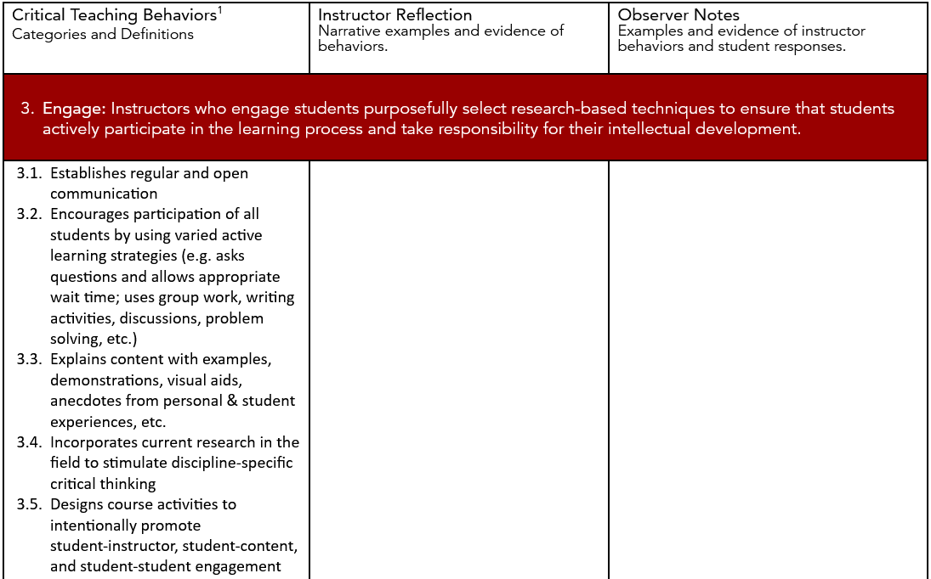

Self-reflection using CTB
Table from Critical Teaching Behaviors Observation Report
(Lauren Barbeau and Claudia Cornejo Happel, 2021)
Notes:
Self-reflection is incorporated into the peer observation materials provided in the book. This is an example from the Observation Report—it’s a portion of the section on Engage. It copies the definition and examples from the CTB framework and then provides space for the instructor to write narrative examples and evidence of behaviors, related to the sample behaviors listed. The observer also uses the framework to frame their observations.
What really resonated with us was that CTB is designed for reflection and conversation, not evaluation.

Slide 19
Benefits for peer observation
Worksheets and reports included in the book
Note-taking instrument available
Self-reflection part of the process
Observations include the instructor, the students, and the environment
Summative report broken down by CTB categories
Specific examples of strengths and actionable steps for growth
(we still feel like this though)
Notes:
[Animation] The CTB framework was designed to support peer observation, and numerous worksheets and templates are included in the book. Additional materials, including a note taking instrument, are available by request via the CTB website.
As we saw on the last slide, self-reflection is part of the process.
The observer takes notes on the instructor, the students, and the classroom environment (like, was it cold? Was it noisy? Was the seating awkward?)
The summative report is broken down into five CTB categories (align, include, engage, assess, and integrate technology), and it encourages recording specific examples of strengths and actionable steps for growth.
[click1] We are still not ready to jump in.

Slide 20
Our approach to peer observation
Building trust and comfort
  Informal conversations
  Instruction retreats
  Ride-alongs
  Teaching skills workshops
Starting with self-reflection first
  Buddy system
Going from this
to this
Notes:
[Animation] We’re taking an incremental approach, designed to build trust and improve comfort levels.
I’ve already mentioned the informal conversations and the instruction retreats. We have also encouraged informal classroom visits, or “ride‑alongs,” which give the instructor a chance to experience having a colleague in their classroom, while their colleagues have the chance to experience being an outside observer without the pressure of taking notes for a formal observation. This has the added benefit of allowing all of us to see more examples of good teaching in action.
We have scheduled a series of workshops highlighting different teaching skills, such as active learning techniques.
As another interim step toward peer observation, we will start with self‑reflection using our adapted CTB language, and like the ride-alongs, we will encourage folks to reflect with a partner – we’re calling this the “buddy system.”
By the time we move toward formal peer observation, librarians will already have the vocabulary and trust needed to make it productive. [click1, click2]

Slide 21

Benefits for instruction leaders
Using CTB can help you
  Define what effective teaching looks like
  Establish the evidence that will document good teaching
  Collect examples and encourage sharing
  Promote structured self-reflection
  Use a structured approach for observation
Notes:
To summarize, using CTB offers many benefits to you, the instruction leader.
I would be curious to hear from you, so we will close with a think-pair-share.

Slide 22
Audience input
How do you define good teaching?
How do you apply best teaching practices in your instruction leadership?
Think. Pair. Share. Report back.

Slide 23
Thank you!
Marlee Dorn Givens
marlee.givens@library.gatech.edu

