Slide 1

Unlocking Library Literacy:
A Gamified Badging Experience
Shapiro Library Content Team:
Shana Chartier, Director of Information Literacy
Alley Lindner, Content Creation Specialist
Emily Bliss-Zaks, Content Creation Specialist
Notes:
Shana: Hi everyone, thank you for attending this session today! We are excited to talk about our badge design process using LibWizard. My name is Shana, one of our Information Literacy Directors at Southern New Hampshire University, and I am presenting with my colleagues Emily and Alley, who are Library Content Creation Specialists. We are part of a team at Southern New Hampshire University’s Shapiro Library that is focused on both maintaining the library’s existing digital learning objects and creating new information literacy content and digital learning objects in a variety of styles—from videos to interactive tutorials to research guides.

Slide 2
Thank you to the other members of the Content Team!
BethMarie Gooding, Director of Information Literacy
Elaina Fisher, Manager of Information Literacy
Notes:
Shana: We wanted to start by shouting out and thanking the members of our Content Creation Team who are not presenting today, but were key parts of this design process—so shout out to Beth and Elaina for all of your work on these badges!

Slide 3
The Task: Find a way to serve over 200k students with less than ten librarians and a grading-free approach
The Ask: Find a scalable solution
Notes:
Shana: Our task last fall was to create a more interactive, engaging form of library badging that allowed for participatory learning, giving students more agency in the learning process. Updated university badge policy also prohibited the use of a grading scale for badges, so we needed to revise the assessment piece of the badges as well. We knew that we could remix a lot of the digital learning objects we had created into badge content, but the removal of grading presented a bit of a problem.
Because we serve over 200,000 online learners, we needed a strategy that would allow for an asynchronous, automated form of evaluation since we do not have the staff to individually evaluate each badge submission.

Slide 4
A Gamified Approach
  users navigate through a narrative
  successful completion of tasks advances the user to the next section
Notes:
Alley: This is how we ended up adopting a gamified approach to badging. A gamified format does not use grades or require individual evaluations by library staff—users “win” the game by successfully navigating to the end of a scenario. In our badges, we create narrative scenarios where a user is assigned a role to play and has to complete a series of tasks by answering questions. Users have unlimited attempts to answer each question, but must eventually get every question correct in order to keep moving forward in the game.
LibWizard was an ideal platform for this project because of the question settings that require correct answers to move forward, the ability to embed video content, and the recent additions of clickable flashing hotspots, which create a game-like environment.

Slide 5


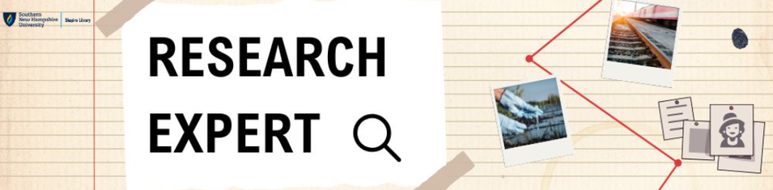

Introducing: The Badges!
library resource navigation skills in an escape room format
information literacy skills in a mystery narrative format
citation and academic research skills in a mystery narrative format
Notes:
Alley: Before we get into the design process for the badges, I’m going to give brief overviews of a few of our existing badges, to give you all a better idea of the format:
Library Navigator: The Library Navigator badge is in an escape room format—at the start of the scenario, the user is “trapped” in a spooky library and must solve puzzles involving library tools to escape. This badge introduces learners to the library website and various library search tools.
Expert Evaluator: The Expert Evaluator badge is an information literacy badge that uses a mystery narrative format in which the user plays the role of an investigator looking into a fictional local factory fire. Users encounter AI generated images, social media posts, and newspaper articles from a variety of characters including a local businessman, a conspiracy theorist podcaster, and a factory employee that they must evaluate using the frameworks of SIFT and CCOW.
Research Expert 1 & 2: These badges were adapted from the mystery narrative structure introduced in Expert Evaluator and created a new storyline where learners take on the role of a reporter at the fictional Riverbend Chronicle, investigating a fictional corporation. Guided by their editor, Veronica, learners complete realistic, story-driven research tasks that reflect key phases of the academic research process.
I’m going to hand things over to Emily to talk about our approach to creating these badges!

Slide 6
Creating the Badges:
Process & Timeline
  Drafted content & adapted existing content from DLO
  Tool: Used ChatGPT to generate story elements, characters, and outlining
  Tools: Used Interactive LibWizard, Camtasia & Vyond for videos, Audiate & Vyond for audio
  Added content, Canva slides, quiz questions, and multimedia
Final Edits and Launch
Draft
Build
Plan
Design
Review
  Integrated feedback
  Launched on website and in badging system
  Promoted badge
  Mapped learning goals
  Mapped story concept
  Mapped existing DLO for remixing
  Tool: Used Canva for slide design
  Detective mystery theme
  Peer feedback
  Student feedback
  Internal accessibility review
Time to complete process for each badge: 3-4 months
Notes:
Emily: This slide outlines our general badge creation process, which we’ll walk through in more detail shortly. At a high level, our workflow moved through five phases: planning, drafting, design, build, and review and launch.
Each badge took about three to four months to complete. We began developing the series in fall 2024 and finished the final badge in the series the following May.
Each badge contains about 35 slides and includes 15–30 embedded quiz questions, along with an opportunity for students to provide feedback at the end. They are designed to take about 45 minutes to an hour to complete and include a mix of text callouts, clickable hotspots, videos, and optional audio to support different learning preferences.
For the platform, we used the interactive version of LibWizard to build and host the badge content, while our university uses the badging system Parchment to officially award the badges. When students complete a tutorial in LibWizard, we receive an email notification. We then share the list of students who completed the badge with our university’s badge team, and they officially award the badges through Parchment.
We used several tools in addition to libwizard to build our badges, including ChatGPT, Canva, Camtasia, Audiate, and Vyond. Next, we’ll take a closer look at each phase of the process and how we incorporated these tools along the way.

Slide 7

Badge Development: Planning Stage
Establish learning goals
Fit story concept to learning goals
Story Format: Escape Room, Mystery, Employment Scenario, etc.
Mapped to ACRL Information Literacy Framework
Measurable via completion of “tasks” (e.g. locating a title in the online library collection or evaluating a source with the CCOW framework)
Mapped existing digital learning objects for remixing
Notes:
Emily: In the planning phase, we drafted measurable learning goals informed by the ACRL Information Literacy Framework, and organized them across the four badges based on related information literacy concepts.
We also reviewed digital learning objects our team had already created, such as videos, infographics, and tutorials, to identify content we could reuse or adapt rather than starting from scratch.
Each badge was also paired with a story concept that aligned with its learning goals, which Alley previously mentioned. These narrative formats helped us shape how students would engage with the content. Alley will talk in more detail about this later in the presentation.
I will pass it over to Alley to talk about how we used ChatGPT in our design process.

Slide 8
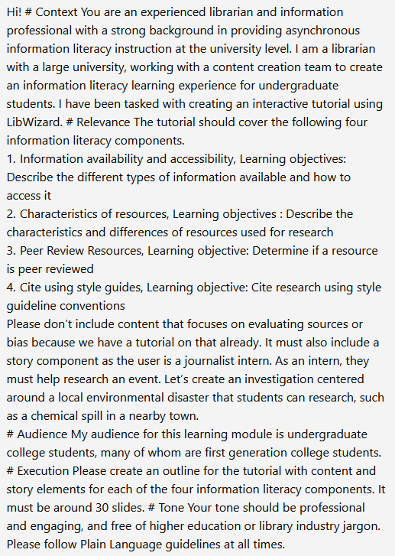
Draft: ChatGPT & AI Support
ChatGPT Prompt
  Used ChatGPT to generate storyline & outline
  Clear structure + AI support helped keep a unified voice
Notes:
Alley: As part of our design process, we used ChatGPT to come up with narrative scenarios that fit our specifications—while the AI generated outlines ChatGPT developed were not the final versions of our badge narratives, they were a helpful starting point. We also used ChatGPT for a variety of other purposes throughout the design process—some examples are: to make text more concise, to generate short mock newspaper articles on fictional scenarios, and to draft fictional social media posts. We used ChatGPT and OpenArt AI to create images both for students to evaluate for AI involvement and to provide backdrops for some of the slides.
We found that ChatGPT was a helpful tool for maintaining consistency—Expert Evaluator was created before Research Expert 1 and 2, so the team creating Research Expert 1 and 2 included the Expert Evaluator badge scenario in their detailed ChatGPT prompt to keep the storyline connected across badges. Part of this prompt is included on this slide. ChatGPT was also helpful in standardizing the language of the Library Navigator Escape Room clues and puzzles to sound cohesive and consistent.

Slide 9
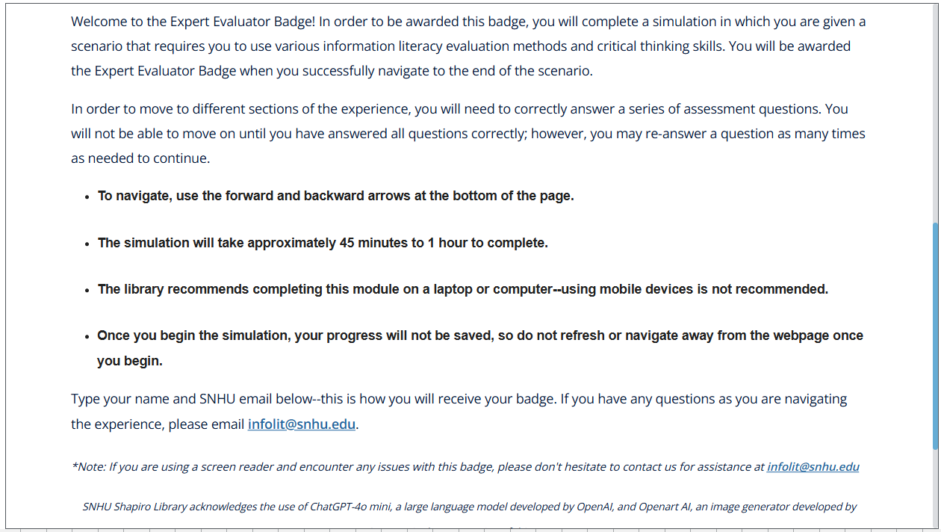
Design & Build: Clear Instructions
one section of the Expert Evaluator “Welcome” slide:
Notes:
Alley: A key piece of the design process was to use the “Welcome” slide LibWizard provides at the start of a badge module to include very clear instructions. All of our badges include the following on the welcome slide: clarification about what is required to earn the badge, an explanation of the structure of the questions (unlimited attempts, but users must get the correct answer to continue), the estimated time it may take to complete the badge, instructions for saving progress on the module, and a strong recommendation to complete the badge on a laptop or computer as our visuals are not as compatible with mobile devices.
This set of clear instructions was developed as we considered potential areas of confusion for students.

Slide 10
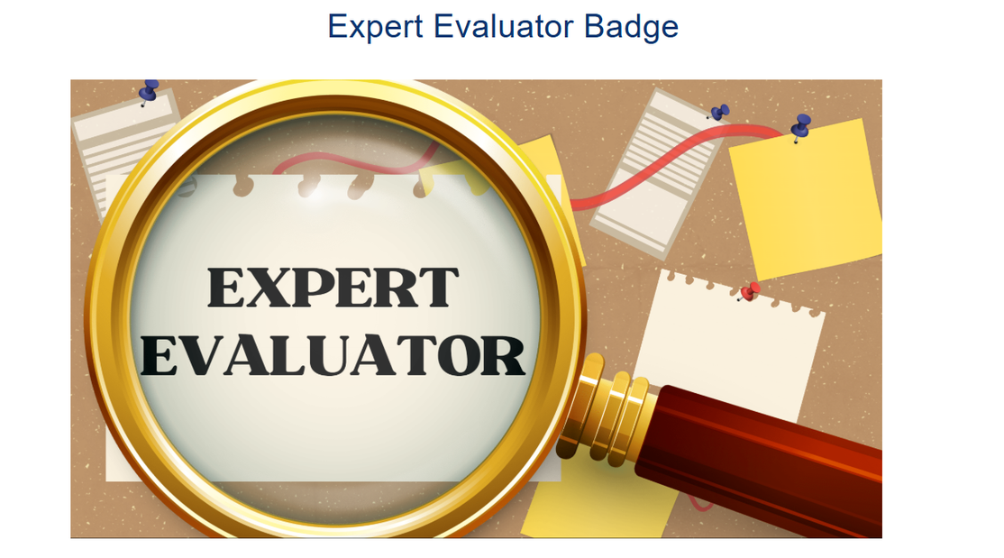
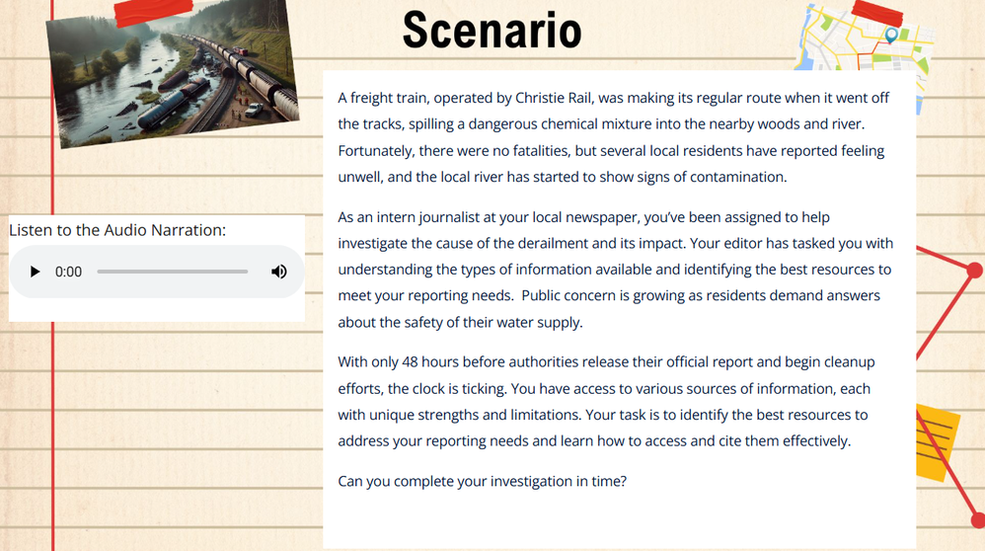
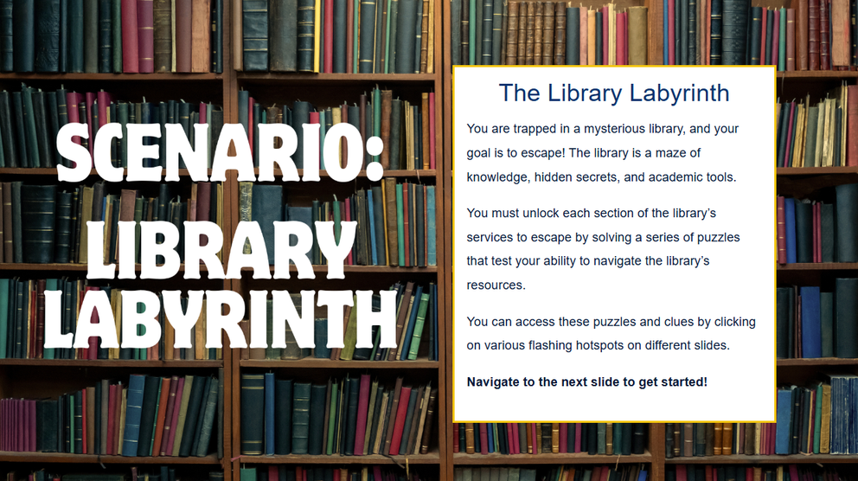
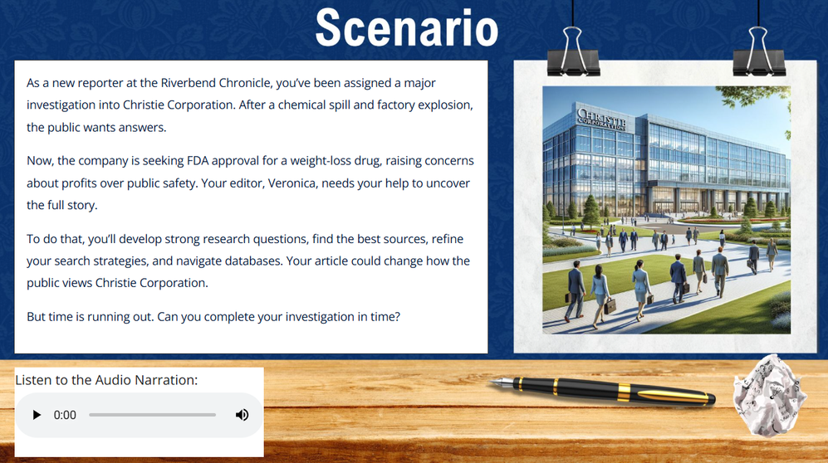
Design & Build: Canva Backdrops
Notes:
Alley: To make all of the badges feel visually engaging, we used Canva to create slide backdrops that we imported into LibWizard as image backgrounds. We looked for Canva templates that would meet accessibility standards with strong contrasts and clean, simple layouts. The Library Navigator badge has a gothic library visual theme, and the other three badges all use variations of a detective-themed, bulletin board or desk style—all of these styles are included on this slide.
We then uploaded the Canva slides into LibWizard as visual backgrounds and added all instructional content using the interactive callouts and hotspots in LibWizard. Adding all instructional content in LibWizard addressed some of our accessibility concerns—adding text in LibWizard seemed to be better for screen readers than having extensive alt text for Canva images containing text. The Canva slides function as image backdrops, not as vehicles for conveying key information.
I’ll hand things back to Emily to talk about incorporating infographics!

Slide 11
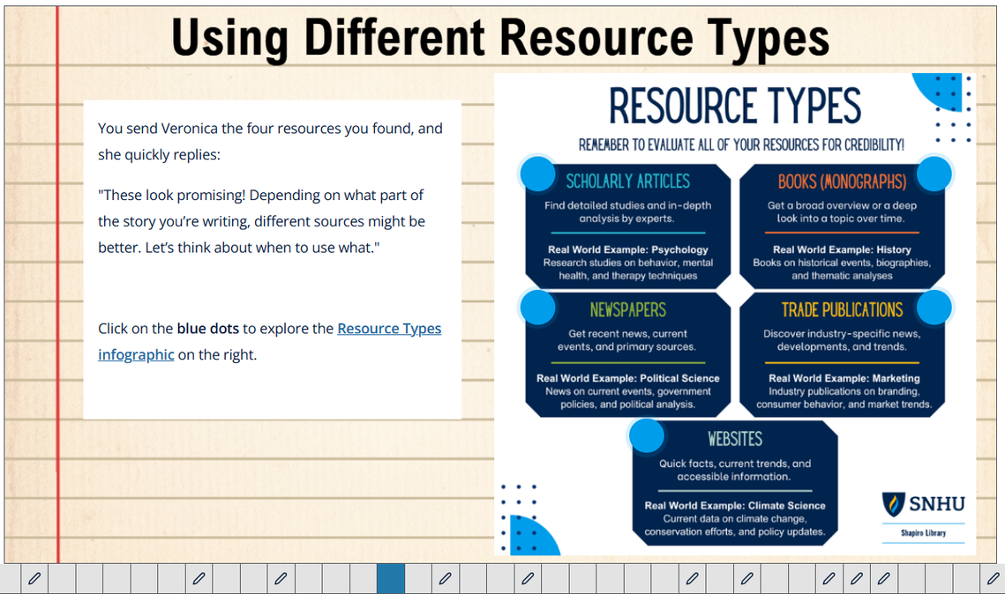
Design & Build:
Embedding Infographics in LibWizards
  Focus on reducing text within graphics or include a link to a PDF
  Use hotspots and callouts in LibWizard to highlight key content from infographic
  Keep slide alt text clear and concise
Notes:
Emily: In addition to the slide backgrounds, we also incorporated previously made infographics to reinforce key concepts. And when possible, we framed them within the story.
For example, having our editor character Veronica send an infographic to the user as part of the investigation.
Our internal accessibility review also gave us helpful feedback about how to make these infographics more accessible within LibWizard.
As Alley mentioned previously, avoid embedding infographics with dense text directly onto slides, as screen readers cannot read the text within images or graphics created in tools like Canva.
If you want to use an infographic, consider adapting it or including a link to a separate PDF version so it’s fully accessible.
Or, use LibWizard’s hotspots or callouts to share the content of the infographic so the text is readable via screen readers. One of our slides shows this approach-hotspots are layered over the image to present key information and related instructional content. We also included a link to the full PDF.
This approach also helps keep the slide alt text concise and user-friendly, since the key information is already presented in the hotspots rather than embedded in the image.

Slide 12
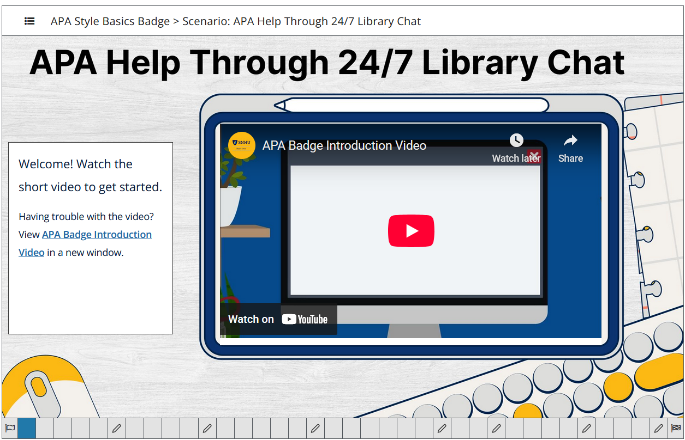
Design & Build: Videos
Preferred embedded video option:
  Consistent visual design
  Shortens length of badge
  Allowed text + backup link
Notes:
Emily: In addition to static visuals, we also incorporated short videos to further support learner engagement and reinforce key concepts.
Each of our badges includes around 3 to 4 videos, each approximately under three minutes long. We created these videos in Camtasia while some of our newer badges include animated videos we created in the software Vyond.
The interactive LibWizard offers flexible options for embedding videos—either as a standalone slide or embedding it in a slide using the media widget. After testing both options, we found that embedding videos within slides worked best for our design goals.
This method gave us greater layout control, passed our internal accessibility review, and allowed us to pair videos with supporting text and a direct link to the video.
Providing the link on the slide proved especially helpful in cases where playback was disrupted, offering students a seamless alternative viewing option. On the slide is an example of what an embedded media widget looks like.

Slide 13
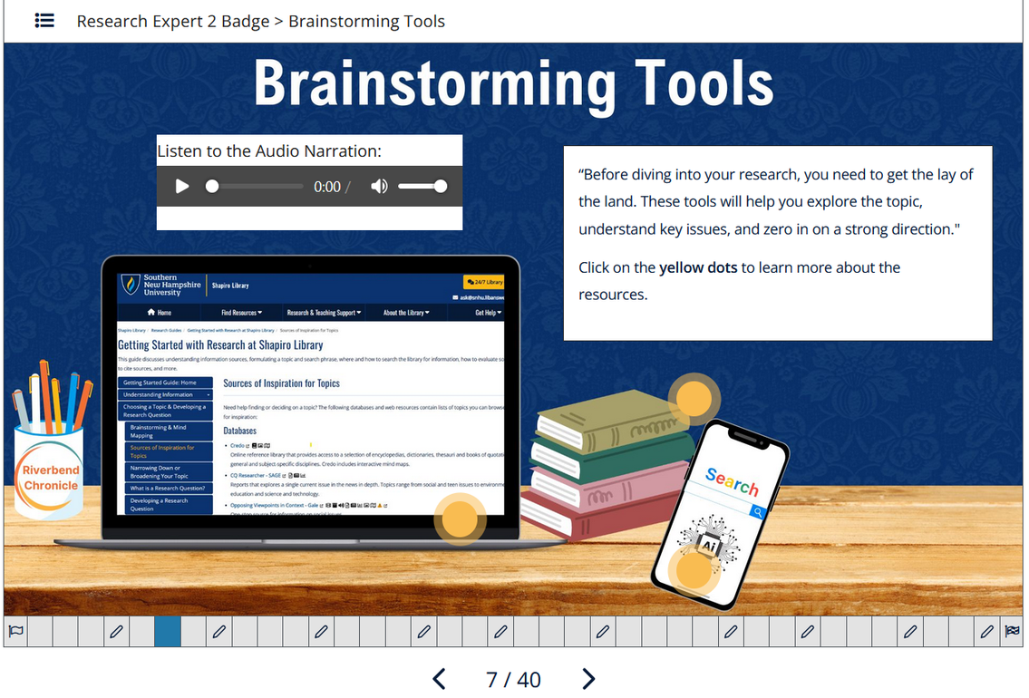
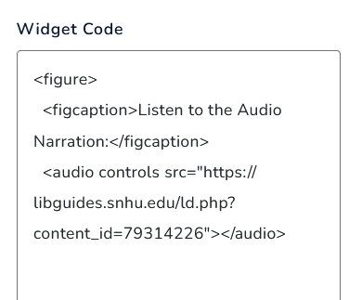
Design & Build: Audio Narration
Goal: Add optional audio for engagement and accessibility
  Created a custom widget using HTML
  Used Audiate + AI voice
  Hosted audio in LibGuides
Notes:
Emily: After completing the Expert Evaluator badge, we wanted to expand our use of multimedia by adding optional audio narration—especially on slides with character dialogue.
This also gave us a way to support learners who benefit from listening alongside reading and to deepen engagement with the content.
While LibWizard doesn’t currently include a built-in audio widget, it does support custom HTML in the widget feature, which allows us to add audio. We used a simple HTML workaround (code shown on screen) to embed narration on slides where our character, Veronica, “speaks” directly to the learner—bringing her voice to life and adding another layer of engagement.
We used Audiate, which is part of the Camtasia suite, to generate natural-sounding AI narration for Veronica, making it faster and easier to produce and update audio.
To host the MP3 files, we uploaded them to a LibGuide, which generated direct URLs we could insert into the custom HTML widget code.
This method worked well for our team, though Springshare storage capacity may vary by institution. In our case, we only needed a few audio files, which fit comfortably within our available space.

Slide 14
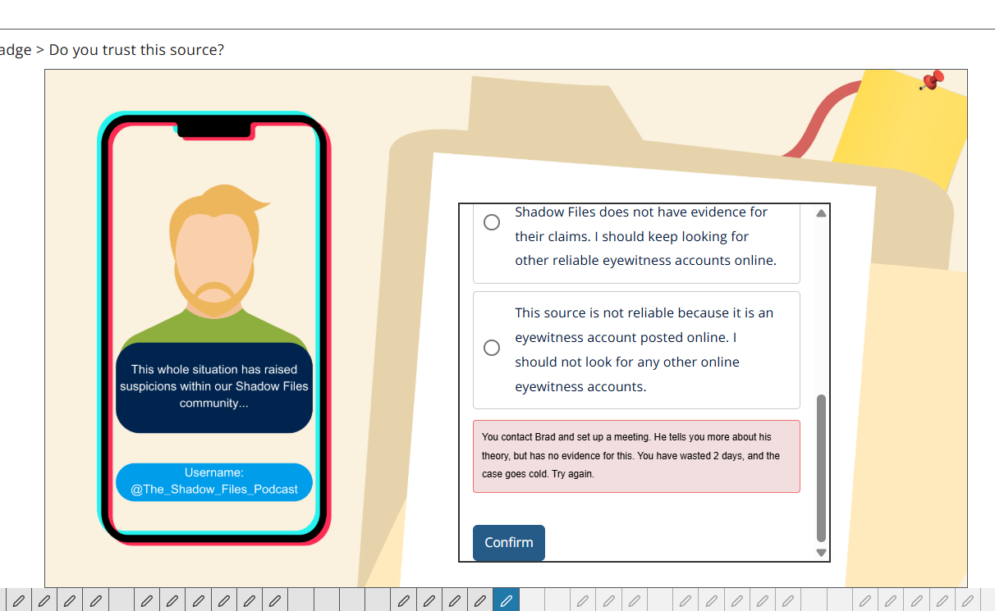
Design & Build: Quiz Design
  Used Multiple Choice and Select All That Apply for automated grading
  Integrated correct/incorrect feedback and hints using LibWizard’s built-in tools
  Used LibWizard's quiz block to group multiple questions on one slide
Notes:
Emily: Another key part of the learner experience was how we designed the quiz questions. Most questions were formatted as multiple choice or “Choose all that apply” to keep grading automated. As mentioned earlier, users have to select the correct answer in order to move forward, but they get unlimited attempts to get it correct.
We also aimed to make the questions advance the narrative, helping users feel like they were solving a larger mystery rather than simply completing a quiz.
For example, we used the correct/incorrect option in the quiz settings to reinforce both learning and story immersion. On the slide is an incorrect response feedback example from Expert Evaluator when a student chooses to trust an unreliable source.
The feedback reads: “You contact Brad and set up a meeting. He tells you more about his theory, but has no evidence. You have wasted 2 days and the case goes cold. Try again!”
In terms of how the questions were presented, we used LibWizard’s quiz functionality to streamline the experience. Instead of showing one question per slide, we grouped multiple questions on a single slide when appropriate. This made the tutorial feel more concise and approachable for students, while still preserving the narrative flow.

Slide 15
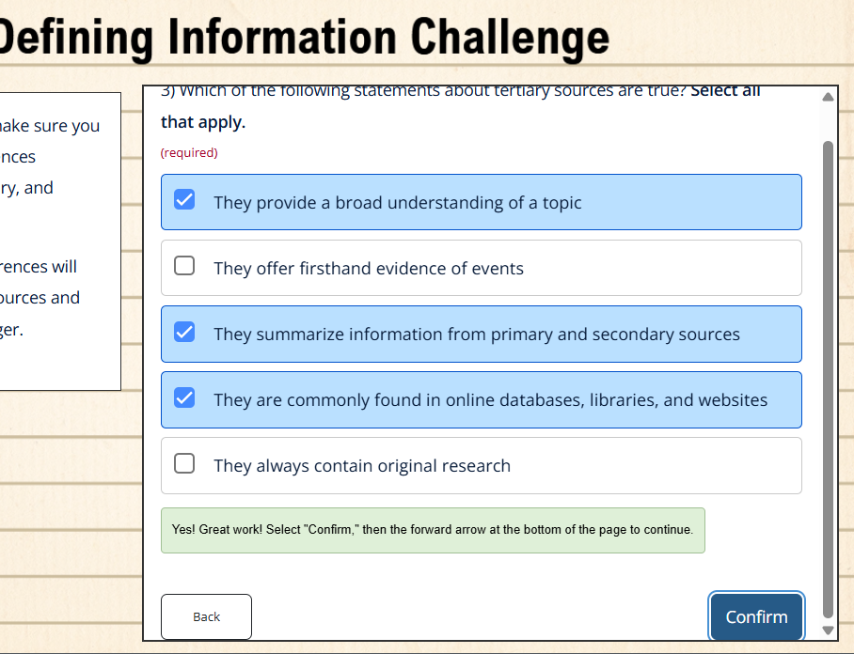
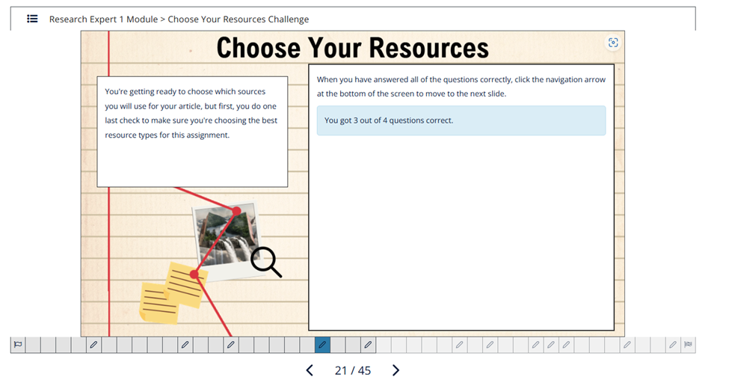
Quiz Design Considerations
Notes:
Emily: One common piece of feedback from students, our UX team, and our own testing is related to the extra click required after submitting a quiz response.
Users must click Confirm or Next again after seeing the feedback to proceed. The extra click is tied to our use of the correct/incorrect option in the quiz answer properties, which we use to support our gamified approach.
As shown in the screenshot on the left, this additional click can feel redundant and slightly disrupt the pacing of the tutorial. Though it is a required step when you use the correct/incorrect message option.
LibWizard also automatically displays a quiz summary message after all questions in a section have been answered. This message includes both a score summary (e.g., “You got 3 out of 4 correct”) and a reminder that selecting the correct answer allows users to proceed. This message is shown in the image on the right. Since our badges already require correct responses to proceed, this message can feel repetitive and/or confuse students in our context.
Currently, there is a system-level setting available to adjust the message, but any changes made there would apply to all our tutorials in LibWizard, which isn't ideal for our specific needs.
We have submitted a feature request with Springshare for this, but for a workaround, we’ve added a clarifying note within the correct-response feedback area that says “Select confirm again to move forward” to help reduce confusion. You can see that message highlighted in green on the left side of the slide.

Slide 16
Review and Launch
Internal review (team review & UX Accessibility review)
Revisions, student testing, & more revisions
initial module results/scores and qualitative-based student feedback survey
Design process complete & badge is ready to go live!
7. Public launch & promotion
Notes:
Emily: Once we completed the design and build stages, we shifted focus to reviewing and refining the badges.
Our team members each completed one another’s badge and shared feedback, and our internal UX team also reviewed the tutorials with a focus on accessibility.
Based on that input, we made a series of final edits.
We also did a round of student testing where students took the module and filled out a survey—we’ll talk more about that process later in the presentation. After making more edits based on student feedback, the badges were ready to go live!

Slide 17
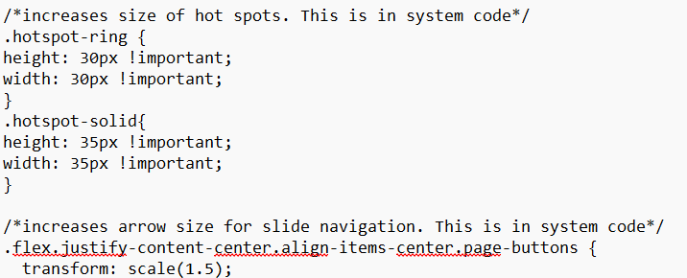
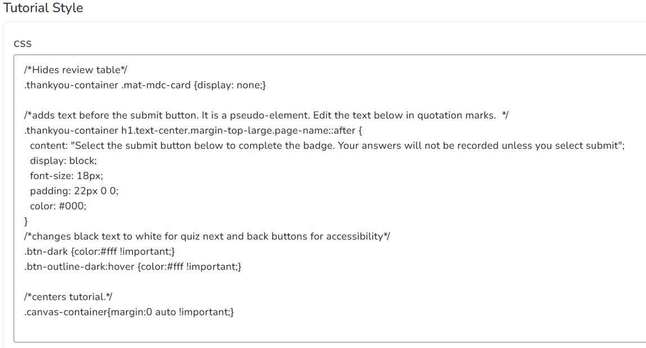


CSS Customizations
Custom CSS:
  Increased hotspot and arrow sizes
  Changed color for quiz buttons
  Hid quiz review table & added thank-you message
  Re-centered tutorials over 35 slides
Shared Code:
  All CSS is stored in SharePoint for easy access
  Added notes above code so non-coders would understand CSS changes
Notes:
Emily: Building on the feedback we received, we implemented several CSS customizations to better support our specific design goals.
LibWizard’s support for custom CSS gave us the flexibility to make these targeted adjustments at both the system and tutorial levels.
At the system level in LibWizard, we adjusted the size of hotspots and navigation arrows to improve usability across all tutorials. Within each tutorial, we added custom CSS through the Look & Feel settings.
A few examples include which are on the slide:
Adjusting quiz button color contrast to align with accessibility standards and our branding.
Because students aren’t receiving a grade, we chose to hide the default quiz review table that appears at the end and replaced it with a brief thank-you message to reduce confusion and simplify the final slide design.
Re-centered the overall LibWizard tutorial on the screen. Whenever our tutorials had more than around 35 slides, they didn't stay centered for us anymore.
To ensure consistency across future projects, we maintain a centralized SharePoint file with our CSS customizations. Each snippet includes comments that explain its function, making it easy for any team member, regardless of coding experience, to understand and reuse the code in future projects.
I will pass it over to Alley to talk more about our story concepts in more detail.

Slide 18
Merging Story Concepts & LibWizard Features
Notes:
Alley: I'm going to walk through how we merged different story concepts with LibWizard features.

Slide 19
Different Story Scenarios
Investigative/Mystery Scenario
  Expert Evaluator
  Research Expert 1 and 2
Digital Scavenger Hunt
  Shapiro Library Orientation
Employment Scenario
  Source Type Specialist
  Company Research Strategist
Academic Narrative Scenario
  APA Style Basics
Escape Room
  Library Navigator
Notes:
Alley: For the story concepts for our badges, we’ve used a range of different scenarios. Our information literacy badge and research skills badges use investigative/mystery scenarios. Our orientation badge is a digital take on the library orientation scavenger hunt. Our source types badge and business database badge both use employment scenarios, where users work for either a fictional museum or a corporation. Our APA badge is an academic narrative scenario. And for our library navigator badge, we use an escape room format.
The key in choosing a story concept for a badge was mapping our learning goals: we found that there were different story ideas that fit better with different goals. For instance, the Library Navigator Badge’s goals mostly involved straightforward skills like identifying the Interlibrary Loan Form or using the Publication Finder, so we felt like the best way to gamify this was to use an Escape Room format with basic library website-related puzzles and tasks. However, we used a more narrative, mystery style format for the badges: Expert Evaluator and Research Expert 1 and 2 as these badges involved more nuanced critical thinking and evaluation skills, so we felt like a mystery-narrative format would allow for more complex evaluation since we could create fictional characters, news stories, and social media posts for users to engage with.
I’m going to discuss three aspects of our story concepts more in depth to give an idea of how we pull together narrative elements and Springshare features.

Slide 20
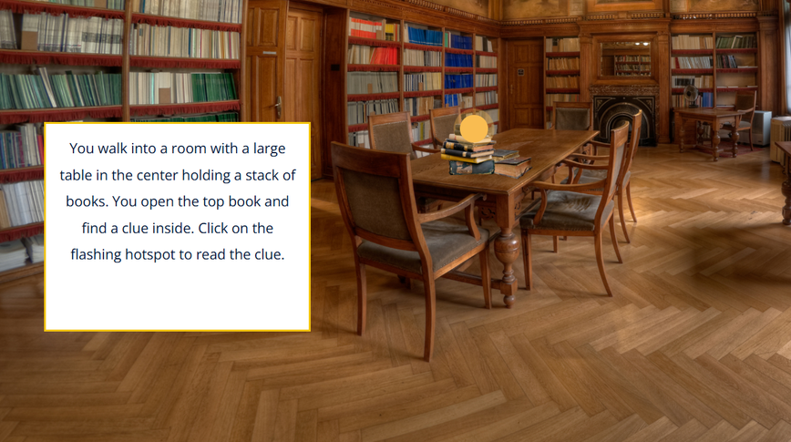
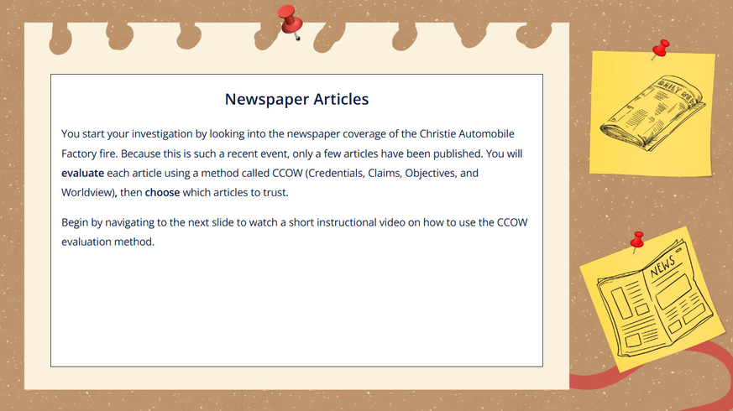
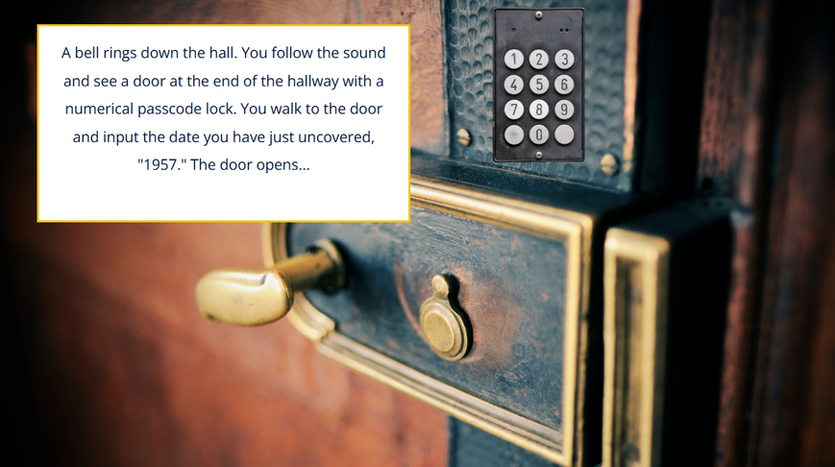
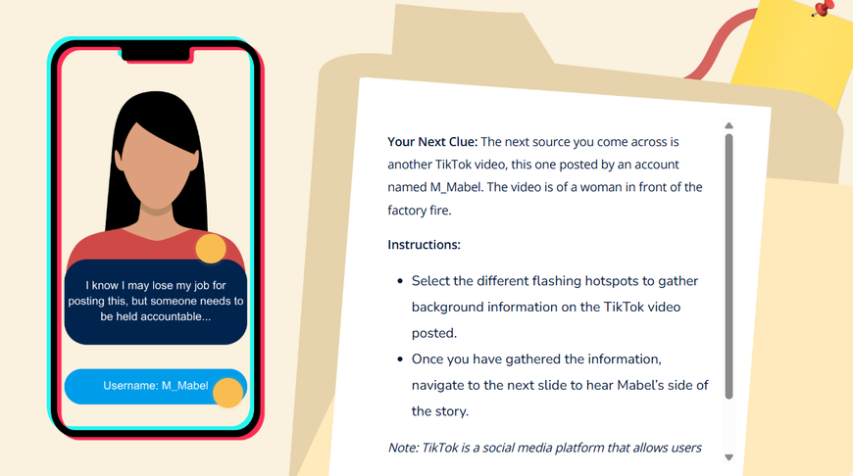
Organizing Badge Scenarios into Levels
Library Navigator
Expert Evaluator
Notes:
Alley: The first thing I’m going to highlight is organizing badges by level. To make the badges feel like games, not quizzes, we try to organize them into different “levels” so that the user feels like they are progressing through a narrative experience. For example, in our escape room badge, Library Navigator, those levels are movement based: solving puzzles allows you to move to different rooms, which again were created using Canva. I’ve included some images of the rooms in this badge on this slide.
These “levels” look a bit different in each badge. For example, in our information literacy badge, Expert Evaluator, the user role plays as an investigator looking into the cause of a mysterious factory fire, and the different levels of game play are based on source type and source evaluation method. So, in Round One, users evaluate newspaper articles using the CCOW method, and in Round Two, users evaluate social media posts using the SIFT method.

Slide 21
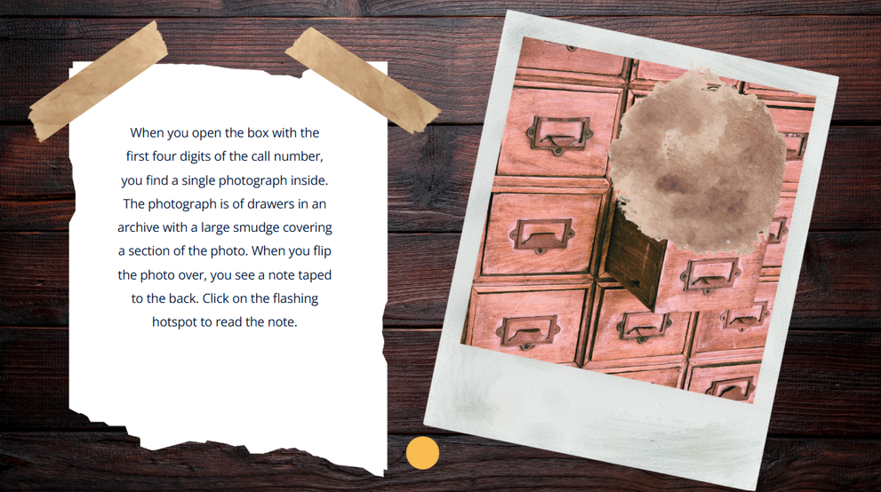
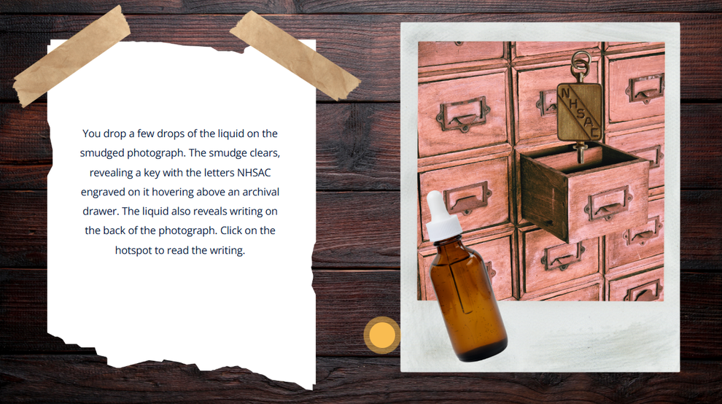
Clickable Hotspots
  Hotspots can reveal “hidden” information, giving agency to the user.
  Using hotspots can enable more complicated role playing actions.
user completes tasks that lead them to a bottle of liquid
Notes:
Alley: Next, I’m going to spotlight the clickable hotspots. The interactive hotspots that LibWizard features really helped us make this whole experience feel more gamelike. In the interactive format of LibWizard, there are flashing hotspots that users can click on and little boxes of text appear. In the Library Navigator Badge, I used the flashing hotspots mostly to make users feel more active. The actual actions users can perform in this tutorial are limited: they can click on hotspots, answer multiple choice questions, and sometimes type in a bit of text. But I wanted to make the users feel like they were performing more complicated tasks like you would in a physical escape room, so I used the hotspots to “reveal” different pieces of information (you click on the hotspots to read hidden clues) and I included role play descriptions.
I have included an example of this on this slide in which the user finds a smudged photograph, then completes a task to find a hidden drawer with a bottle of liquid that clears the smudge, with hotspots revealing directions and information.

Slide 22
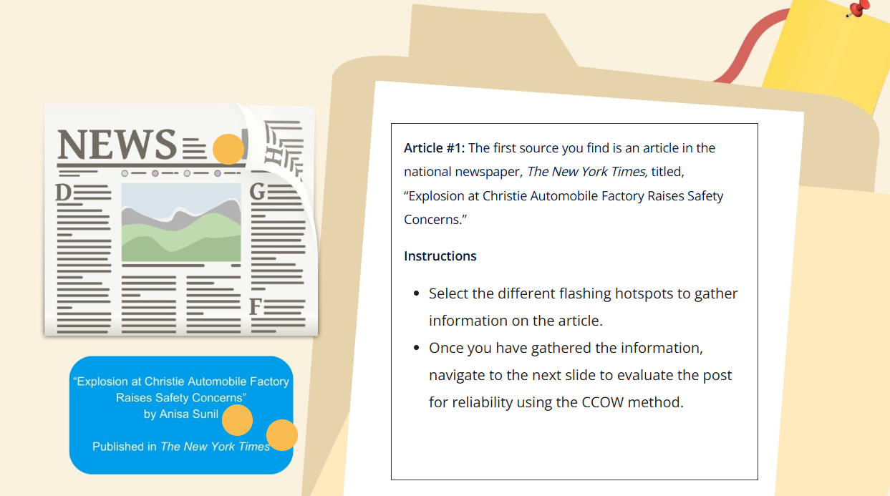
Clickable Hotspots
  Hotspots enable separation of text into smaller sections.
  This is ideal for more complicated source types and evaluation scenarios.
Notes:
Alley: The hotspots are also very helpful when it comes to dividing up information into more bite sized chunks that can be processed more easily. In our more narrative badges like our information literacy badge, Expert Evaluator, we incorporated fictional characters, news stories, and social media posts, which means that we had a lot of text that we needed to communicate.
The clickable hotspots were a really helpful way to include all of this text without just having three straight paragraphs written on a slide. In the slide I have pulled up from Expert Evaluator right now, I used the hotspot format to have users encounter different parts of a character or a situation: so in the image on this slide, you have the reporter’s biography, publisher overview, and mock newspaper article all in different hotspots.

Slide 23
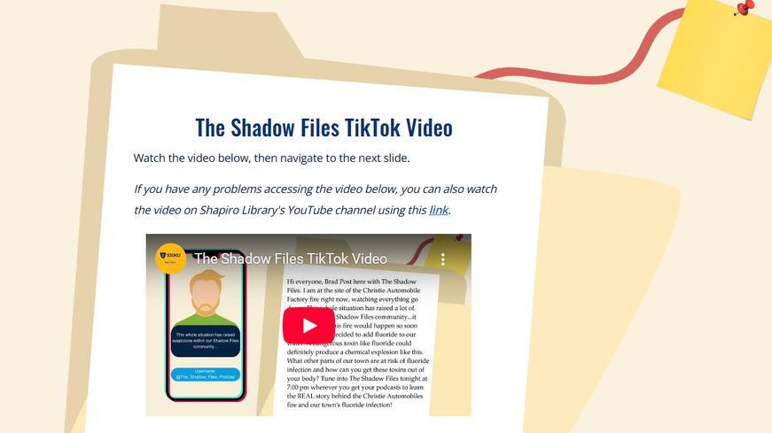
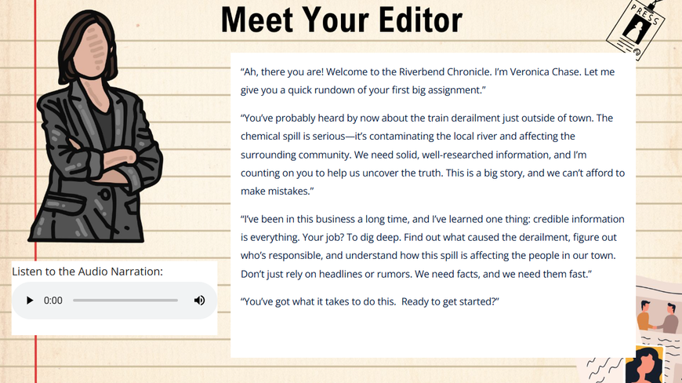
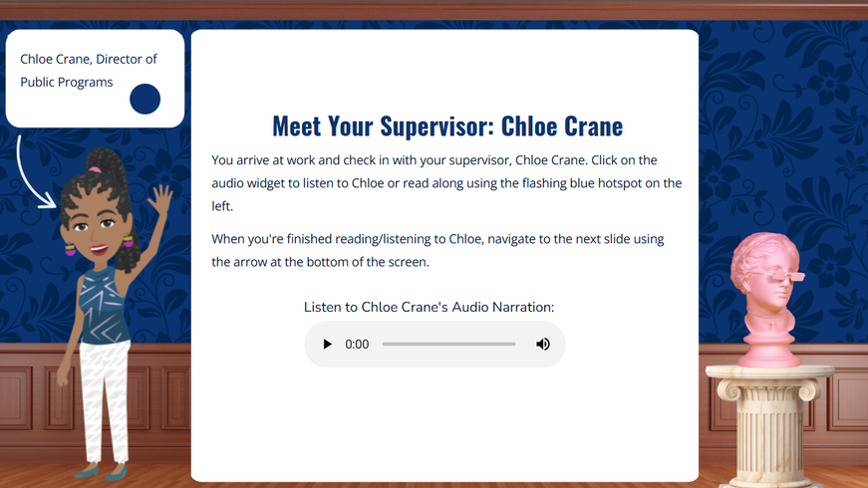
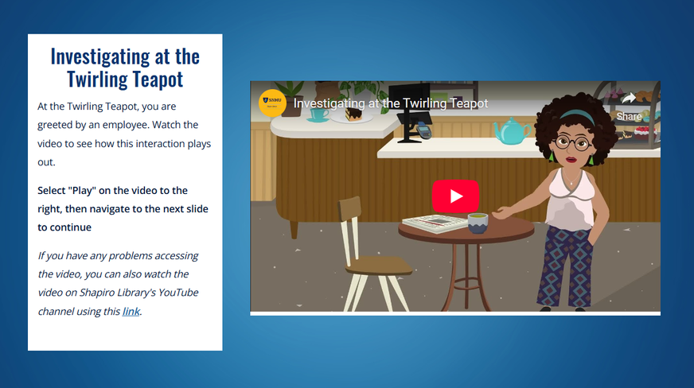
Character Development
Expert Evaluator
Research Expert 1
Source Type Specialist
Shapiro Library Orientation
Notes:
Alley: The third feature I’m going to walk through is character development. A really helpful way to gamify these badge experiences is to add in characters. We were able to use a few LibWizard features for different methods of character development.
In some of our early badges, we created images of characters in Canva that we could import into LibWizard—we used a faceless, animated style so that we did not have to coordinate mouth movements with speaking. In Expert Evaluator, we embedded short videos of our animated characters overlaid with members of our library staff voice acting that character’s fake TikTok videos or social media posts. So in this Expert Evaluator image on this slide, we have our animated character, Brad Post, who is a conspiracy theorist podcaster, he is voiced by our AVP of Library Content Creation, and we include a script of what is being spoken in the video as well.
In Research Expert 1 and 2, we added custom CSS code to create audio widgets as Emily discussed previously, and used a female AI voice to bring the main character’s editor, Veronica Chase to life—she is pictured in the Research Expert 1 image on this slide.
In our latest badges, specifically our Source Type Specialist, APA, and Orientation badges, we have used a program called Vyond to create images of characters, audio voiced by AI, and short animated videos that move the narrative forward. We’ve embedded our Vyond items as audio widgets and animated videos in LibWizard. The bottom two images on this slide demonstrate our use of Vyond with the supervisor character of Chloe Crane in Source Type Specialist and a barista that users encounter in their search for clues in our orientation badge. Including these short animated videos has really helped us establish narrative settings and guide users through the badges.
I'm going to hand things back to Shana to talk about gathering student feedback!

Slide 24
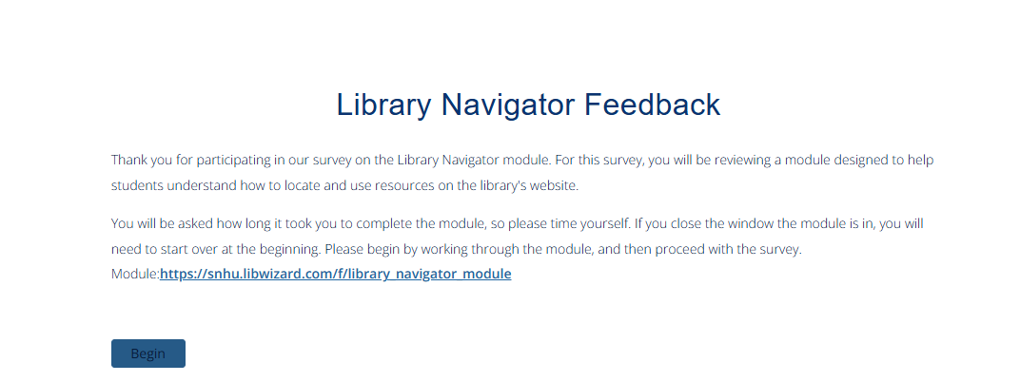
Gathering Feedback
Outreach: Reaching out to student worker managers to recruit for student feedback
  Time it took to complete the module
  Enjoyable elements
  Areas for improvement
  Clarity
  Relevance to coursework and real life scenarios
  Understanding of material covered
Notes:
Shana: As mentioned earlier, feedback played a key role throughout our process. Prior to launching the badges, our leadership team reached out to student worker managers to get buy-in for a round of student testing.
Around ten to twenty students completed each of the badges and provided feedback.
As mentioned earlier, feedback played a key role throughout our process. Prior to launching the badges, our leadership team reached out to student worker managers to get buy-in for a round of student testing.
Around ten to twenty students completed each of the badges and provided feedback. Using LibWizard’s reporting feature, we could see which questions students answered incorrectly on the first attempt—this was helpful in identifying where students were struggling and perhaps which questions needed clearer wording.
We also built individual LibWizard surveys for each badge that students completed in addition to the badge itself. An example is on the slide. The survey asked students: how long the module took to complete, what elements of the module they enjoyed, areas for improvement, areas needing clarity, relevance to coursework and real life scenarios, and understanding of the material.

Slide 25


Student Feedback Highlights
I really liked the story aspect in the way the information was presented, it kept me engaged and mirrored how a real life evaluation would look like.
I like the detective kind of thing to it! It made it more engaging.
I liked how the module was a scenario rather than just presenting the information that's presented. It also had certain engagement styles such as videos, bubbles to click on, and text.
Overall this module was easy to follow and a fun interactive tool to learn how to evaluate resources.
I think this module/study should be completed by every SNHU student.
Yes, I think it adds a certain 'fun-factor' that wouldn't really be present if I were just scrolling through a slideshow and answering quizzes.
This badge has me feeling much better about writing my first term paper. I feel much better prepared to choose the correct sources to support my argument in my persuasive essay.
What a fabulous resource! I wish every student in a program that uses APA were required to go through this badge.
Notes:
Shana: Overall, students found the storyline engaging and enjoyed the interactive format, especially the clickable hotspots. They also felt the content was relevant to their coursework. On the slides are a few quotes we pulled from the feedback. One student said the modules added a “fun factor,” and another said they thought these modules should be required for all SNHU students, which was really great to hear.
Surprisingly, several students reported they preferred reading text over watching videos. All four badge tutorials included multiple videos, each around 3–4 minutes long. We had anticipated that students would want more video content, but their feedback suggested the opposite.
Unsurprisingly, students favored multiple-choice questions over "select all that apply", which they found more challenging. For some of the badges, we also noticed that the overall first-attempt scores on quiz questions were lower than expected. So, for example, in Research Expert 1, the average score on the first attempt was around 63%.
In reviewing the data and student feedback, we realized that some of the questions on all four badges may have had confusing wording, which likely contributed to the lower scores. In response, we revised several questions to improve clarity and strike a better balance between question types.
Research Expert 1 was our first badge that incorporated optional audio in addition to text and videos. The feedback for the optional audio was generally positive. While some students didn’t use the audio, they appreciated having it available to support different learning preferences. Others suggested including audio on every slide. Based on this input, we decided to incorporate more audio options in Research Expert 2 to better support diverse learning needs.
Our badges also have a feedback section built into the end of each module, so I’m sure we will continue to get more feedback as more students encounter the badges and make improvements!

Slide 26
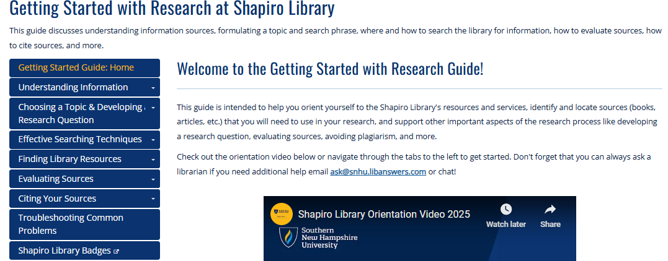
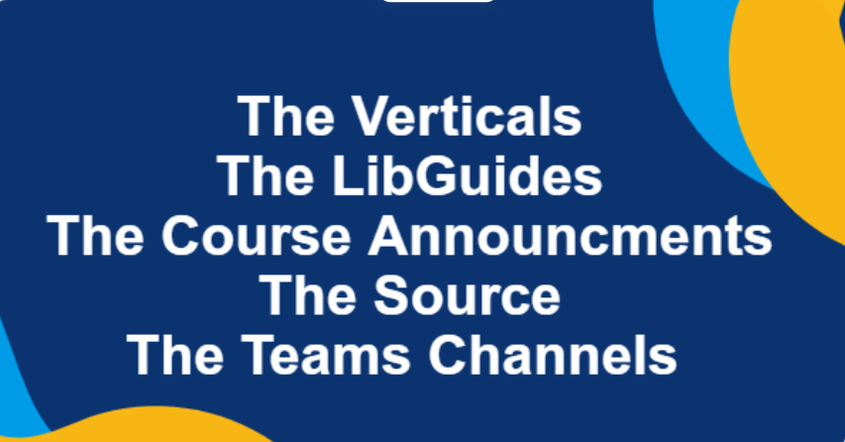




Promoting
Notes:
Shana: After incorporating student feedback and finalizing the badges, our next step was making sure students and faculty could find them. Since the badges are optional, we used multiple university channels to promote them. To reach the faculty, our managers shared these badges at their monthly program Verticals meeting with the program’s leadership. We’ve also featured the badges on The Source, our internal site for SNHU faculty and staff, using the News and Announcements section to raise awareness.
In addition, we took a more direct approach by posting in internal Teams channels. For example, we’ve shared information in The Commons chat, which supports first-year Gen Ed courses, and in the Writing Across the Curriculum/Writing in the Disciplines (WAC/WID) channel for writing-intensive courses.
To help instructors share the badges with students, we partnered with our Center for Online Learning and Teaching to develop ready-to-use course announcements that faculty can post directly in their courses.
Within the library, we focused on making the badges visible and easy to access by creating a dedicated LibGuide and adding the guide as a redirect page to several high-use guides, including the Getting Started with Research guide, which is integrated into many of our courses.
So far, we’ve awarded around 200 badges across all four tutorials, a number we expect to grow!

Slide 27
Course Implementation: IDS 104
Working with course developers to get the badge into the course in a way that works on a large scale
Notes:
Shana:
By the time we had a number of badges published and being successfully completed, a development project manager reached out asking if they could integrate our Expert Evaluator badge into one of our introductory courses, IDS 104: Information Age Digital Literacy. We were asked to provide a formative assessment that students could complete and then submit a PDF as proof with a date, name and timestamp. A few things happened very quickly. We learned that we had limited seats available for our badges, and anticipated around ten thousand students per term to complete the experience. What we ended up having to do was make a duplicate of the badge and call it an activity. Making that change allowed us to also include a downloadable PDF to submit upon completion, which is not an option with our regular badges (the reward is the badge!). This way we were able to work around those limitations while also reaching thousands of students with key information literacy concepts. We average out around 7500 students per term, and have reached over thirty thousand learners already. I'll pass it over to Alley to talk about the data and feedback collected from this pool.

Slide 28
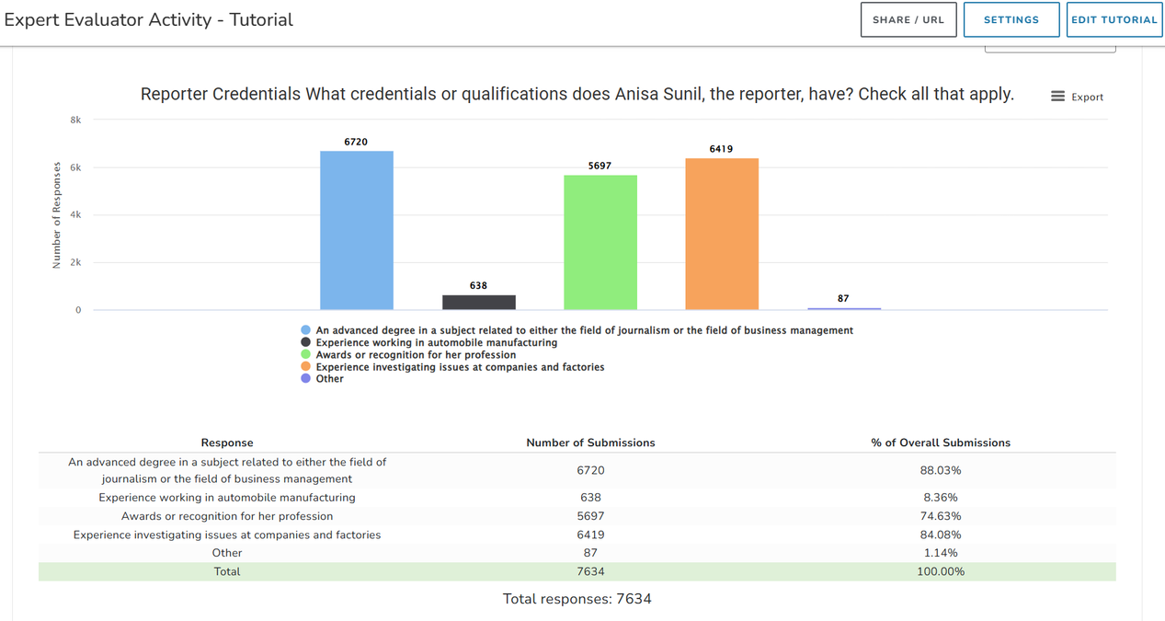
Data and Feedback from IDS 104 Implementation
  Typically between 7,100-8,600 results per submission round
Statistics
  October: 80.97% average and 84.85% median
  December: 81.58% average and 84.85% median
  March: 82.82% average and 87.88% median
  identified most commonly missed questions
Sample Field Analysis for a Question
Notes:
Alley: We have now had 3 rounds of data for the Expert Evaluator Activity in IDS 104 submitted and analyzed. We typically have between 7,100-8,600 results each round, which gives us a lot of data to work with!
We have two types of data to evaluate: the statistics for the tutorial and qualitative feedback through the text submissions in our “activity feedback” slide at the end of the activity.
For our tutorial statistics, we looked at students’ “grades” on their first attempt to answer a question. We were ideally hoping for the average to be between 80 and 90% as that would mean the tutorial was challenging, but not excessively difficult. The averages and medians for our first two rounds of implementation were in range with what we were looking for. We made edits to the tutorial before round 3, and our edits did increase our average from 81.58 to 82.82 and our median from 84.85 to 87.88.
After looking at data from our October and December submissions, we identified the most commonly missed questions (which had answer percentages consistently below 60% in both rounds of submissions). We tried to pinpoint potential issues with each question, sometimes that was a phrase we thought might be unclear to students or a lack of review before questioning. For instance, we added a “recap” slide before one question at the end of the tutorial that required students to recall information from the start of the tutorial.
We also used the Field Analysis feature of LibWizard to try to understand the issues with some of the “Check All that Apply” questions that were consistently incorrectly answered. This feature allows us to see which answers users selected. For example, if users consistently did not identify Option B as a correct answer, then we would look at the wording of Option B to see if we could clarify things a bit.
In between our December and March rounds of implementation, we also edited a section of the activity that deals with analyzing an AI-generated image—we revisit this section whenever we evaluate the tutorial due to the quickly changing nature of AI technology.

Slide 29
Data and Feedback from IDS 104 Implementation
  Text feedback analysis: Customer Experience Insights report and internal Microsoft CoPilot analysis
Executive Summary from Customer Experience Insights Report:
“Across two large datasets (December 2025 and March 2026), learner feedback shows consistently high engagement (~55% explicitly positive), low technical friction (<1–2%), and increasing depth of conceptual reflection over time. March feedback suggests stronger metacognitive engagement with the SIFT framework and credibility evaluation. The activity demonstrates instructional effectiveness with limited UX friction.”
Student Feedback
“The activity helped me understand how to evaluate sources using methods like SIFT and CCOW. It was especially helpful to see how bias, missing evidence, and emotional language can affect a source's reliability.”
“This was a super fun and helpful way to take on the confusing age of digital media we're in! Thank you so much!”
“I loved doing this, it felt like I was in my own detective little world.”
“Honestly a real fun activity and should definitely have more like this.”
Notes:
Alley: To analyze the text feedback, we both reached out to our Customer Experience Insights team for a thorough report and, internally, we used Microsoft CoPilot to analyze the text submission feedback for trends, user sentiment, and suggestions for improvement. Both the UX report and our internal report suggested similar trends in these areas. The executive level summary from our UX report stated,
“Across two large datasets (December 2025 and March 2026), learner feedback shows
consistently high engagement (~55% explicitly positive), low technical friction (<1–2%), and increasing depth of conceptual reflection over time. March feedback suggests stronger metacognitive engagement with the SIFT framework and credibility evaluation. The activity demonstrates instructional effectiveness with limited UX friction.”
These reports have been so helpful in analyzing our qualitative text data, and we plan to continue using these resources to analyze our text data after each round of submissions.
I also included a few quotes from the student feedback on this slide to spotlight some of the things students liked about the tutorial like the detective scenario and the use of SIFT and CCOW.
I’m going to hand things back to Shana to talk about our next steps for the badging program!

Slide 30
Where to Next?
Subject Specific Badges-Nursing, Business, History, and more!
Maintenance and Updates-keeping up with change
Notes:
Shana: With all formative badges complete, we created a Meta Badge (visible on the previous slide) that students can earn after completing all four badges. We have expanded our suite of offerings to include a source type specialist badge, an orientation badge designed for first year students, an APA Style Basics badge for both students and faculty, and a company research strategist badge for our business students. Future badges in the works include media literacy, peer review, and more citation badges. We would also like to hone in on subject specific badges that tie in subjects like nursing, history, more business focused badges, and more.
Recent analysis of student persistence and badge completion recently came out, showing a statistically significant connection between students that engage with these experiences and persistence. In fact, badges showed disproportionately positive effects for Black/African American students, suggesting potential as an equity intervention, or cause for further study.
Of course the next frontier is maintenance. As we've shown, we have already had to make iterative changes to our badges, ensuring that the information is up to date and matches the student experience. AI has been increasingly difficult to keep up with in this regard, but as we grow our collection ensuring that the content remains relevant and up to date will continue to be a major part of the process.

Slide 31
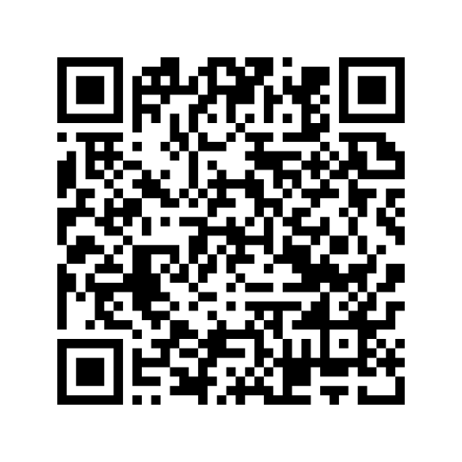
Try Them Out!
LOEX Presentation Companion Guide
https://libguides.snhu.edu/library-badging-companion-guide-loex
Notes:
Emily: We have created a companion guide for our presentation that includes samples of four of our live badges. There is a URL on this slide as well as a QR code to get to this guide. I’ll quickly walk through what is on the guide.

Slide 32
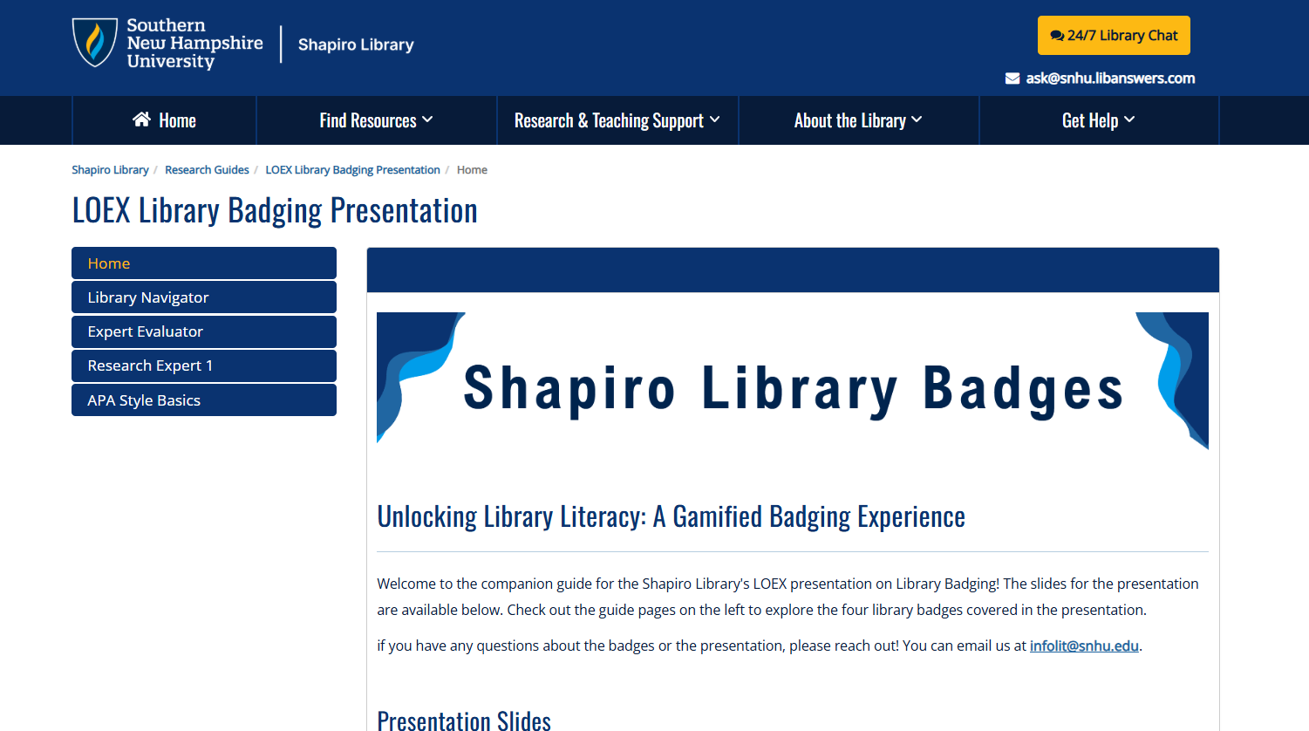
Companion Guide
https://libguides.snhu.edu/library-badging-companion-guide-loex
Notes:
Emily: The slides for this presentation are embedded on the landing page, and we have a page for each of the badges. I’ll show you the Library Navigator page, briefly, as each page is set up the same way.

Slide 33
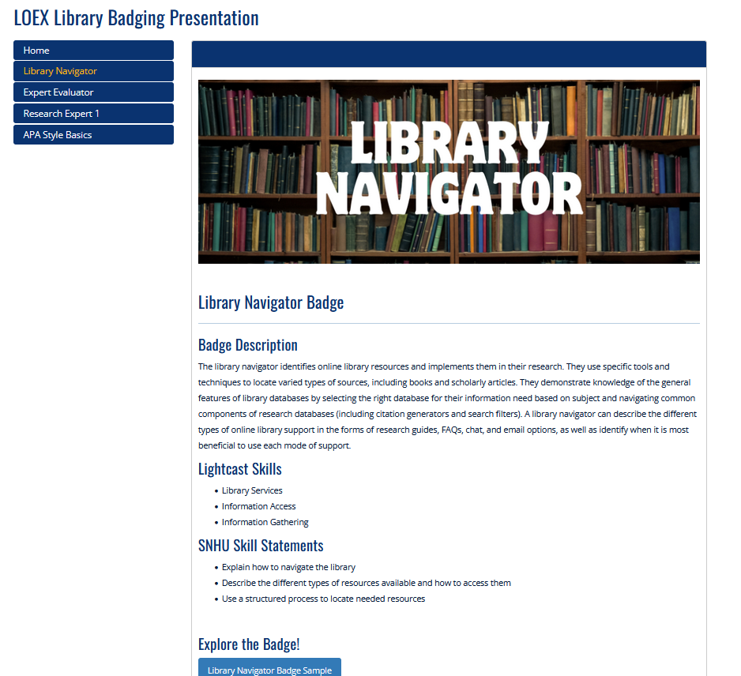
Companion Guide
Notes:
Emily: The badge description is the same one that is visible in Parchment, our badging platform. Towards the bottom of the page you will find a link to the sample badge.
We’ve also included a link to the full badge, and you are welcome to explore that experience, we just ask you to please not click Submit at the end. Only SNHU users can officially earn the badge, and outside submissions can disrupt our workflows and data tracking.
That said, at the end of each sample badge, there is a Submit button, and you are welcome to click that one! This won’t interrupt our workflows, as it’s a unique tutorial, and it simply lets us know how many people viewed our sample content.

Slide 34
Q & A
Contact our team at infolit@snhu.edu
Notes:
Shana
Thank you all for attending today! Please feel free to contact us with any questions you may have, and in that vein, we'll take any questions that you have now as well.

