Slide 1

WHALE
Elephant Hunting
Teaching Information Literacy in Contentious Environments
Brooke Gross, Western Kentucky University
brooke.gross@wku.edu
Notes:
change in title for theme's sake

Slide 2
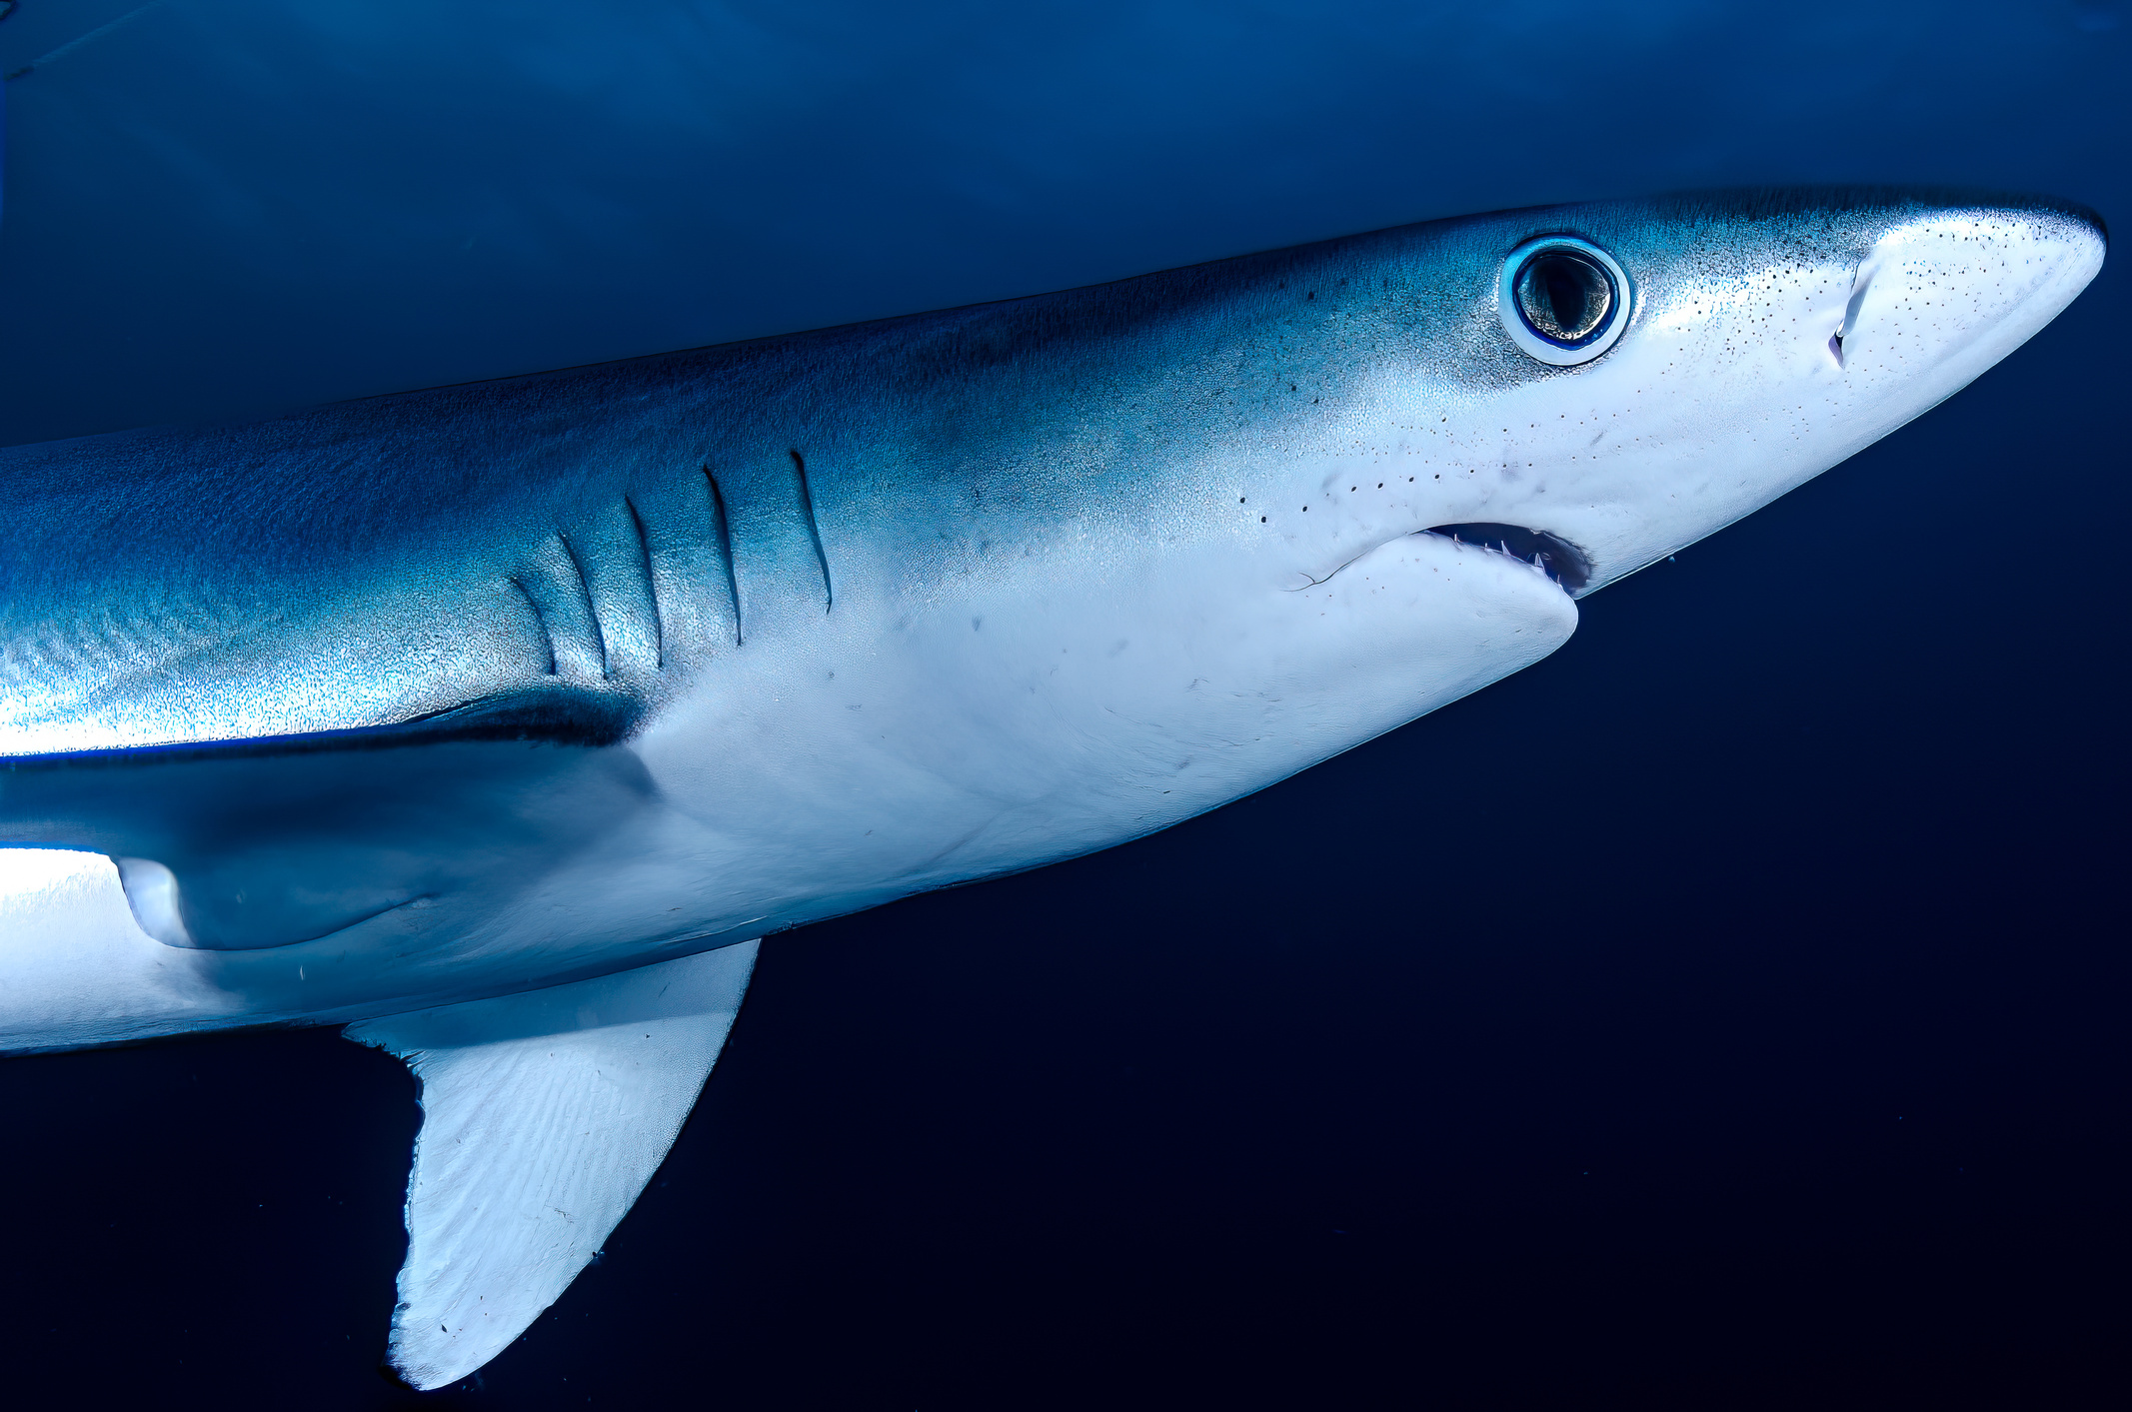
INTRODUCTION - Why I’m Here
Background
Academic Librarian & Assistant Professor Since 2021
Community College > R1 > Regional Comprehensive
Information Literacy, Critical Thinking, News/Media Literacy, AI Literacy, Real-World Applications
See Also: Mother, Creative Writer, Humanities Major
Recenter Library Neutrality in Times of Pedagogical Upheaval
Introduce Contentious Discussion as a Skill for Librarians
Promote Confidence, Self-Assurance, Assertiveness, and Transparency in Information Literacy Instruction
Purpose
Notes:
Information- and Instruction-Oriented but Also Human-Centered; Life Experiences as an Approach to Contention
Neutrality is the middle ground, and that's not a bad place to be. "I can do hard things." > We can have hard conversations.

Slide 3



INTRODUCTION - Why You’re Here
CONTENTIONS
Today’s Agenda
Artificial Intelligence
Misinformation
Public Perception
Notes:
AI - Innovation vs. Environment, Ethics vs. Advancement, Workforce Readiness vs. Critical Thinking; Purpose of Education
Misinformation - Delicate Times, Desperate Measures; Bias = Lens; Fake News; Complex Credibility in a Time of Niche Expertise and Home Remedies; Filter Bubbles
Public Perception - What are libraries? What can we do? How much do we know? Why are we valuable?

Slide 4

A Statement on Neutrality:
WE’RE NOT MAKING
A NEUTRAL STATEMENT
Notes:
"Neutrality" (in this context) refers to a temperament, not a position.

Slide 5
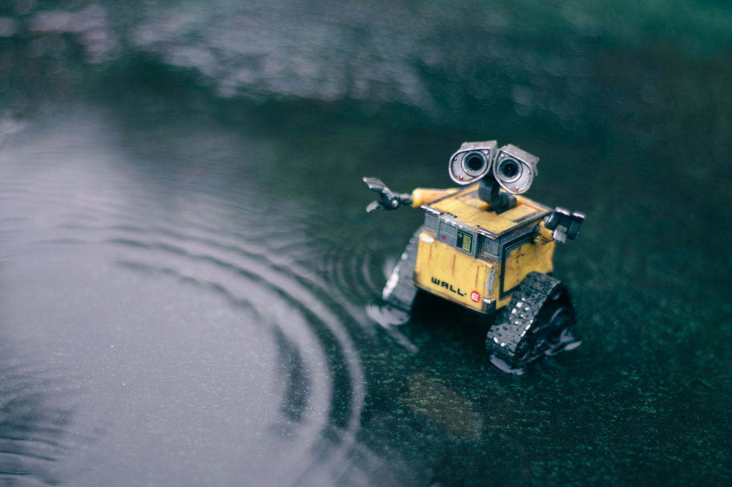
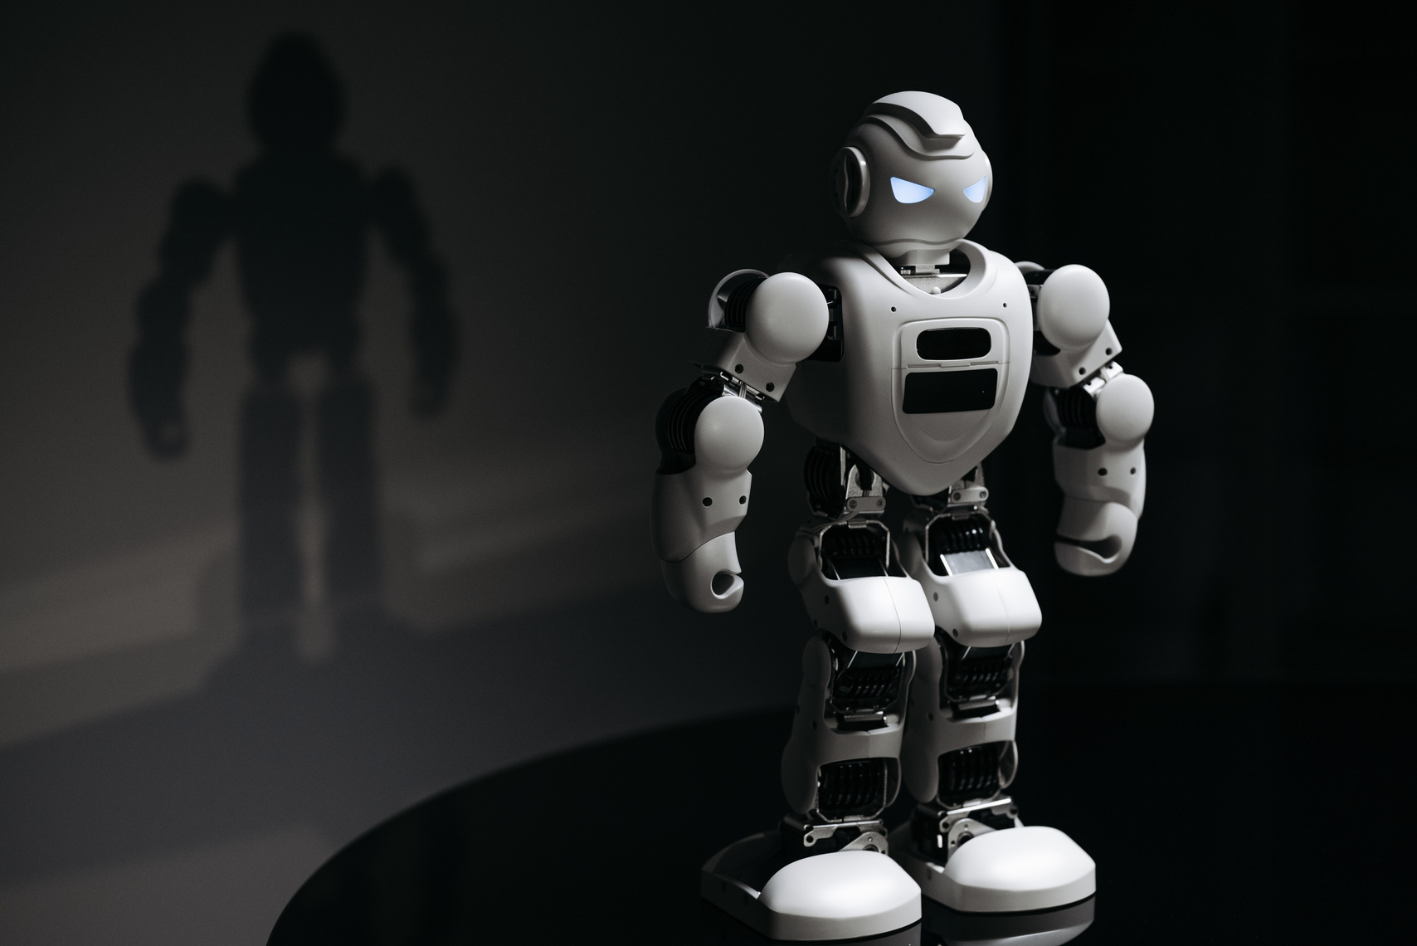
ARTIFICIAL INTELLIGENCE - What We’re Facing
Helper, Heretic,
and Homewrecker
“It saves me so much time!” “I never would’ve been able to make that on my own!” “It makes everything easier!”
“It’s killing the planet!” “It’s making us dumb!” “It’s stealing from artists!” “It’s making everything worse!”
“What about education?”
Notes:
Who It Helps - Science, Technology, Business, Equity*
Who It Hurts - Arts, Humanities, Education, Equitable Access*
How It Wrecks - Environment, Knowledge Authority, Intellectual Property, Competition
the more you know, the more you can competently speak on

Slide 6

ARTIFICIAL INTELLIGENCE - How We Address It
Determining “Appropriate” Use
Understand the Mechanics
Evaluate Gains and Losses
Intended Purpose - Microworlds, Replicable Tasks, Human Error, Process Automation, Machine Learning
Should You Shortcut? - Delegating Thought; Diluting Learning and Development; Cultivating Deficiency
Technical Terminology - Large Language Models, Generative vs. Discriminative, Deep Learning
Can You Streamline? - Eliminating “Grunt Work” in Favor of Complex/Real-World Problem-Solving
Simpler Analogies - Predictive Text, Crowdsourcing, Statistical Reasoning, Word Association, Regurgitate
Is This Worth It? - Maintaining Trust, Authority, Equity, Transparency, and Critical Thinking
Notes:
1. Identify "Appropriate" - What's the ultimate goal? What learning, reflection, or understanding is most critical to maintain? What can be sacrificed or lost?
2. Explain the History, Mechanics, and Feasibility - What are reasonable expectations? How do they challenge, take advantage of, or fall subject to manipulation by the tool? What's the big picture?
3. Acknowledge Losses - Reflect on why you're willing to sacrifice or lose parts of the learning, creative, and/or development process. Consider whether you're setting a dangerous precedent.

Slide 7

Deep Breath Moment

Slide 8

MISINFORMATION - Fake News Epidemic
Political Weapon, Personal Impact
A Double-Edged Sword - How to address news and media bias without alienating, demoralizing, or condescending our audience?
Manipulation as a Personal Failing - How to explain the consequences of limited information consumption without placing blame?
An Optimistic Use of Lenses - How to reframe bias, authority, credibility, and quality to promote better information-seeking behavior?
BONUS: GOOD
DIGITAL CITIZENSHIP!
Notes:
Tact and Diplomacy - "I saw something different when I looked at this website." vs. "What kind of idiot believes that?"
Place blame where blame is due and hold political, news, media, etc. entities accountable.
Using the term "lens" instead of "bias" allows for more positive skill-building and decreases the need for defensiveness.
Shared Experiences = Shared Expertise; Shared Knowledge = Shared Improvement; Shared Resources = Shared Responsibility
[ripple effect]

Slide 9

MISINFORMATION - Need for Metaliteracies Instruction
Modern Skill Sets
Information Literacy (Here & Now)
Key Concepts: Misinformation vs. Disinformation vs. Malinformation; Social Media Filter Bubbles; Credibility (Reliability, Authority, Validity, Accuracy); Popular vs. Scholarly Sources; Primary, Secondary, Tertiary Sources; Scholarly Communication; Media Bias as a Spectrum
News and Media Literacy
College Literacy
Key Concepts: Language Use; Platform Stability; Readability; Reputation; Sponsorship; Relevance
Key Concepts: Peer Review; Academic Journals; Professional Sources; Research; Article vs. Journal vs. Database; Publishing Lifecycle; Scholar Networks
Teaching Strategies: Shared Vocabulary; Real-World Experiences; Examples; Article Comparisons
Related: Open Access, Impact, Hidden Curriculum
Notes:
[keeping our heads above water]
Information Literacy - How did we get from "fund, access, use, evaluate, redistribute" to this? What does knowledge look like today? What does bias?
News/Media Literacy - How do we explain that popular media isn't always trustworthy? How do we justify doing the extra work to keep ourselves well-rounded and up to date?
College Literacy - How do we teach students how to be students? What does help-/information-seeking look like at different parts of the educational journey?
Best Practice: Get on their level.

Slide 10

Deep Breath Moment

Slide 11

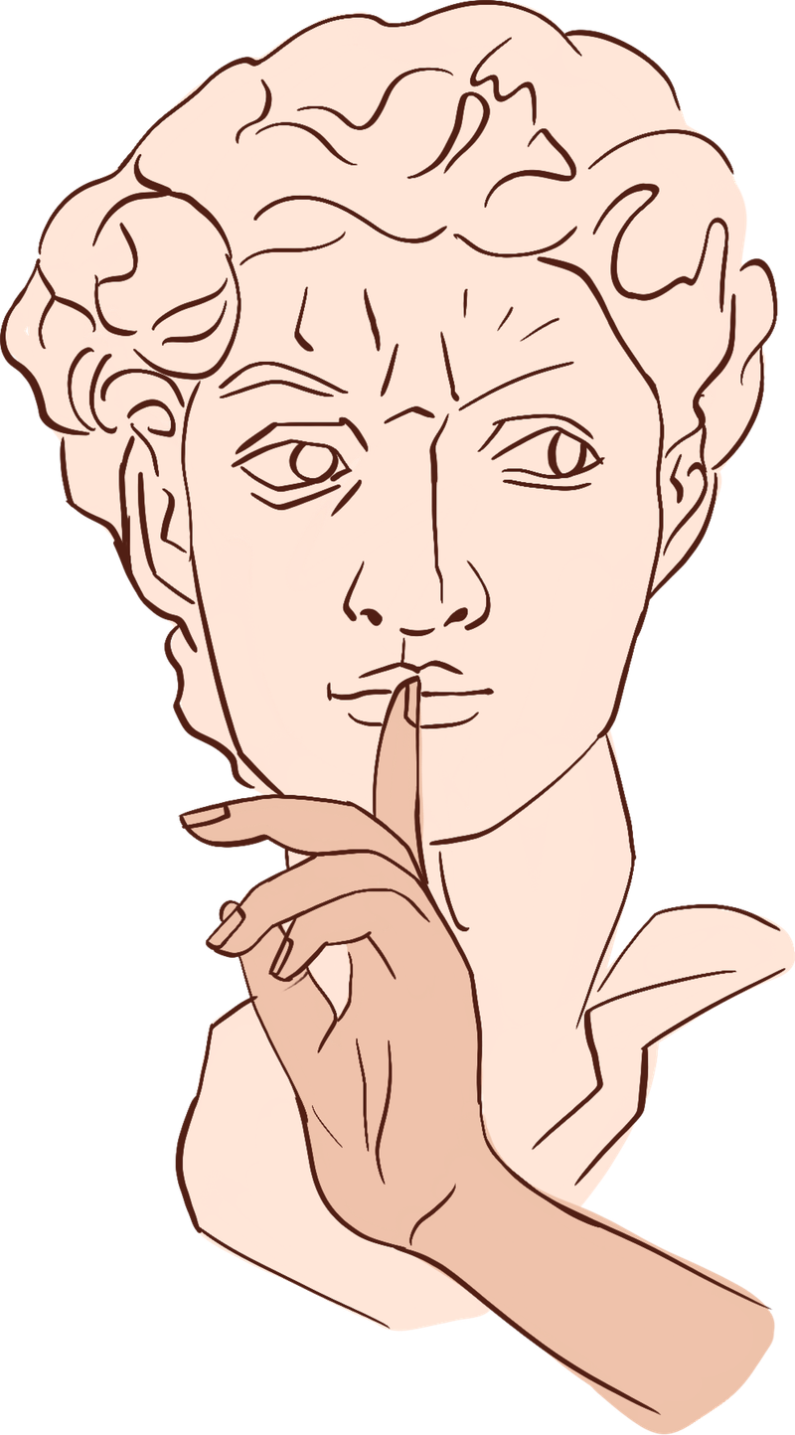
PUBLIC PERCEPTION - reputation
The Library Image
Student Perspective: Open Spaces / Access to Food and Drink / Just In Time / Class Requirement
The Value of Care vs. Cost of Expertise
Institutional Perspective: Support Unit / Recruitment Builder / Co-Curricular / Point of Access
Librarians as Service Providers
Accessible, Responsive, Moldable, As-Needed, Reference-Oriented, “Customer Service Mode”
Librarians as Information Literacy Experts
Assertive, Forward-Thinking, Innovative, Self-Led Prioritization, Authoritative, Pedagogy-Minded
Notes:
[activity: "Raise your hand if..."]
Student Perspective - closed doors, physical sustenance, last resort, busy work/checkbox
Institutional Perspective - keeping the lights on, safe space, academic-but-not, technology
Professional Perspective - let's talk about collegial conflict

Slide 12

PUBLIC PERCEPTION - Building Political Capital
What Can We Do?
Leverage Emerging Graduate Competencies
Get Involved and
Make Yourself Useful
Information Literacy, Critical Thinking, Interdisciplinary Approaches, Collaboration, Soft Skills, Strategic Implementation
Shared Governance, Working Groups, Communities of Practice, Task Forces, Book Clubs, Teaching Support Collaborations, Webinars
Notes:
Emerging Competencies - What was once expected of incoming freshmen is no longer part of academic preparation. Find the gaps only your expertise can fill.
Getting Involved - Don't be afraid of big rooms with heavy doors. Get in the room, stay in the room, and speak up. Imposter syndrome is cancelled; we have valuable insights on teaching and learning too.

Slide 13

CONCLUSION & CONNECTIONS
We Retain Authority by Asserting Expertise
Notes:
The water's getting rockier, and education is getting harder to navigate for students as well as instructors.
We can be a powerful force for good, but we have to keep our priorities and values in sight and be willing to push back when critical thinking or information literacy are at risk.
The key to growth is being willing to have hard conversations.

Slide 14

QUESTIONS? EMAIL BROOKE.GROSS@WKU.EDU
Thank You
For Your Attention
Notes:
contact info, "we were the whale all along"

