Slide 1
Accessibility Considerations for Online Citation Guides
Christine Vasica
Anne Arundel Community College (Maryland)
Notes:
These slides use the Open Sans font face (free).

Slide 2
Learning outcomes
Consider accessibility concerns associated with teaching formal citation
Apply accessible design principles to online citation guides
Recognize and remedy barriers for assistive technologies
Notes:
Full outcomes from program:
Consider specific accessibility concerns associated with the teaching of formal citation.
Apply principles of accessible design to the revision or creation of online citation guides.
Recognize and remedy barriers to the effective use of assistive technologies.

Slide 3
Contexts
Basic knowledge of WCAG and accessible design principles
Online resources to support use of MLA, APA, etc., style guides to format citations

Slide 4
Accessibility beyond the checklist
Notes:
It’s actually fairly easy to format a webpage that just shares a lot of information and examples so that it passes an automated accessibility check. However, does that mean every user can access the same information? Is the presentation equally effective to all?

Slide 5
Why citation?

Slide 6
Inherent challenges
Visual formatting:
  Italics, Capitalization, punctuation.
Abbreviations
URLs

Slide 7
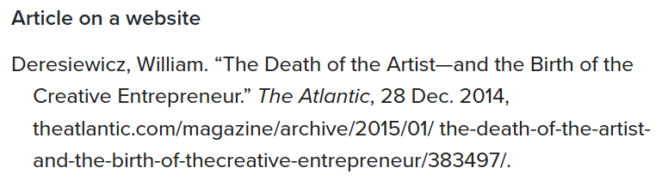
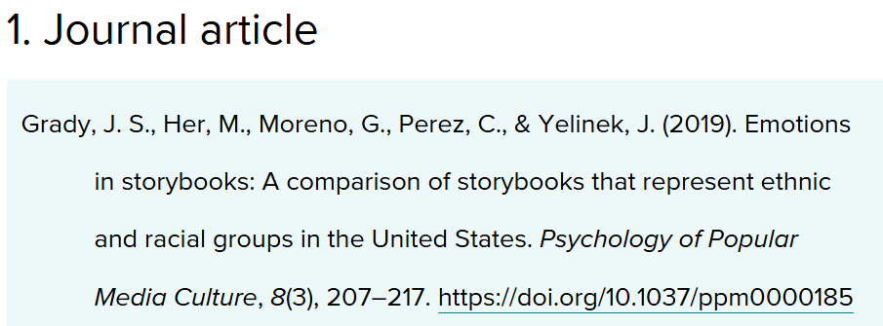
Instruction commonly relies on examples
From MLA Style Center:
From APA Style:

Slide 8
Considering screen readers
Order and orientation – think linear
What’s read (announced)?
What’s ignored?

Slide 9
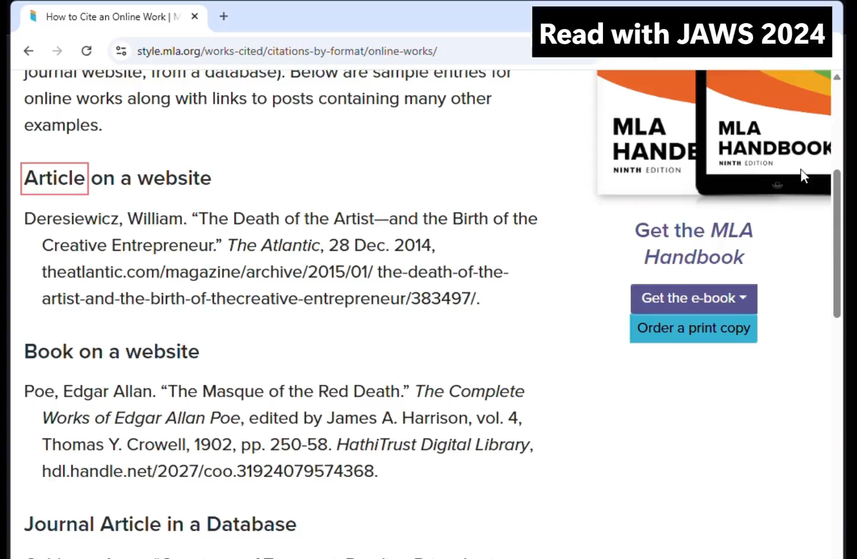
Video: JAWS reads MLA examples
Open on YouTube
Notes:
Note: captions represent what JAWS voice is saying. This is JAWS 2024 with out-of-the-box settings.

Slide 10
Settings and software vary!
JAWS, NVDA, VoiceOver, etc., don’t always behave the same
Users may customize settings
So – provide context for user:
what’s important here?

Slide 11
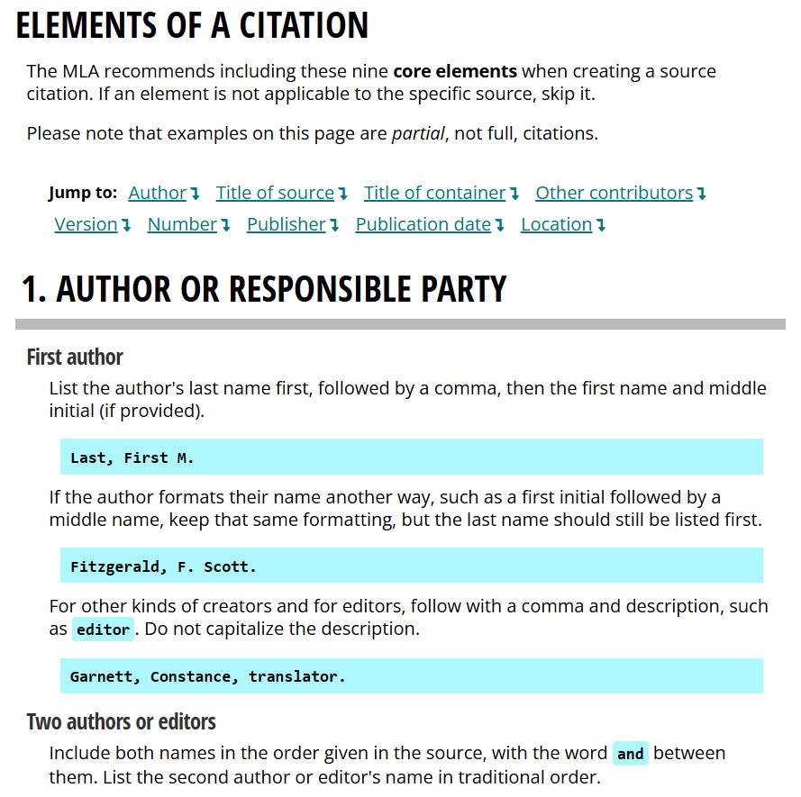
Steps toward remediation

Slide 12
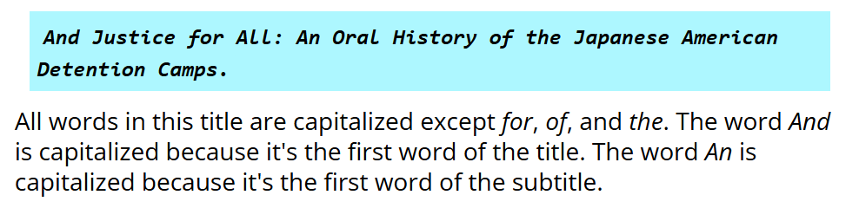
More “explication”
Spell out what the examples are meant to illustrate

Slide 13
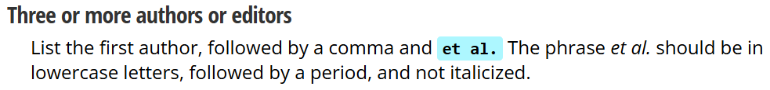
Abbreviations
HTML abbr tag
Called out and formatting explained:

Slide 14
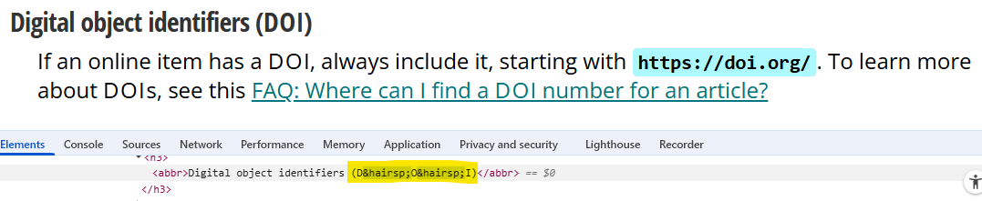
Abbrev. for screen readers
Force pronunciation of letters with hair space (not a perfect solution!)
Notes:
Also, Roman numerals -- “IX” may be read as “icks.”
Hair space isn’t a perfect solution! It’s more visible in some font faces, especially monospace ones. For certain uses, such as coding examples, it might break the functionality. Note that I only tested this solution with JAWS, which treated it as a space when announcing letters, though it did not recognize small space characters (zero-width and thin space) and simply ignored them.

Slide 15
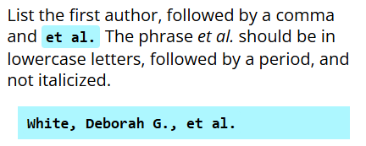
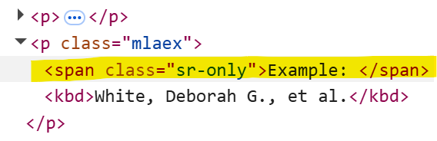
Supplemental text cues
Page displays:
Screen reader “sees”:
Notes:
Class “sr-only” comes from the Bootstrap framework, which LibGuides is built on. You can replicate this behavior on any platform by creating a custom CSS class.

Slide 16
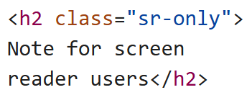
Context for “equivalent UX”
Placement of proper punctuation, including commas and periods, is vital to correct MLA citation, so you may wish to adjust your punctuation or verbosity settings to ensure all punctuation is spoken…

Slide 17
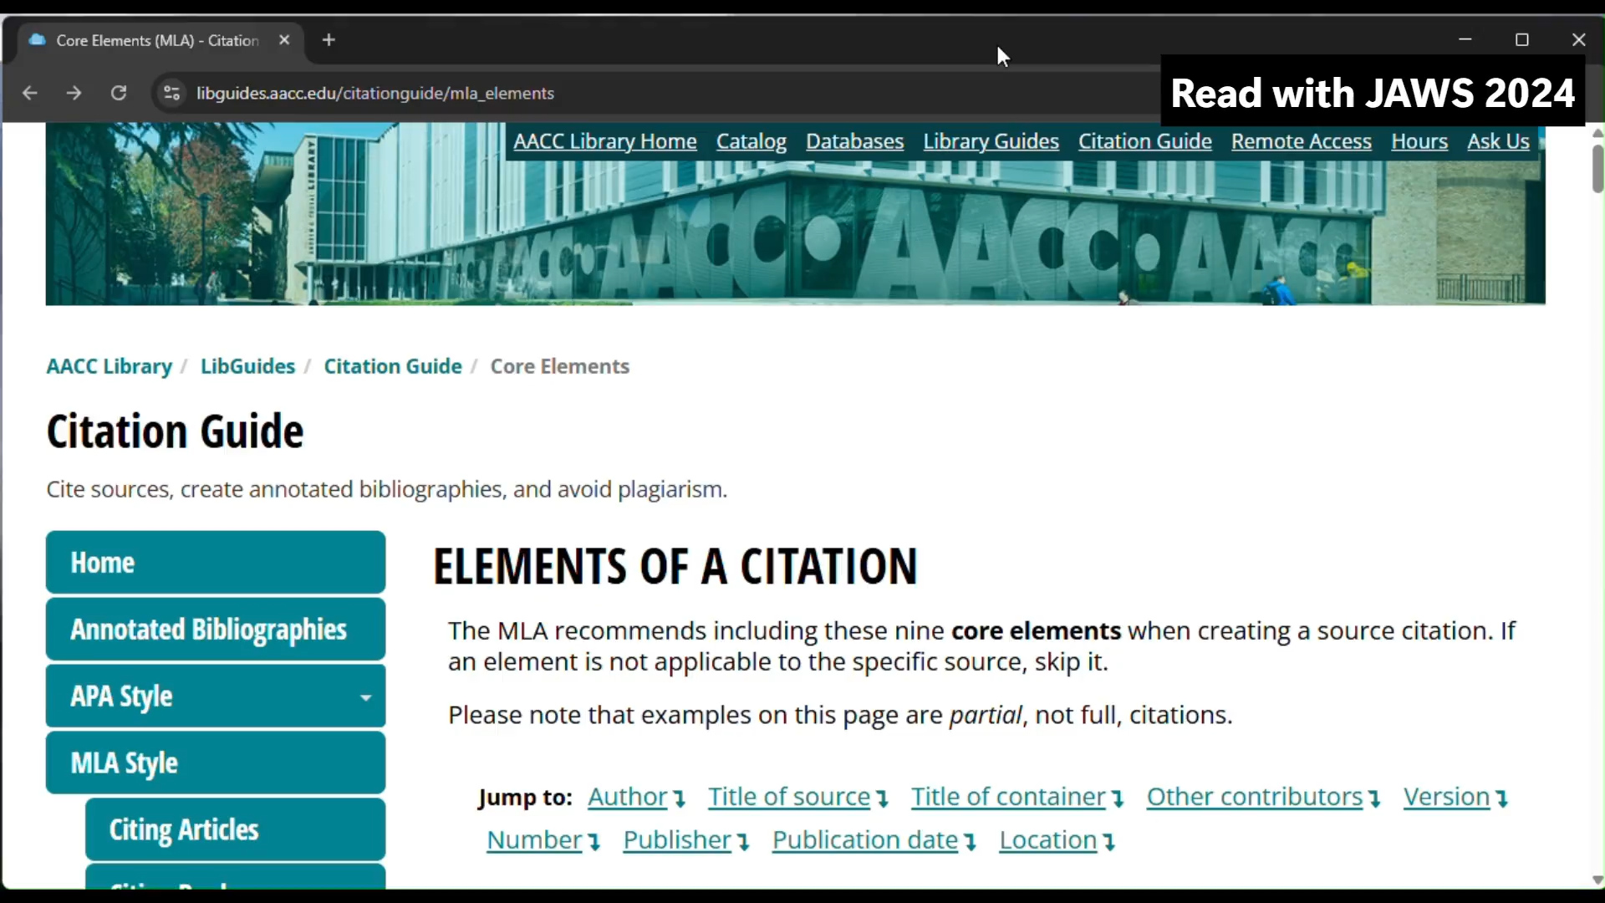
Video: JAWS reads remediated page
Open on YouTube
Notes:
Note: captions represent what JAWS voice is saying.

Slide 18
Another challenge: URLs

Slide 19
The problem
Guidelines require untitled/bare URLs
Contradicts WCAG, Level A – Success Criterion 2.4.4, Link Purpose
Notes:
Note: has been WCAG Level A requirement since at least 2.0 (same designator).

Slide 20
Alternatives from style guides
MLA: Accessible links in works cited entries
APA: Accessible URLs
For digital-only documents – what about print?

Slide 21
Instruction vs. navigation
When teaching or modeling citation, we decided to include URLs per style guide – with modifications.

Slide 22
Structure to allow skipping
Citation lists formatted with <ul>
URL last element in citation <li>
  Allows user to skip ahead

Slide 23
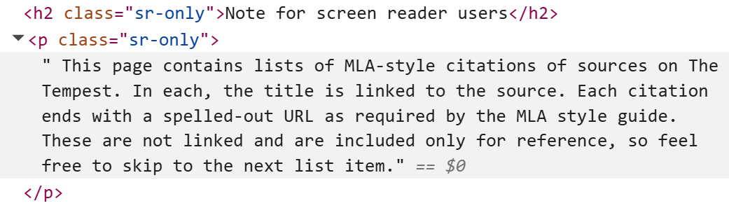
Alert the user

Slide 24
Pushback
“Why not change the requirements?”
“Students don’t care anyway…”

Slide 25
Handy resources
Chrome extension: Accessible Web
Browser extensions: WAVE (WebAIM)
Bookmarklet: h123 Outliner – displays outline of all headings on page
Contrast Ratio
JAWS Hotkeys

Slide 26
Questions?
Thank you!
Christine Vasica
cjvasica@aacc.edu

