Slide 1
Hereditary Headaches:
A Survival Guide for Overcoming Inherited Obstacles
Nicole Daly, Social Sciences Librarian
Margot Accettura, STEM Librarian
Villanova University

Slide 2
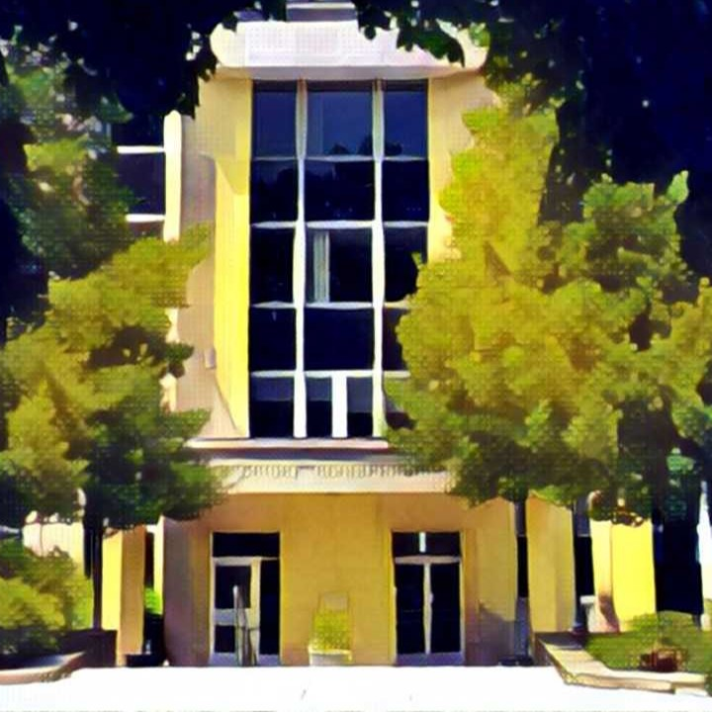
By the end of this session attendees will be able to:
Employ new outreach and testing techniques in order to adjust pre-existing academic liaison relationships
Adapt and grow as a liaison to meet your department’s needs while keeping in mind interpersonal relationships within the library
Build and modify existing instruction techniques and materials for an ever changing student population

Slide 3
WHERE WE ARE LOCATED
Villanova University is ~30 mins outside of Philadelphia

Slide 4

VILLANOVA UNIVERSITY
One main library: Falvey Library
6,700 Full-Time Undergraduates
Separate Law Library
3,100 Graduates
11 subject liaison librarians
3 teams: social sciences, humanities, and sciences
R2 Research Institution

Slide 5
Presenters
Nicole
Social Science Librarian
Department Liaison to:
Communication
Sociology and Criminology
College of Professional Studies
Margot
STEM Librarian
Department Liaison to:
Astrophysics and Planetary Science
Biology
Chemistry
Computing Sciences
Geography and the Environment
Mathematics and Statistics
Physics

Slide 6
Initial Introductions

Slide 7
Cons…
Institutional Memory
Assumptions
Blank Slate

Slide 8
… Pros
Blank Slate
New Ideas
Collaboration

Slide 9
02
Outreach

Slide 10
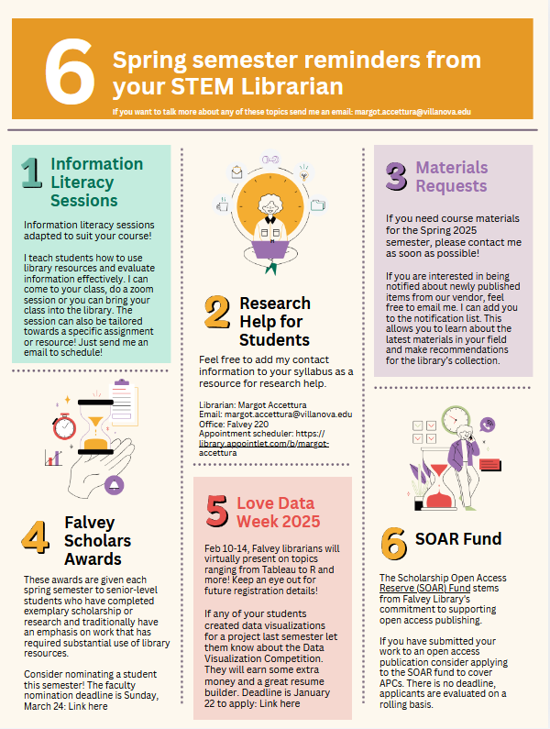
Outreach Methods
Start of semester emails
  Canva/Adobe Express
  Includes:
    Contact information
    Scheduling for classes
    Collections awareness
    Upcoming Events
Meetings with department chairs
  Go over department needs and collections
Check-ins with faculty
  Invite for tea

Slide 11
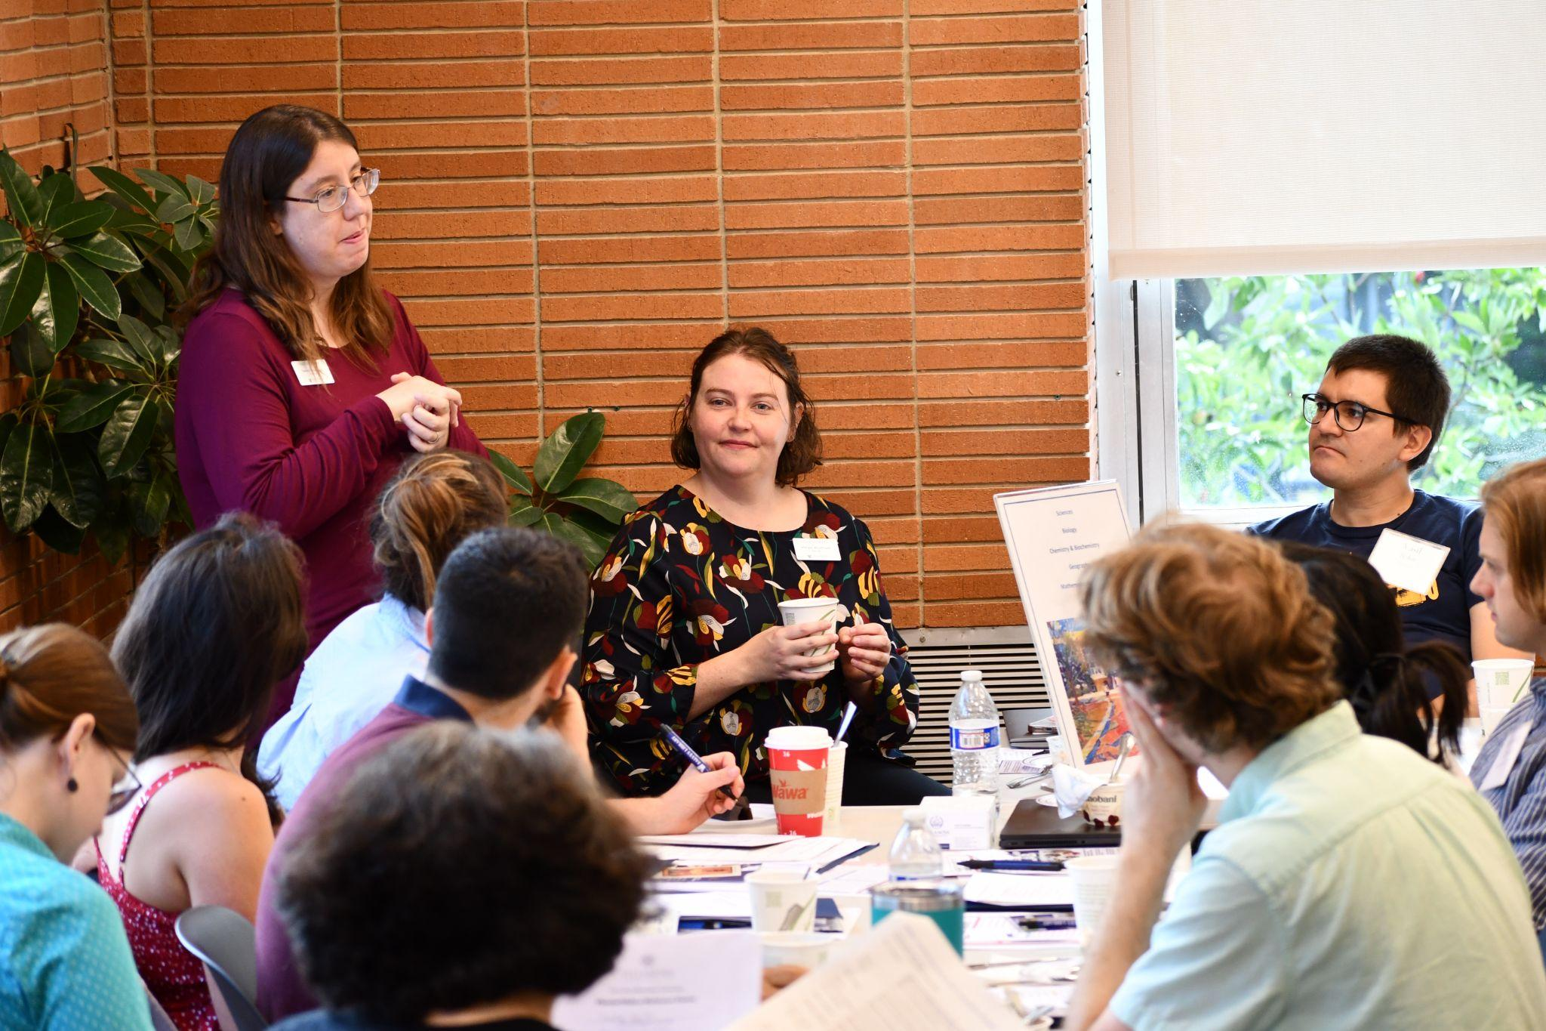
New Faculty Orientation
Every fall semester includes a breakfast at Falvey for new faculty to get:
Overview of library resources from the dean
Time with liaisons to discuss services
Benefits:
Strong connections with new faculty members
  Invited into new courses
  Shaping course syllabi
Learn about new needs
  Overleaf
  Streaming videos, PPR
New Faculty Orientation in 2024. Margot’s STEM table during a brief introduction of Nancy Foasberg, Scholarly Communication Librarian

Slide 12
03
Instruction

Slide 13
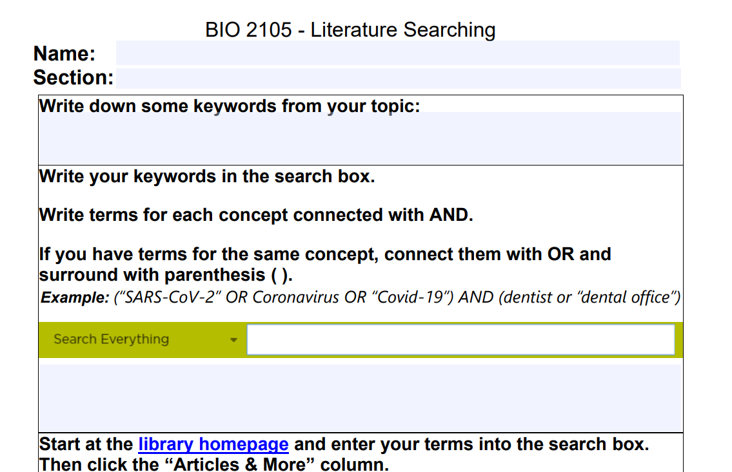
General Biology I
Every Fall Semester
  ~200 students over 12 sessions
Inherited a powerpoint, worksheet, course guide, and post-class quiz
No introduction to faculty or lab manager prior to course
  Given conflicting reports about lead faculty mentor’s needs
Notes:
Bowden, T. S., & DiBenedetto, A. (2001). Information literacy in a biology laboratory session. Research Strategies, 18(2), 143–149. https://doi.org/10.1016/S0734-3310(02)00071-X

Slide 14
General Biology I Adjustments
Provided feedback to all faculty and reviewed assignment
  AI inclusion
  Given assurance as expert could make any necessary changes
Adjusted worksheet
  No longer needed to be turned in
Adjusted powerpoint
  More focus on scientific articles
Next year: quiz updates and flipped classroom
Connection with lab manager for future information literacy inclusion
Consultations
Fall 2024 | 3
Fall 2025 | 13

Slide 15
04
Assessment

Slide 16
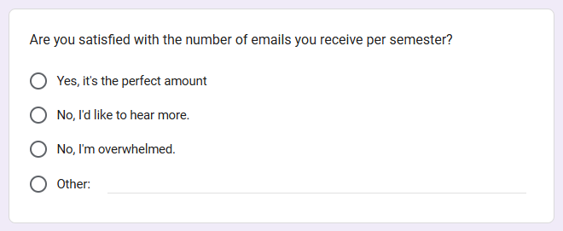
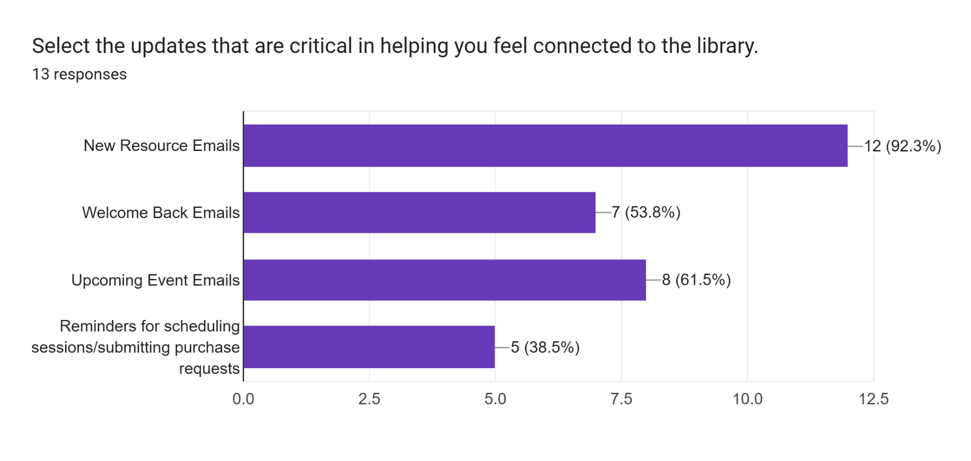
Communication Survey

Slide 17
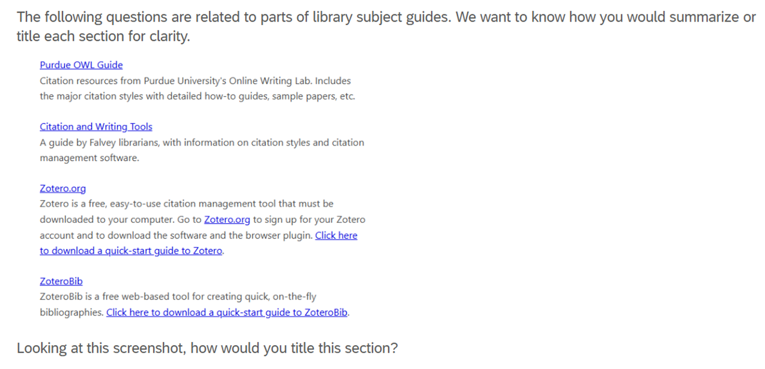
Subject Guide Terminology
Goals:
Identify commonly used guide labels for four categories:
  Citation
  Scholarly articles
  Reference resources
  Books
Survey students about which (already in use) label provides the clearest title for example sections
Have students rank selected categories by importance to inform layout decisions

Slide 18
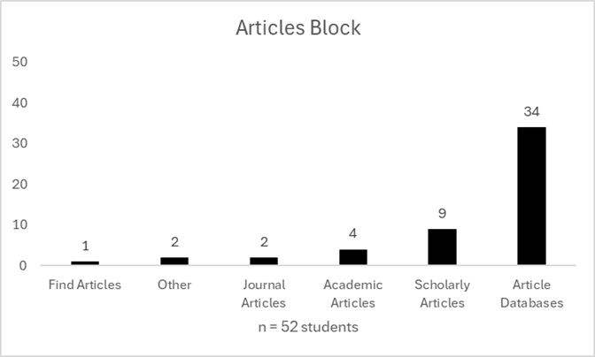
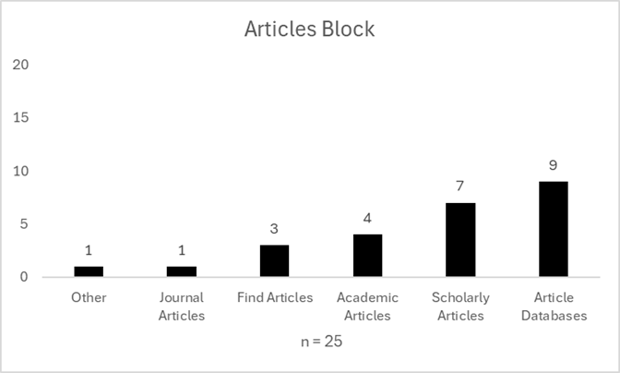
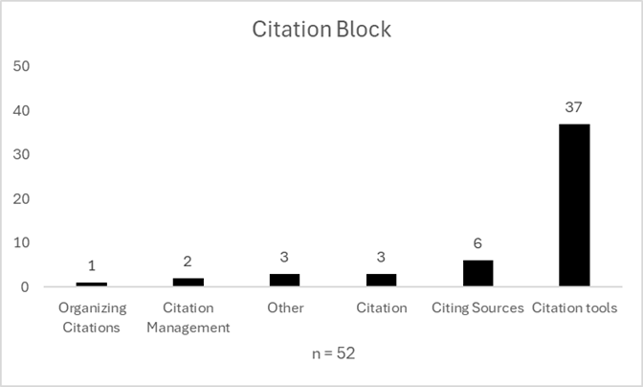
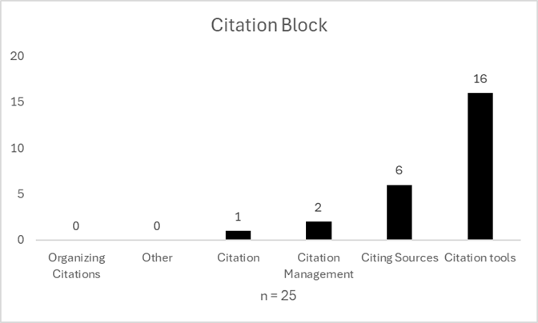
Subject Guide Terminology
Notes:
Results Top choices:
Citation Tools
Article Databases
Dictionaries, Encyclopedias, and Other Reference Sources
Finding Books

Slide 19
Advertising
Email
Newswires
Sent to departments and groups on campus (grad center)
Student and Faculty/Staff weekly newsletter
Flyers
Tabling
Posted around campus with QR to survey
Candy and a flyer

Slide 20
Final Thoughts
Instruction
Outreach
Trust your instincts, you are the information literacy expert
Assessment
You won’t know what faculty need if you don’t open the dialogue
Check in to see what works and what needs to be adjusted

Slide 21
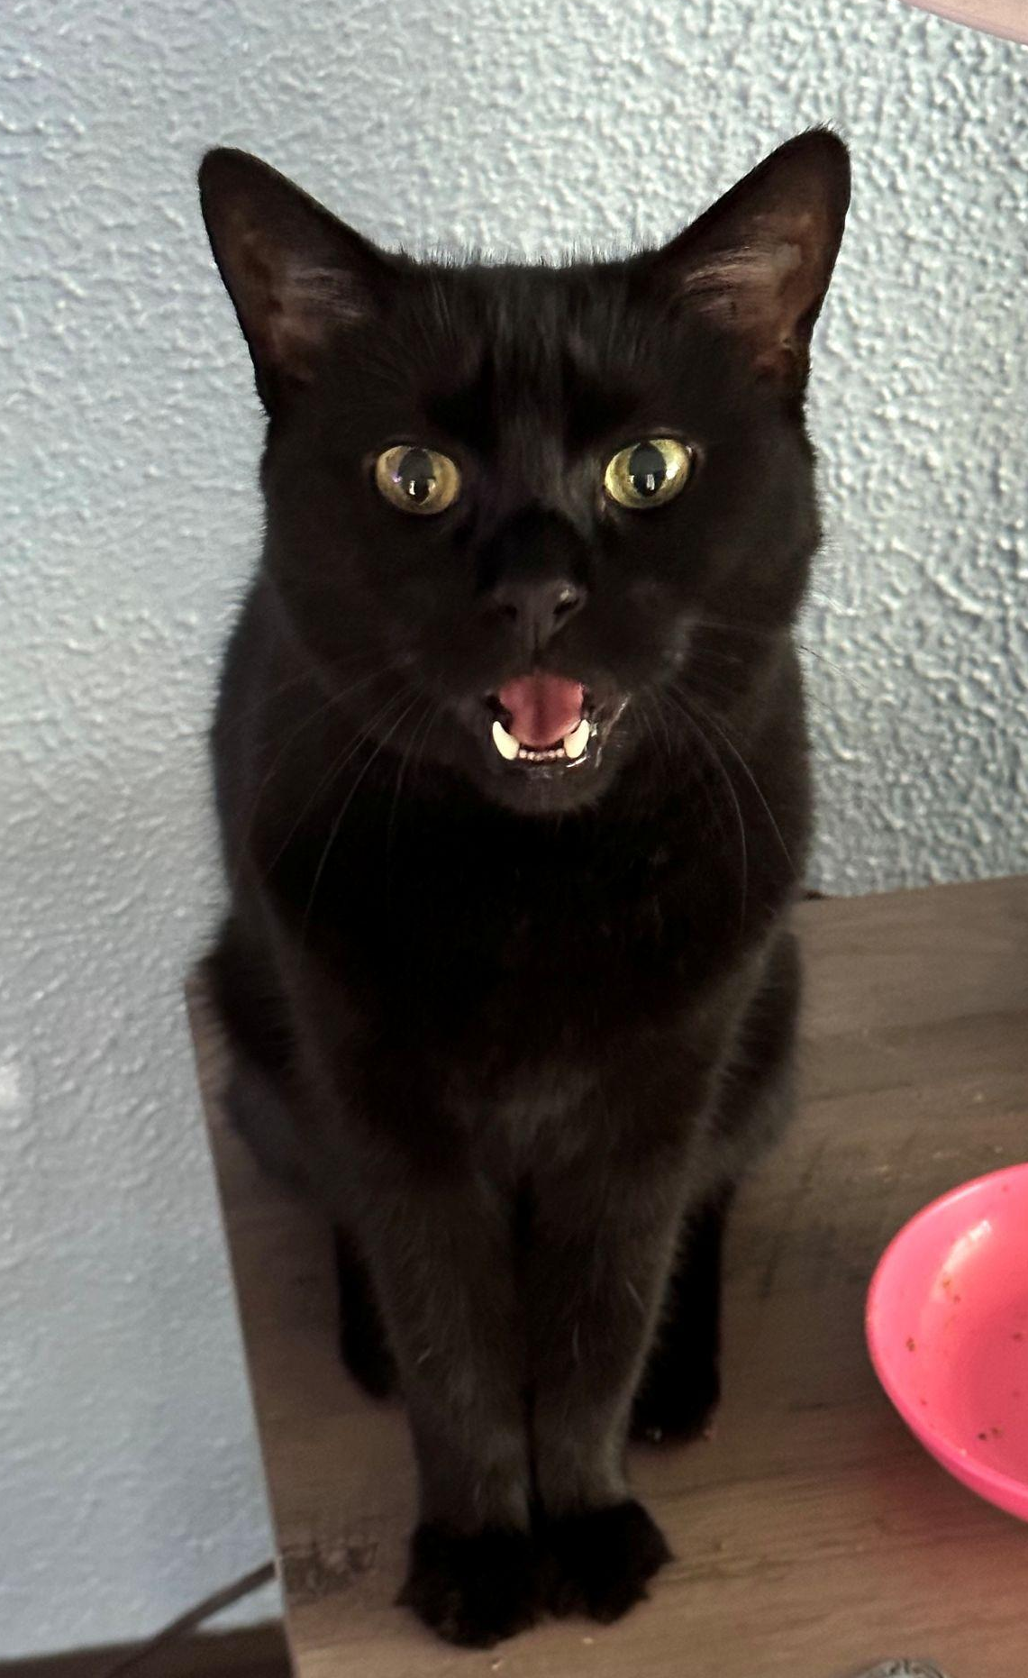
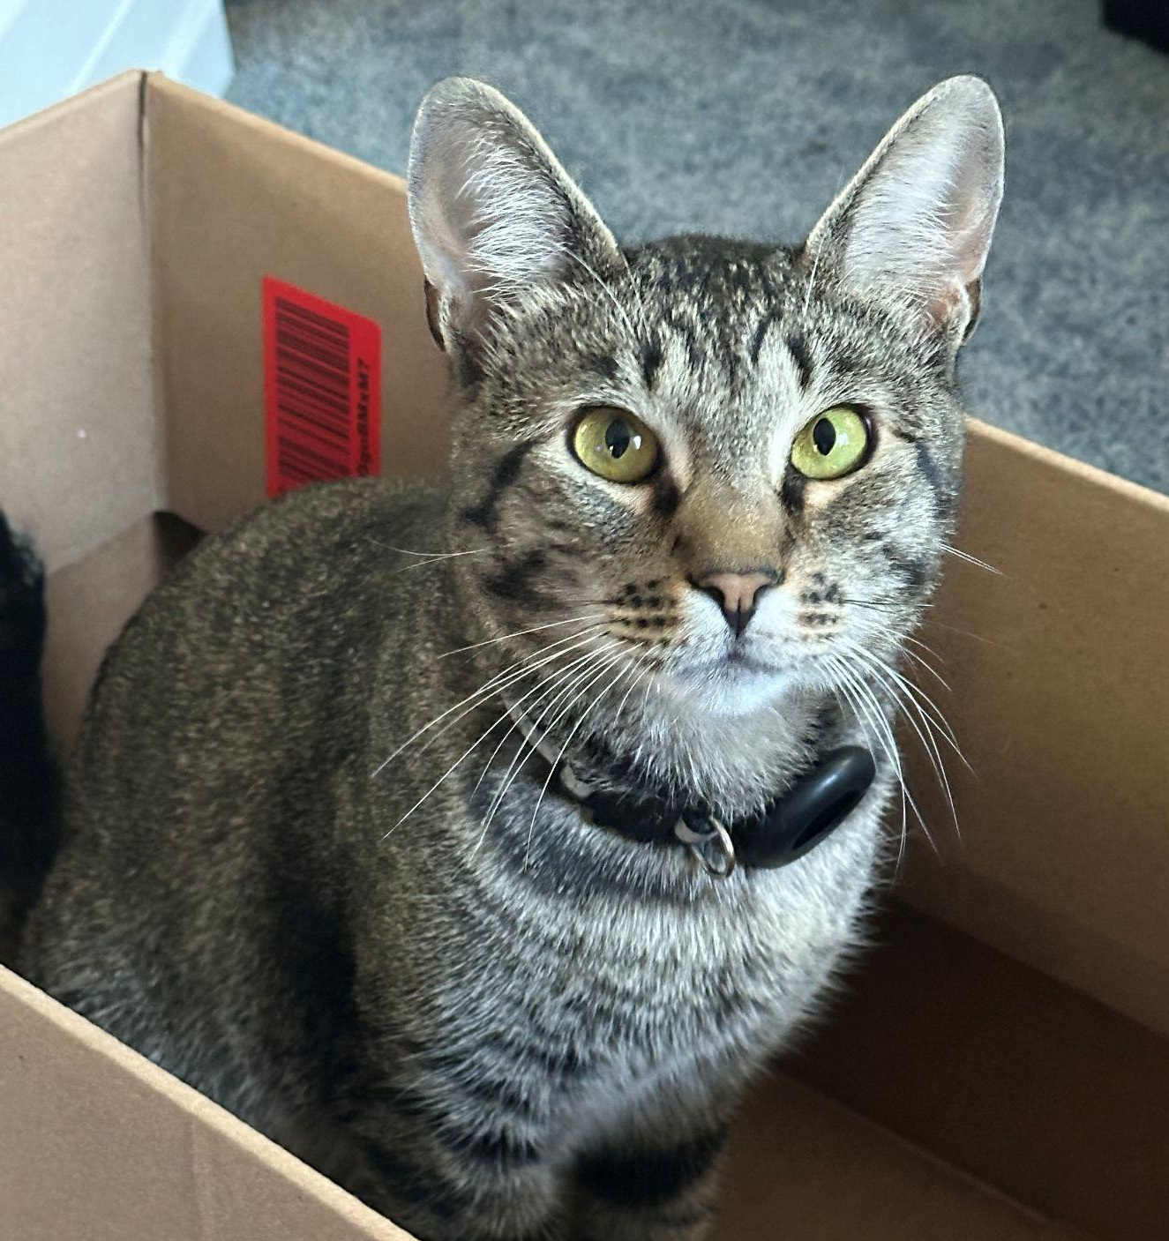
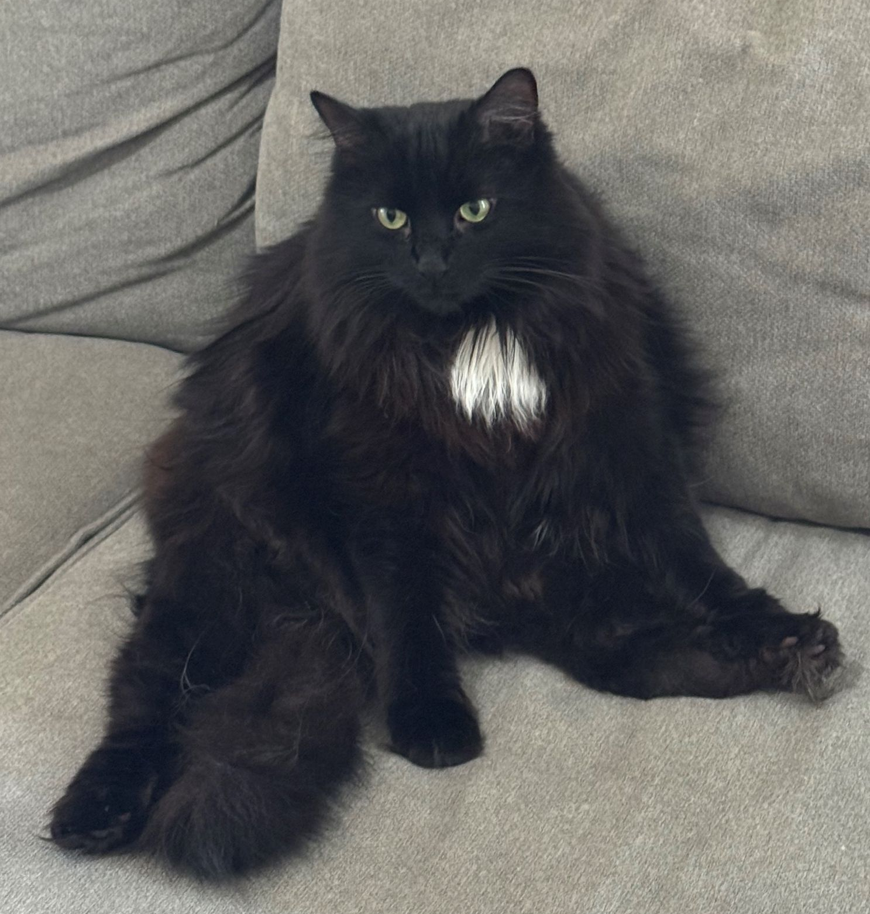
THANKS!
ANY QUESTIONS?
Nicole.daly@villanova.edu
Margot.accettura@villanova.edu

