Slide 1
Tastes Great, Less Filling:
How to Design and Deliver Substantial Instruction to Large Enrollment Classes Without Being Overwhelmed
Stephanie JH McReynolds and Hyerin Bak

Slide 2
Session Overview
Brainstorm Opportunities & Threats of Large-Enrollment Classes
Summary of One Instructional Strategy for Large-Enrollment Class
Summary and Analysis of Assessment Strategy and Results
Brainstorm Strengths & Weaknesses, as well as suggestions for Improvement of Instructional Strategy
Recommendations Based on Lessons Learned
Consider Adapting Instructional Approach for Your Own Teaching

Slide 3
SWOT ANALYSIS
“SWOT analysis is a strategic planning tool for identifying and understanding the strengths, weaknesses, opportunities, and threats affecting a business, project or situation.”
Webster, Martin. (2014, May 25). How to Use a SWOT Analysis ― A Perfect SWOT Analysis Example. Retrieved from http://www.leadershipthoughts.com/how-to-use-a-swot-analysis/

Slide 4
SWOT Terms
Factors of the Outlined Instructional Strategies
Strengths = Positive Factors Weaknesses = Negative Factors
Factors that Large-Enrollment Classes
Present to Library Instruction
Opportunities = Positive Factors Threats = Negative Factors

Slide 5
Opportunities & Threats
Factors that Large-Enrollment Classes
Present to Library Instruction
Opportunities = Positive Factors Threats = Negative Factors
Brainstorm & Discuss Opportunities & Threats
Be prepared to share Opportunities & Threats with the rest of the presentation participants

Slide 6
Instruction Request
Invited to speak to all incoming business undergraduate students during one morning
Three 55-minute sessions to 160 students each time

Slide 7
Suggestion
No prior knowledge of work done by predecessors
Suggested that library assignments be integrated into the course’s required final team project
Suggestion accepted by course coordinator

Slide 8
Course Final Project
SOM 122 Final Project required student teams to....
Study a Firm, a Regulatory Agency, and a Regulatory Issue between the two, in order to write a paper and create a presentation.

Slide 9
Instructional Design
Sought guidance from Libraries’ instructional design expert Steven Hoover to draft….
Pre-Assignment
In-Class Activity

Slide 10
Pre-Assignment
Focused on identifying credible sources of information (including Libraries’ company databases) for final project
Sought to determine students’ information literacy skill levels
Pre-Assignment on Firm Research

Slide 11
Company Databases Handout
Created “Company Databases” handout to help students navigate the Libraries’ company databases
Company Databases Handout

Slide 12
Informational Handouts
Created one-page informational handouts for professors to distribute at appropriate times during the course
Market Research handout
Industry Research handout

Slide 13
In-Class Activity
Asked student teams to identify their regulatory agency, their firm, the issue the two had, and to provide basic citation information for an article about that issue from one of the Libraries’ databases
Library Presentation Assignment (Finding Articles)

Slide 14
Integrating Assignments into Course
Faculty included library assignments on course project guidelines page, with due dates:
Assignment 1: Team Brand creation, due 9/05
Assignment 2: Library Pre-Assignment on Firm Research, due 9/19
Assignment 3: Library Presentation Assignment, due 9/26
Assignment 4: Paper, due 11/07
Assignment 5: Formal Presentation, slideshow due 11/30
SOM 122 Team Project

Slide 15
Instruction Session Outline
5 minutes
  Introduction and time for students to find and sit in their groups
10 minutes
  Basics of SU Libraries (including how to get to the databases)
5 minutes
  Questions about pre-assignment? Explanation about why pre-assignment was assigned
10 minutes
  How to search for articles (video and demonstration)
15 minutes
  Finding articles activity
  Handing in assignments (pre-assignment and finding articles assignment)
10 minutes
  Highlight key industry, company, and market research databases
5 minutes
  Questions and conclusion

Slide 16
Faculty Support for Instruction Session
All four course professors….
Provided classroom management support
Distributed in-class activity worksheets
Helped address any team issues with in-class activity
Collected pre-assignment and in-class activity worksheets
Thanks in large part to faculty support, all three instruction sessions (including in-class activity) ran smoothly.

Slide 17
Assessment Strategy and Results

Slide 18
Context
Formative assessments
  “to monitor student learning to provide ongoing feedback that can be used by instructors to improve their teaching and by students to improve their learning”
  Assignment 2, Assignment 3
Summative assessments
  “to evaluate student learning at the end of an instructional unit” (Carnegie Mellon Univ.)
  Collected bibliographies from the final papers and presentations
Notes:
Time/resources

Slide 19
Context
Student work (84 teams) was collected by the business librarian
Assessment Project by the instructional design librarian, a graduate student intern (MLIS), and the business librarian
Created an assessment plan
Processed data
Had results and analyzed
Notes:
In the hopes of gaining insight into student performance, as well as informing future instructional iterations, student work was collected by the business librarian and shared with the assessment team, which consisted of the librarian with expertise in instructional design and a graduate student intern from the School of Library and Information Science whose research interests include instructional design. The team created and instituted an assessment plan that allowed for rapid processing as well as detailed performance data and recommendations for future practice.

Slide 20
Library Pre-Assignment on Firm Search
Assignment 2
What sort of responses do you expect for students?
Think about how you might approach assessing this type of assessment
  Hint: Focus on Q 5
Notes:
[2 min] ACTIVITY
This is the Assignment 2 the business librarian handed out.

Slide 21
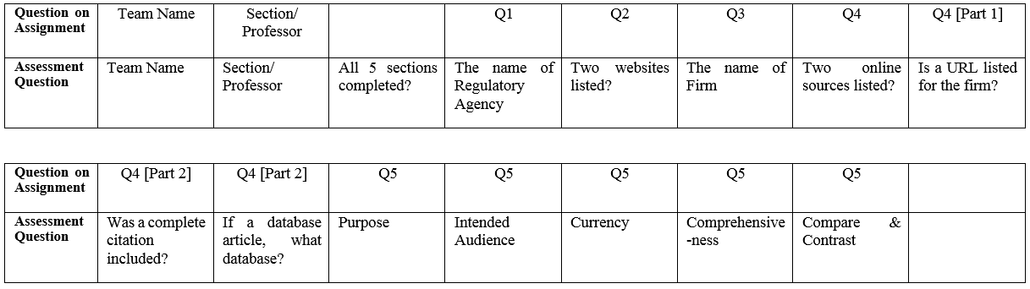
Assessment Planning Process
Identified the intended goals of each assignment/ Created a set of assessment questions
Assessment questions for Assignment 2
Notes:
For both assignments, the assessment team first had to clearly identify the intended goals through discussions with the business librarian in order to create an assessment plan. This allowed the team to relate each goal to appropriate assignment questions. The team identified a different purpose for the pre-assignment (Assignment 2) and the assignment given during the library instruction session (Assignment 3).
While the goal of the in-class assignment was simply to familiarize students with at least one of the Libraries’ article databases, the pre-assignment generally aimed to check students’ information literacy skills. Given time constraints, the team decided to forego assessing Assignment 3.
The assessment team identified the following specific intended goals for Assignment 2: determine whether student groups were able to complete the given worksheet; whether there was any particular section that seemed difficult for groups; the number of groups that actually utilized a Libraries’ database to complete the second half of Question 4; the quality of the response to Question 5; and the groups’ understanding of information source evaluation.
With these goals in mind, the team created new assessment items, such as “Completion of all sections” because this might be a basic indicator of whether the students had trouble with completing the given assignment. Through this process, the team was able to create a set of assessment questions. The most complicated question to assess was Question 5, which asked students to evaluate the information sources they had found. Since the question included suggestions of criteria to use for information evaluation, the team decided to make each criterion a separate assessment question.

Slide 22
Assessment Planning Process
2. Norming Process
  The official (and Unofficial) Rules for Norming Rubrics Successfully by Claire Holmes & Megan Oakleaf (2013)
A very simple rubric: Yes or No
Realized disagreement on evaluation
Discussed student work samples
Agreed on checking Yes for what sort of responses
Notes:
The official (and Unofficial) Rules for Norming Rubrics Successfully (Claire Holmes & Megan Oakleaf, 2013)
In order to institute an assessment plan, the team needed go through a “norming” process. For Question 5, the team decided to just check whether the students used each evaluation criterion or not. But, how could the team determine whether a certain criterion had been used? The team drafted a very simple rubric: Yes or No. Then the team realized that they had a disagreement on evaluation. So, the team discussed imaginary student work samples that might vary and also discussed a few real samples. The team finally agreed on checking Yes for student answers that included one word or one sentence related to each criterion. For example, the team would consider the student answer to have compared/contrasted two sources if it had any sentence to connect the two sources or if it applied any evaluation criteria. The team referred to and followed the process outlined in The Official (and Unofficial) Rules for Norming Rubrics Successfully. (Claire Holmes & Megan Oakleaf, 2013).
Another example of norming involved the second half of Question 4, which asked students to write down a URL or a citation of an information source. This was related to the goal of seeing whether teams utilized a Libraries’ database, which would also provide insight into whether the previously distributed handout on company databases was effective. The URLs or citations helped the team judge the usage of Libraries’ databases and the team could observe inconsistency of answers during processing. Thus, the team agreed to check No for a URL that did not work, an unclear citation, information that made it hard to determine which database had been used, or a government document that was easily found from Google or Summon (the Libraries’ metasearch function). In addition, the team also decided to write down the databases names in order to see which Libraries’ databases the students used.

Slide 23
Assessment Planning Process
2. Norming Process
Question 5 [information source evaluation- compare/contrast]
  If the answer had any sentence to connect the two sources or if it applied any evaluation criteria, check Yes.
Question 4 [Two online sources listed?]
  Judged the usage of Libraries’ databases based on given URLs or citations
  Check No for a URL that did not work, an unclear citation, information that made it hard to determine which database had been used, or a government document
Notes:
The official (and Unofficial) Rules for Norming Rubrics Successfully (Claire Holmes & Megan Oakleaf, 2013)
In order to institute an assessment plan, the team needed go through a “norming” process. For Question 5, the team decided to just check whether the students used each evaluation criterion or not. But, how could the team determine whether a certain criterion had been used? The team drafted a very simple rubric: Yes or No. Then the team realized that they had a disagreement on evaluation. So, the team discussed imaginary student work samples that might vary and also discussed a few real samples. The team finally agreed on checking Yes for student answers that included one word or one sentence related to each criterion. For example, the team would consider the student answer to have compared/contrasted two sources if it had any sentence to connect the two sources or if it applied any evaluation criteria. The team referred to and followed the process outlined in The Official (and Unofficial) Rules for Norming Rubrics Successfully. (Claire Holmes & Megan Oakleaf, 2013).
Another example of norming involved the second half of Question 4, which asked students to write down a URL or a citation of an information source. This was related to the goal of seeing whether teams utilized a Libraries’ database, which would also provide insight into whether the previously distributed handout on company databases was effective. The URLs or citations helped the team judge the usage of Libraries’ databases and the team could observe inconsistency of answers during processing. Thus, the team agreed to check No for a URL that did not work, an unclear citation, information that made it hard to determine which database had been used, or a government document that was easily found from Google or Summon (the Libraries’ metasearch function). In addition, the team also decided to write down the databases names in order to see which Libraries’ databases the students used.

Slide 24
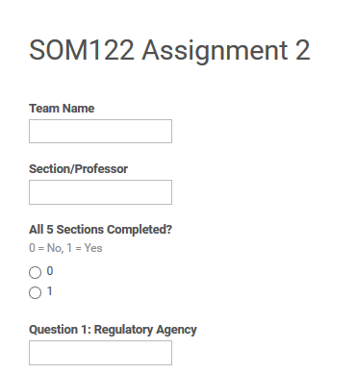
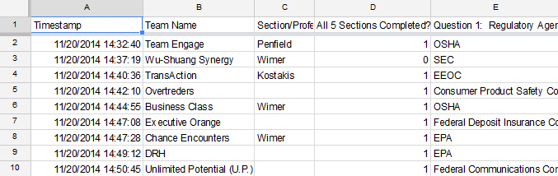
Assessment Planning Process
3. Google Forms
Notes:
After creating the plan, answers from Assignment 2 were processed through Google Forms, according to the agreed upon assessment questions. Google Forms provides both a survey form, which has a convenient interface for rapid input of data and automatic output to a spreadsheet of results. Using Google Forms enabled both the form and spreadsheet files to be used simultaneously, yet independently, by team members, which increased efficiency. Team members simply entered the names of the regulatory agencies and databases directly from the worksheets, while the other items were processed as No=0 or Yes=1. The results of student answers could be analyzed through totals of Yes=1 on the spreadsheets.

Slide 25
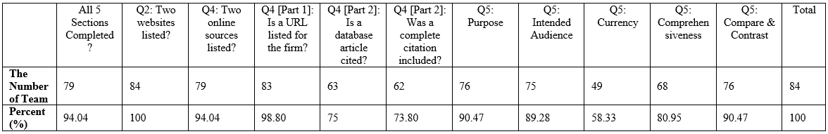
Assessment Results
The worksheet had given teams criteria for information source evaluation
-> The majority of teams (over 90%) were able to address at least one suggested criterion
Even though the worksheet had given the options to use an online source outside the Libraries’ databases, most teams (75%) located a source about their firms in a Libraries’ database
Notes:
- According to the results, most teams (75%) were able to locate a source about their firm in a Libraries’ database
the vast majority of teams (over 90%) addressed at least one suggested information evaluation criterion when answering Question 5.
The business librarian found the fact that most teams referenced a source from a Libraries’ database to be pleasantly surprising,
since the worksheet had also given teams the option to use an online source outside the Libraries’ databases.
The fact that the majority of teams were able to address at least one suggested criterion was also encouraging. However, given the open-ended nature of this question, the quality of the responses to Question 5 could not be gauged using the current assessment plan.

Slide 26
SWOT Terms
Factors of the Outlined Instructional Strategies
Strengths = Positive Factors Weaknesses = Negative Factors
Factors that Large-Enrollment Classes
Present to Library Instruction
Opportunities = Positive Factors Threats = Negative Factors

Slide 27
Strengths & Weaknesses
Factors of the Outlined Instructional Strategies
Strengths = Positive Factors Weaknesses = Negative Factors
Brainstorm & discuss Strengths & Weaknesses, as well as Suggestions for Improving Instructional Approach
Be prepared to share your thoughts with the rest of the presentation participants

Slide 28
Recommendations
Rely on Your Team
Get Faculty Support
Plan Carefully
Have Realistic Expectations
Know the Limitations of Assessment

Slide 29
Consider Adapting Instructional Approach
We hope that you will leave this session with a few new instruction or assessment ideas, or even inspiration to adapt the outlined approach for use in your own instruction.

Slide 30
Thank You!

