Slide 1
A Picture is Worth a Thousand Words: Or is It?
LOEX 2014 – Sharon Radcliff
CSU East Bay
See http:// imagininginformationliteracy.wordpress.com
Sharon.radcliff@csueastbay.edu

Slide 2
Using Images to Teach Visual & Information Literacy
Visual Literacy was founded as an academic movement by Jack Debes of Kodak in the ‘60’s with members of the University of Rochester; they began the International Visual Literacy Association
To exchange ideas related to visual literacy
ACRL Now has Visual Literacy Competencies

Slide 3
Some articles relating information literacy to visual literacy & argument
Hattwig, D. , Bussert, K. Medaille, A., Burgesss, J. (2013). Visual Literacy Standards in Higher Education: New opportunities for libraries and student learning. Portal: Libraries and the Academy. 13 (1) 61-89.
Fleming, D. (1996) Can pictures be arguments? Argumentation & Advocacy 33(1), 11-18
Ravas, T. & Stark, M. (2012) Pulitzer-prize-winning photographs and visual literacy at the University of Montana: A case study. Journal of Art Libraries Society of North America 31 (Spring). 34-44.
Birdswell D. S., Groarke, L. (2007). Outlines a Theory of Visual Argument. Argumentation & Advocacy. 43(3-4). 103-108
Duggan, M. (2013) Photo and video sharing grow online: additional analysis. Pew Research Center. http://www.pewinternet.org/2013/10/28/additional-analysis/

Slide 4
Two Books for Inspiration
Classic in the field of Visual Culture:
John Berger’s Ways of Seeing
Many excellent examples of how to use images to teach writing (Many of these can be adapted for information literacy):
Kathleen Walsh-Piper’s Image to Word: Art and Creative Writing

Slide 5
Why include images in your instruction?
Our current generation of students use: Pinterest, Instagram, YouTube, Flickr, Facebook, Snapchat to communicate their thoughts and ideas via images.
According to a PEW Research report (Duggan, M. 2013) over 50% of all internet users post pictures online and over 45% re-post them. Those numbers go up to 81% and 61 % respectively for adults aged 18-29. To them, the image is as much (if not more) a medium of communication as the word.

Slide 6
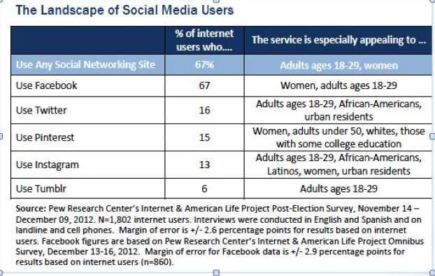
And…

Slide 7
My assignments in LIBY 1210:
News photographs:
  Google image; image citing; background research; alternative perspectives, visual literacy; threshold concept: Research as Inquiry & Format as Process; Scholarship as a conversation
  Advertisements:
  Jib Fowles 15 appeals of advertising; identify and check claims; analyze reliability of source & credibility of author; threshold concept: authority and contextualized and constructed

Slide 8
Context: 2-unit Information Literacy Course
Learning Objective: Students write a research paper – 2 possible topics:
  Energy and the environment
  Person who made a difference: explore a key issue, using alternative perspectives
  In groups do a final presentation using visual images and spoken word (Pecha Kucha)
  Teaching goal: Integrate argument and images into information literacy

Slide 9
Visual assignments:
Photographs: Alternative perspectives, copyright, researching an issue using Web and library sources
Advertisements: Explore authority, advertising appeals, audience in ads and writing
Political cartoons: Bias, point of view, research an issue
Infographics: Explore data telling a story, alternative perspectives, authority, create an infographic.

Slide 10
Using Photos to Teach Alternative Perspectives and Research
Students work in groups to identify a photo in Google image
Two versions:
  Historical and news photos
  Energy and environment photos
Research the photo’s context on the Web and using library resources (eg Lexis Nexis; Academic Search Premier)

Slide 11
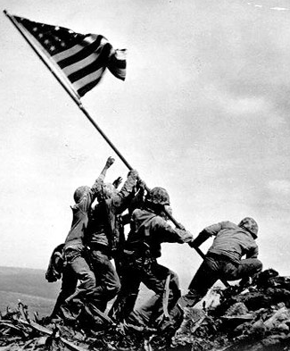
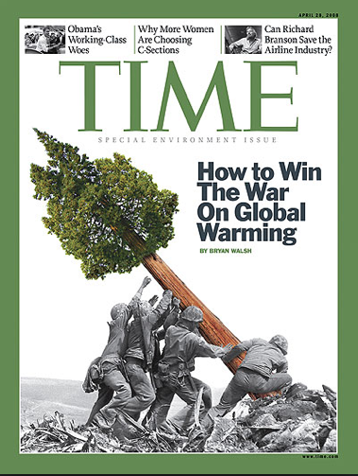
Find a photo representing an alternative perspective -- student example:

Slide 12
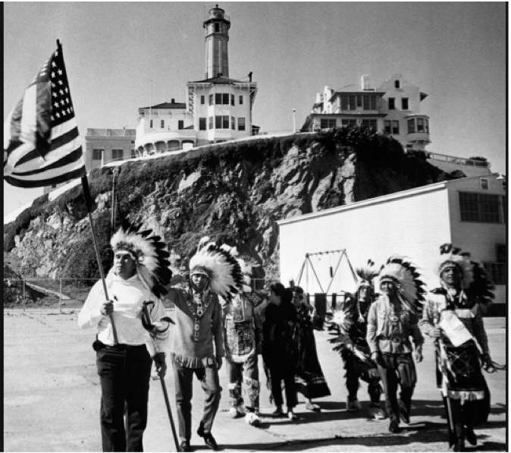
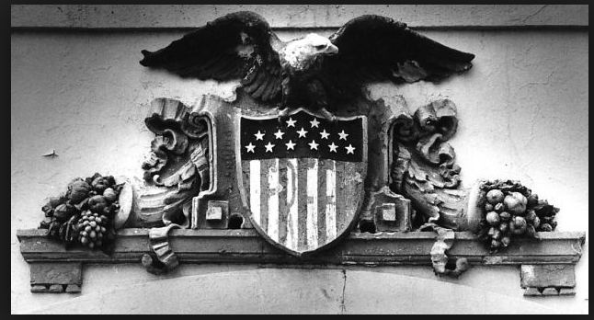
Another Example

Slide 13
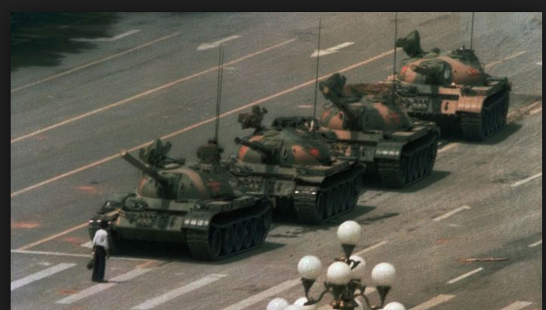
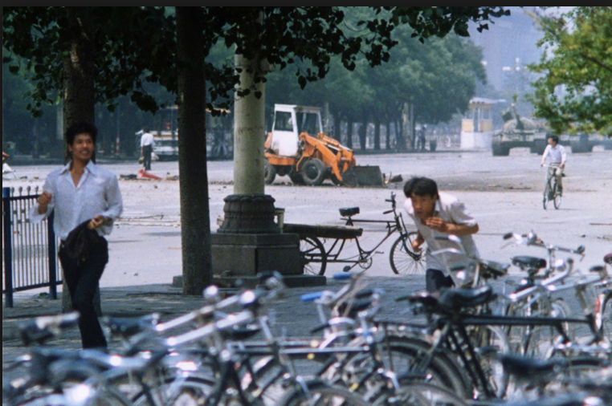
Tank Man

Slide 14
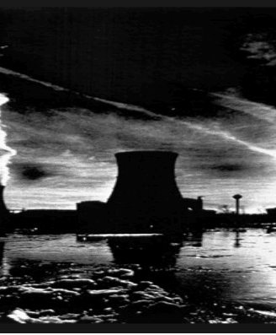
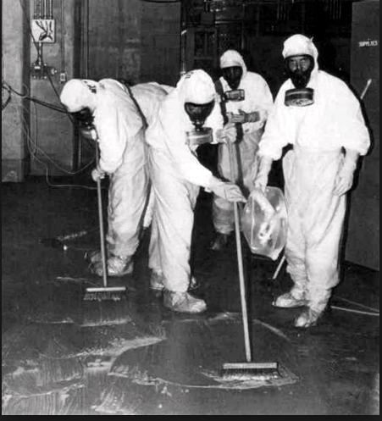
Three Mile Island

Slide 15
Students answer critical questions about photographs
Cite Photographs in MLA or APA
Discuss copyright; ethical use of information
Present in groups the photograph pairs to the class
Homework: find, cite and analyze an image relating to their research paper topic.

Slide 16
Photograph Homework
Find an image related to their research topic
Answer critical questions about it
Some resources for more in depth critical questioning:
http://twp.duke.edu/uploads/assets/photography.pdf
http://www.iste.org/docs/excerpts/MEDLIT-excerpt.pdf
http://www.learnnc.org/lp/pages/675

Slide 17
Advertisement
Exercise
Each student is given an advertisement
  Alternative method: show a few ads; have students find their own.
  Examples: Sports drinks; nutritional supplements; health foods
In groups, student choose on ad to focus on
Students analyze ads using Jib Fowles 15 appeals of advertising
Students identify claims and check them in library sources and report out to class.

Slide 18
Advertisements can appeal to:
Excerpt from Common Culture: Reading and Writing About American Popular Culture.
1 The need for sex
2. The need for affiliation
3~ The need to nurture
4. The need for guidance
5. The need to aggress
6. The need to achieve
7. The need to dominate
8. The need for prominence
9. The need for attention
10. The need for autonomy
11. The need to escape
12. The need to feel safe
13. The need for aesthetic sensations
14. The need to satisfy curiosity
15. Physiological needs: food, drink, sleep, etc.
http://www.cyberpat.com/shirlsite/education/essay2/jfowles.html

Slide 19
Advertising Cont.
Students identify claims and check them in library sources.
Students evaluate their source using criteria identifying characteristics of popular, trade, academic sources.
Students examine sources for credibility, reliability, timeliness, relevance.
Students report out to class.

Slide 20
Your turn: For photos
Option One: Download a photo from:
  https://imagininginformationliteracy.wordpress.com
Option two: Use photographs in packet
All: Answer questions in packet
One or two groups present briefly to the group

Slide 21
Your turn: For ads
View your ads in your group
Answer questions in packet
One-two groups report out.

Slide 22
In your groups
Brainstorm ideas for integrating images and visual literacy into your information literacy instruction
Possibilities: GIS, Photographs, infographics,
advertising, or ?
Full group discussion

Slide 23
End
Questions or suggestions
E-mail Sharon Radcliff
Sharon.radcliff@csueastbay.edu

