Slide 1
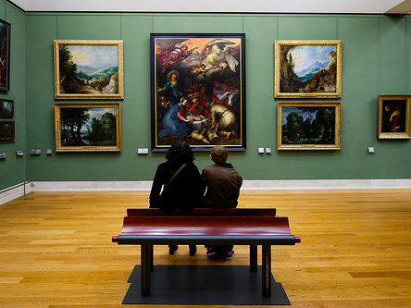
Beyond Eye Candy: Strategies for Engaging Students in Conversations About Visual Literacy
LOEX 2014: May 10, 2014, 9:50 – 10:40am
“Art Appreciation” by Dustin Gaffke. CC-BY-2.0. https://www.flickr.com/photos/55608722@N06/13073175563
Debbie Abilock
Co-Founder
NoodleTools, Inc.
Kristin Fontichiaro
Clinical Assistant Professor
University of Michigan
School of Information
Notes:
Intro

Slide 2
We were able to use copyrighted images in our presentation under Fair Use. However, we cannot post them online.
Please contact one of us if you’d like to see them:
Kristin Fontichiaro font@umich.edu @activelearning
Blog: : http://www.fontichiaro.com/activelearning/
Debbie Abilock debbie@noodletools.com @noodletools

Slide 3
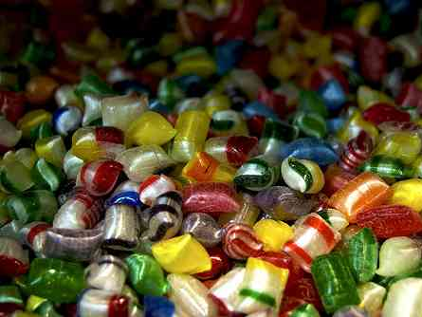
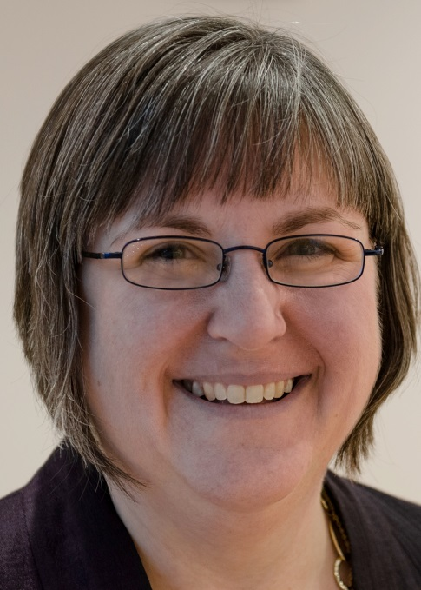
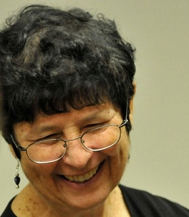
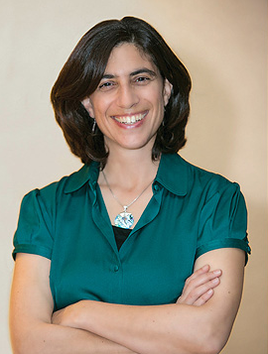
The EyeCandyShop Thinkers
“Wonky Allure” by Joel Penner on Flickr. CC-BY-2.0.
https://www.flickr.com/photos/55915190@N00/3098244175
From left to right:
Kristin Fontichiaro,
Debbie Abilock,
Tasha Bergson-Michelson

Slide 4
Add your comments / questions to the rubric
http://bit.ly/loexeyecandy

Slide 5
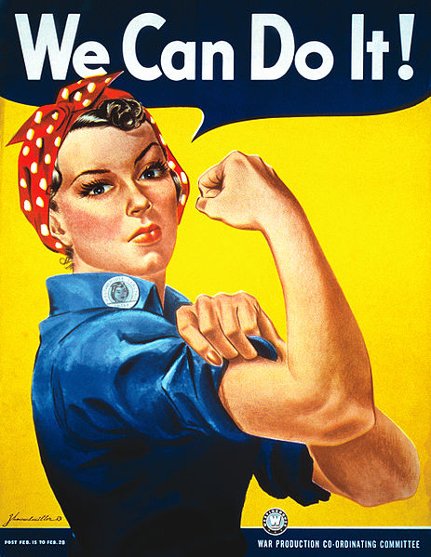
Final Thoughts, AHAs, and Questions Kristin font@umich.edu @activelearning Debbie debbie@noodletools.com @noodletools
DID
“We Can Do It!” by J. Howard Miller for Westinghouse/War Production Co-Cordinating Committee.” Public Domain.
http://en.wikipedia.org/wiki/File:We_Can_Do_It!.jpg

