Slide 1
Information Literacy at the Crossroads: The Convergence between the Research & Writing Processes
LOEX 2014 May 9, 2013
Notes:
Welcome!

Slide 2
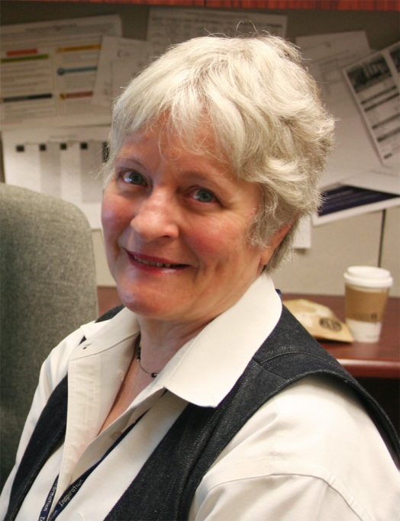
Contact Information
Susan Ariew
Academic Services Librarian for Education
University of South Florida
sariew@usf.edu
Blog: http://lib.usf.edu/edlibreport/
Notes:
Introduce myself. Poll the audience: How many of you are: academic librarians? Academic faculty? Writing instructors? Administrators? Instructional Coordinators? Designers? School Librarians? Public? Other?
I taught English and composition for 13 years, first at the high school levels and later at the collegiate level (BHS and VA Tech). Much of the material I present here is based on my blended experiences both as a writing teacher and academic librarian. It also reflects my own journey as a writer.

Slide 3
Objectives
Exploring the comparison between the writing & research processes
Discussing the role of librarians in the writing process
Identifying teaching strategies that reflect both processes
Offering resources for future learning
Notes:
Overview

Slide 4
Think, Pair, Share
Turn to your neighbor, introduce yourself, and for three minutes brainstorm about where the writing and research processes intersect.
Think about your own processes in terms of time and steps involved.
Notes:
Allow 3-5 minutes for this activity and a few more minutes soliciting responses from the group. Write their responses down as they give them and use as a jumping off point for further discussion.

Slide 5
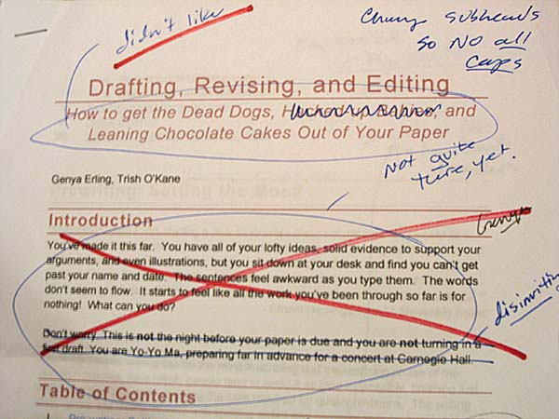
The Writing Process
Prewriting/Invention
Critical Reading
Organization/Thesis
Composing/Drafting/Word-Processing
Revision/Editing
Documentation
Proofreading
Notes:
The writing process when taught in textbooks tends to look somewhat like this—a linear list of steps that one takes to move from expressive writing to academic writing. The process, however, is more complex than this representation of it. As Stephen Kucer writes in his book Dimensions of Literacy, “as the surface text is evolved, the writer may discover new meanings not originally anticipated. This discovery, in turn, may lead to a modification of the writer’s background knowledge and a new understanding of the context of the situation” (181-182). (In keeping with the “writing as learning” theory by Janet Emig).

Slide 6
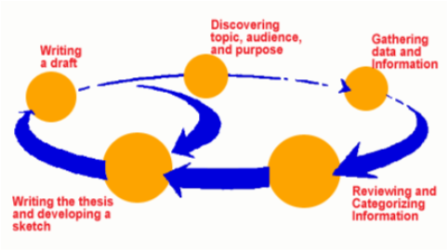
Writing Process as Recursive
Notes:
Kucer and other composition theorists since the 1980’s describe the writing not as linear but as recursive. He says, “Writers shuttle back and forth in their use of the strategies. Revision—deletion, addition, synthesis, reordering, refocusing—and the editing of such surface level features as spelling and punctuation can occur at any point in the process. The actual writing can serve as a form of prewriting in that it provokes the discover of new meanings to add to the text.” (Kucer, 187).

Slide 7
The Research process
Identifying & selecting manageable topics
Creating a research questions
Setting up a search plan
Matching research questions & search terms to resources
Identifying and evaluating your sources
Citing sources appropriately
Notes:
So, too, has the research process been representing in linear terms in books written about research. This is also partly due to the list of the ACRL information literacy standards. They break down research skills into specific goals and learning outcomes. While it can be helpful to look at what we do when using the standards, the overall impression they give is an oversimplified version of the research process.

Slide 8
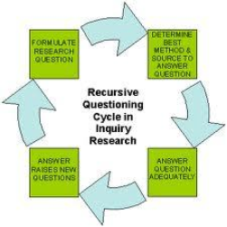
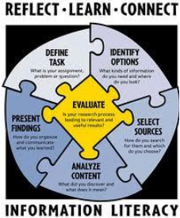
Research Process is Also Recursive
Notes:
Like writing, the research process is recursive and not linear. Most librarians have experienced the recursiveness of library research in action as students change their topics after obtaining background information, when searching the literature, if they come to the library with topics that are unfocused or too broad, when they are looking in the wrong database for information and each time they report to librarians that there is “nothing on my topic.” Thus, if we understand the true nature of the research process as recursive, we can adapt teaching information literacy not as a hierarchical series of steps that are fixed and giving students the false impression that it is simpler than it is.

Slide 9
Where Research and Writing Overlap
Which part of the writing process do you think librarians spend the most time in library instruction or at the reference desk?
Prewriting
Critical Reading
Focusing/Organizing
Composing/Drafting
Documentation
Notes:
It is difficult to separate the research from the writing processes and yet that is exactly what librarians and instructors do when instructors work in the classroom with the students focusing on the writing aspects of their assignments and then when librarians tech them how to find information that they will need to use as sources for their writing. Yet it is easy to collapse the two into one process and from the student point of view it IS one process.
Give audience handouts.
This handbook illustrates a figure in Mike Palmquist’s textbook, the Bedford Researcher. The chart outlines both the writing and research processes in a chart that includes choosing, exploring and narrowing a topic; developing and refining a research question; collectin information; reading critically, evaluating, and taking notes; organizing and planning; drafting; revising; editing; designing, and finally documenting sources (Palmquist, 4).

Slide 10
Where Research and Writing Overlap
Prewriting→ Creating manageable topics
Prewriting→ Evaluating sources (critical reading
Composing/Drafting→ Assisting students as they discover “information gaps” in their papers
Documentation→Teaching students to cite sources appropriately and avoid plagiarism
Notes:
Research is often characterized as a conversation with a scholarly work or community of scholars and their work. That conversation doesn’t always happen before writing. More often than not, it happens at the same time, so the question for me is are we teaching these processes to students in a way that gives them an accurate and realistic understanding of them or are we doing them a disservice by showing them linear representations of them?

Slide 11
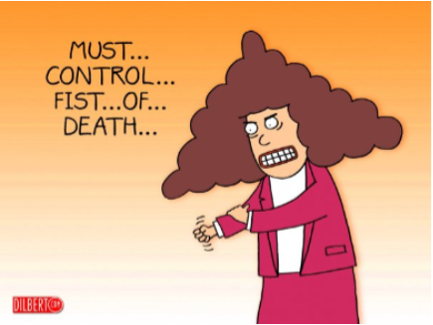
Misconceptions
What might be some misconceptions about the writing
and research processes? How do misconceptions affect
the work that occurs between academic faculty and
librarians?
Notes:
Write down responses from audience. Misconceptions from both sides are acceptable answers.
Possible misconceptions:

Slide 12
Misconceptions
Understanding the complexity of the research process as a subset of the writing process helps librarians understand:
Skills that are developed over time are not learned in a linear fashion but a recursive fashion
Expectations of learning transfer thus will change
Notes:
The writing and research processes are linear and simple.
That once a student does one research project and paper that they can do it again for other projects. Not necessarily true.
That it is the only job of librarians to teach research and only the job of the instructor to teach the writing process. They overlap so that’s problematic.
Librarians contribute nothing to teaching about the writing process and should leave that part out of their work.
Writing instructors should not get involved in teaching about how to research the literature as it relates to library and information resources.
Librarians do not teach. They train students to use specific tools.

Slide 13
Looking at the Boundaries
Librarians and Academic Faculty/Writing Instructors
Notes:
Being aware of the boundaries, the places where library instruction and writing instruction overlap allows one to have meaningful conversations with instructors in achieving learning goals.
It helps to be clear about what you are willing to do with regard to how information literacy content dovetails with course content.

Slide 14
Strategies for Library Instruction
Collaborating with academic faculty
Adopting a “process” approach to teaching research similar to how writing is taught
Scaffolding both writing and research within course management systems
Notes:
Collaborate with faculty to customize the instruction session and the learning goals of the instructor. Look at the syllabus, assignments, and then determine what you can suggest to the instructor by way of instruction that is integrated and relevant.
Discuss the research process in library instruction classes with the students. It helps students understand the futility of procrastination as you reveal the complexity of the process and why it takes time select manageable topics, gather information, read critically, digest material and then begin to write. It also offers the opportunity for librarians to talk about where they make a contribution in the process before, during, and after the one session with the students. It encourages students to contact librarians beyond the brief encounter with librarians in the classroom.
Use course management system and other tools to scaffold instruction.

Slide 15
Embedded-ness to Teach Process Over Product
“Flipping” instruction using tutorials, webcasts, or videos in course management systems to teach the basics.
Using valuable class time to explore topics, set up a search plan, identify resources based on topics, and get students started on projects.
Using course management systems to insert content to help students after instruction is conducted.
Notes:
Flipping the Basics. If time permits you can illustrate with Canvas stuff.
Being in course system allows you to do some assessments as well to measure student learning.
You can follow up instruction with inserting more content: PowerPoints, handouts, links to LibGuides etc.
Adopt a “process” attitude instead of a product attitude in how you approach your work and your students. (It’s the journey).

Slide 16
Spending More Time with Students on Topic Selection
Teaching students how to identify topics that are too narrow, too broad, and “just right” for assignments.
Help students brainstorm topics for assignments
Analyze student-selected topics in class
Help students set up a search plan/concept mapping based on their topics before searching the literature (pre-searching similar to prewriting)
Notes:
I’ve done “two-shot” classes where we spend an entire class on how to explore topics, brainstorm and manage them. I include a role-playing activity which helps get things started.
After students come up with topics, I critique them in terms of their manageability. Then I help them set a search plan for the session we do in the library.

Slide 17
References
Kucer, S. B. (2009). Dimensions of literacy: A
conceptual base for teaching reading and
writing in school settings, New York: Routledge.
Kvenild, C. & Calkins, K. (2011). Embedded instruction librarians: Moving beyond one-shot instruction, Chicago: ACRL.

Slide 18
Thank you!
Questions?

